Slide 1
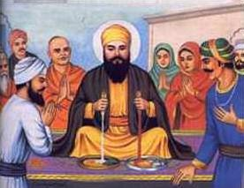
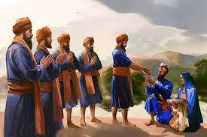
Spring Trust Partnership School – Knowledge Organiser
RE Focus | Sikhism: Belief and morals | Year 5 | Spring 1
What? (Key Knowledge)
Guru Nanak | Sikhism was founded by a wise man called Guru Nanak. Guru Nanak is considered the first Sikh Guru. Sikhism is still based on his teachings and those of the nine Sikh Gurus who followed him.
The story of Bhai Lalo and Malik Bhago | Guru Nanak visited a village. A rich man (Malik Bhago) wanted to show off, but Guru Nanak chose to stay with a poor man (Bhai Lalo). At Malik’s feast, Guru Nanak squeezed one of the cakes and blood came out. Milk came out of Lalo’s bread. This showed that the rich man had earnt his money by cheating the poor and being dishonest. Malik changed his ways and followed the Guru from then on.
Guru Nanak, Mardana, the milk and the jasmine flower | Guru Nanak shows the townspeople there is always room in the world for more holiness, and that only good deeds go with us to the next world, not money and gold.
Guru Gobind | Guru Gobind Singh was the last of the ten Gurus, the one who transformed the Sikh faith. In 1699 he created the Khalsa, a community of the faithful who wore visible symbols of their faith and trained as warriors.
Attainment Targets
I can describe what a Sikh/non-Sikh might learn from a Sikh story and start to explain why stories can be important. I can understand how what Sikhs learn from stories can influence how they behave.
Key Questions
Are Sikh stories important today? What does the Guru Granth Sahib teach Sikh’s? What are the key messages within each of the Sikh stories? Do you think they are relevant in modern day society? What can Sikh stories teach non-religious people? Can you think of any times you have stood up for what you believe in?
What? (Key vocab)
Spelling | Definition
Vaisakhi | The community kitchen in a Gurdwara where a free meal is served to all the visitors, without distinction of religion, gender, economic status or ethnicity.
Amrit | the name of the holy water used in Amrit Sanchar, a ceremony which resembles baptism
Singh | A promise to do something.
Guru Granth Sahib | Sikh holy book that gives guidance on how Sikhs should lead their lives. It is considered as the living Guru (teacher)
Khalsa | the collective name given to Sikhs who've been baptised.
The forming of the Khalsa
Guru Nanak and Malik Bhago

