Slide 1

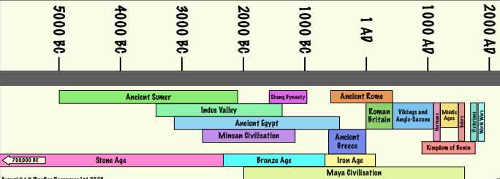
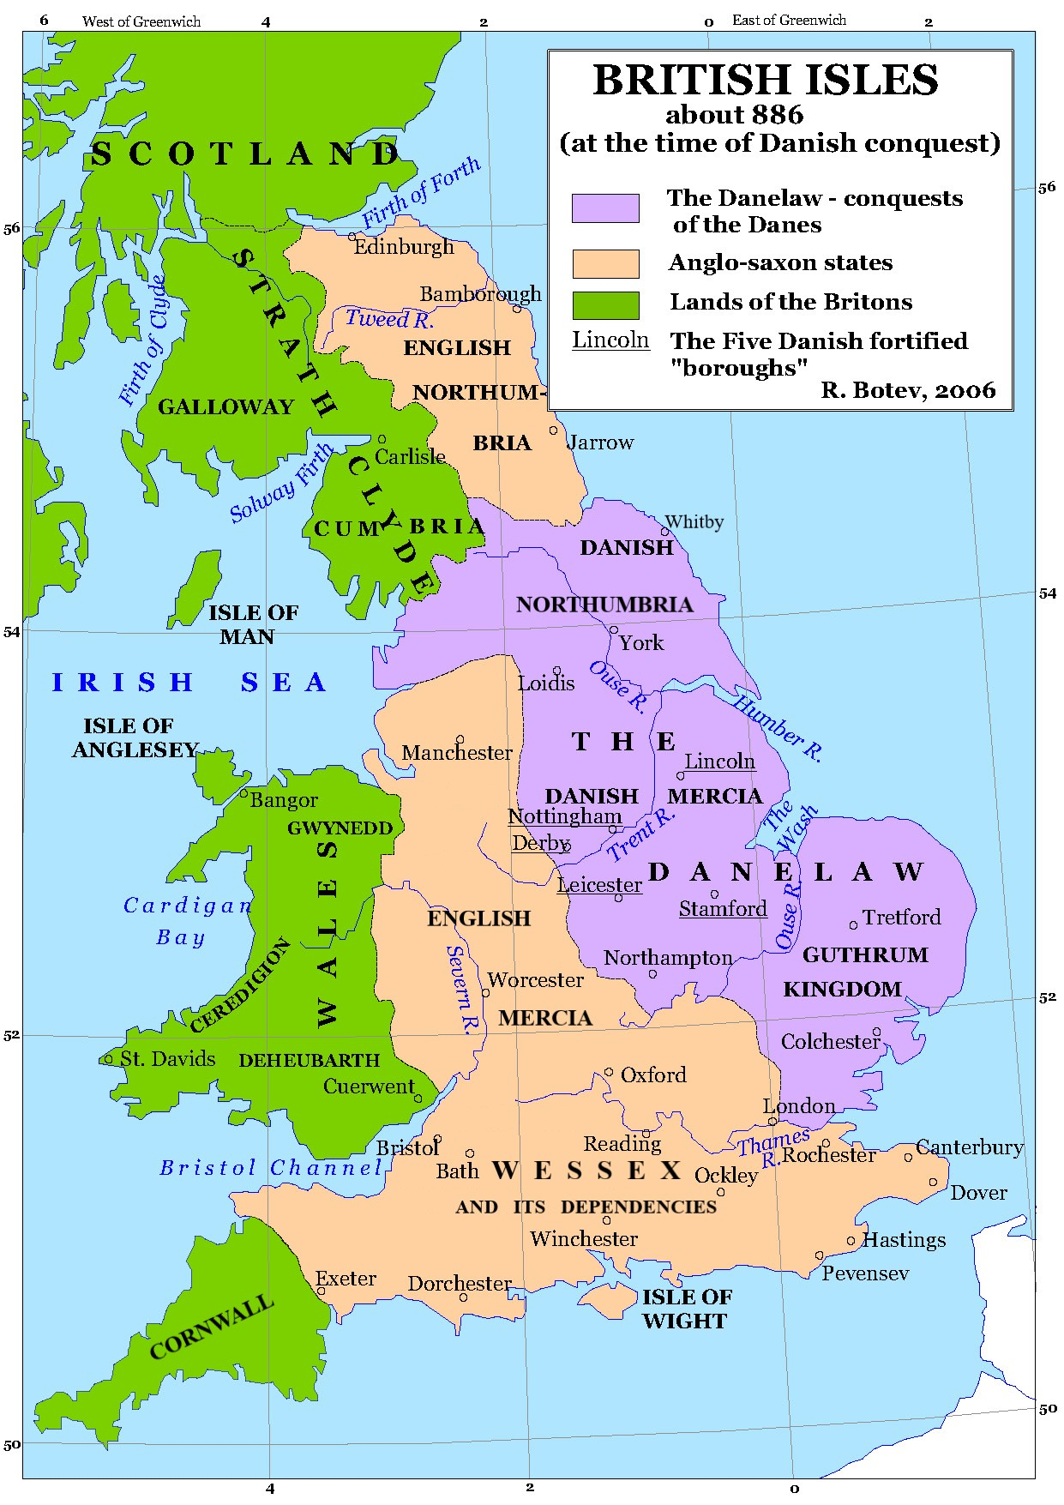
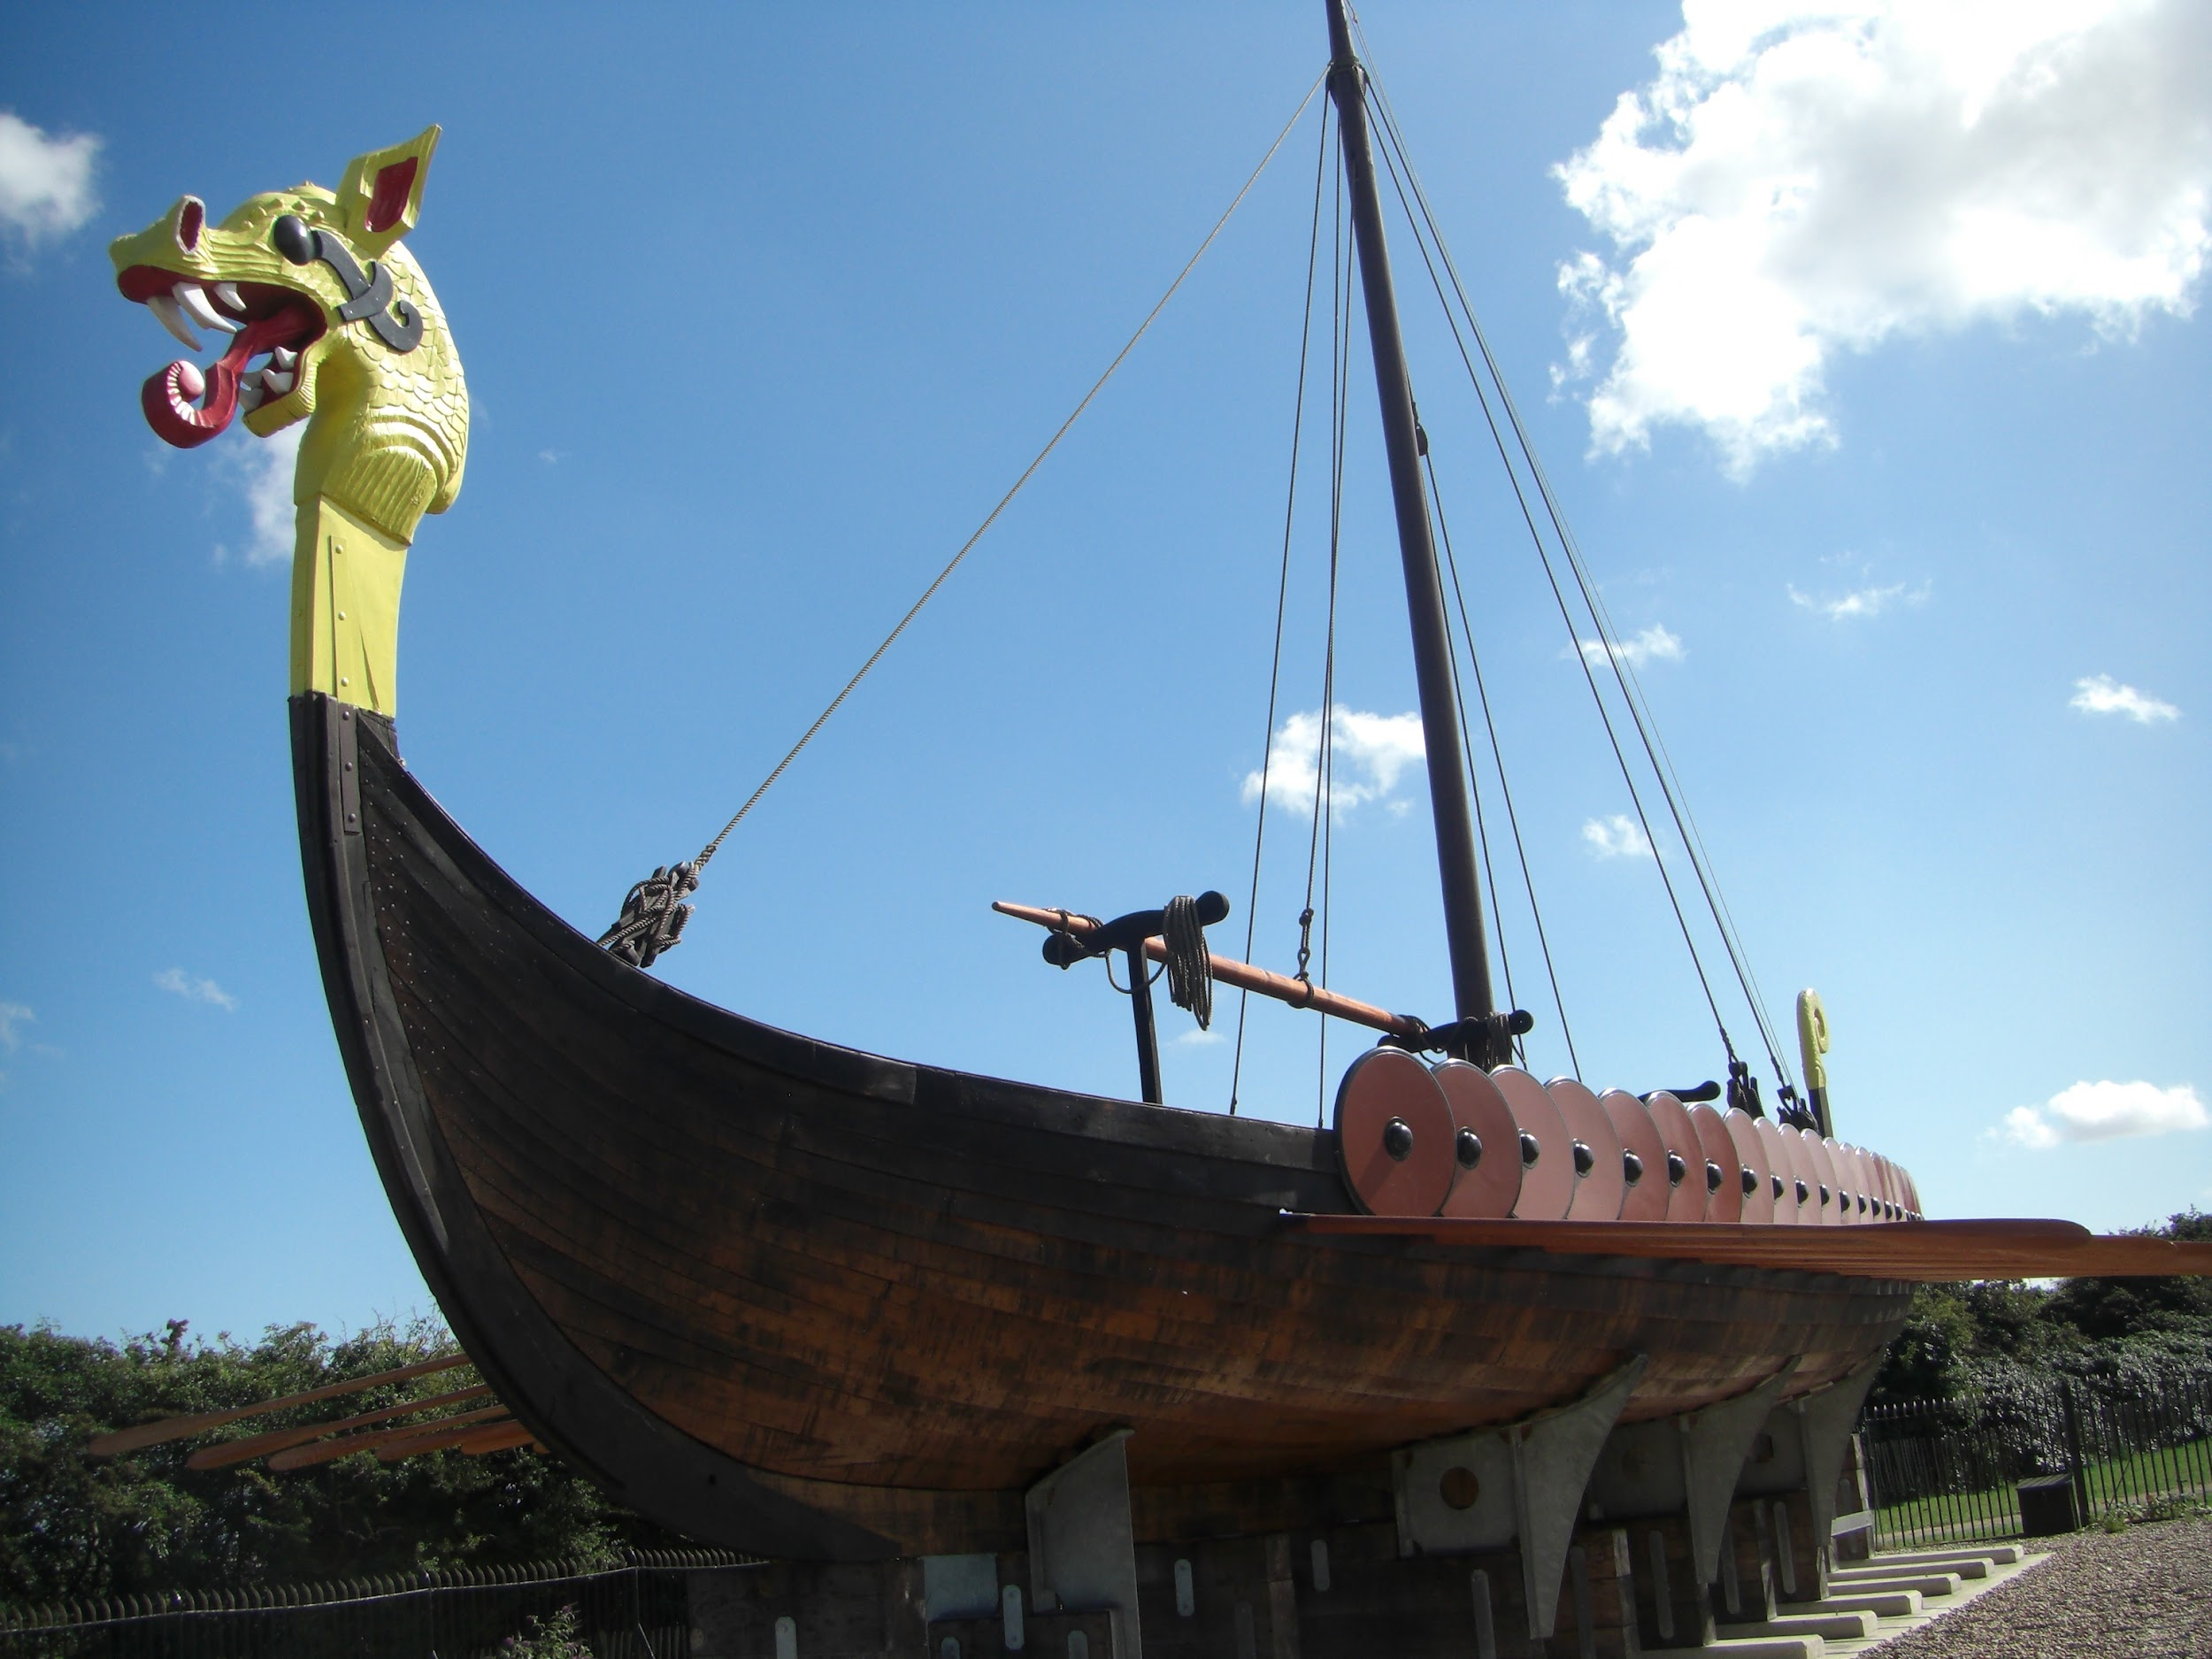
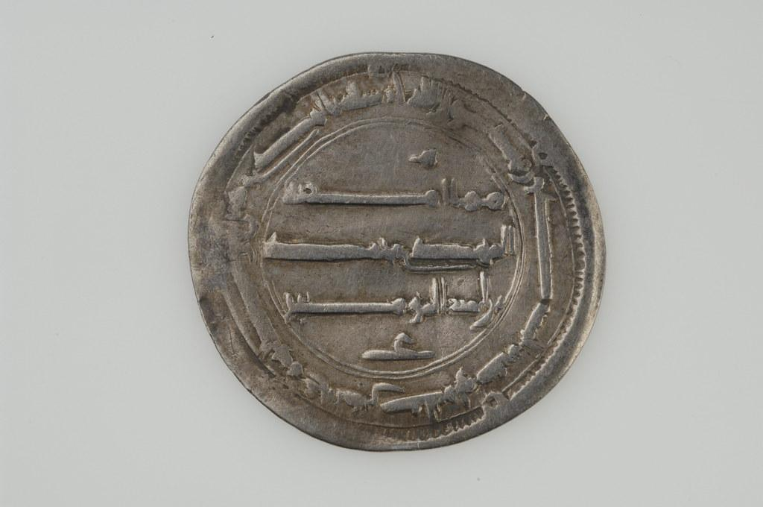
Year 5 History Knowledge Organiser - Did the Vikings deserve their reputation?
Key vocabulary
Danelaw | The name of the area that officially belonged to the vikings.
Lindesfarne | Also known as Holy Island, an island of the coast of Northumberland. Site of a Monastery and centre for celtic Christianity.
Longships | A medieval ship used by the Vikings. A long narrow hull and a number of oars.
Norsemen | People who lived in Scandinavia in the past, especially the Vikings.
Pagans | A person with different religious beliefs to the main or recognised religions.
Polytheistic | belief in more than one god
Raid | A rapid, surprise attack on an enemy
Scandinavia | A subregion in Northern Europe that denotes Norway, Sweden and Denmark.
Settlement | A place where people live
Valhalla | The hall of Odin where soldiers who die in battle live eternally
Viking | A person belonging to the Scandinavian race. They travelled by sea and attacked parts of Europe. They often settled in the areas they traveled to.
Viking Britain
The Viking period was from 789 - 1066 The Vikings travelled from Scandinavia to Britain via longboat The Gods were important to all aspects of Viking life The Vikings invasion of Lindisfarne was pivotal in their conquering of key British settlements
Viking Britain
789 AD - 1066 AD

