Slide 1
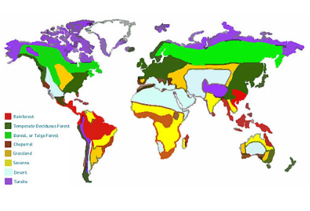
The Spring Partnership Trust – Knowledge Organiser
Geography Focus | Biomes | Year 5 | Spring
What? (Key Knowledge)
What are the six major biomes? | Woodlands Grasslands Rainforests Savannah Deserts Tundra
Why are there different biomes around the world? | Climate, soil type, the amount of light and water all impact where biomes will be located and their features.
What can cause damage to ecosystems? | Ecosystems can be damaged naturally or by humans. They can be damaged by: Disease Food chains Adaptation Human actions
What can we do to protect biomes? | Conservation is protecting species from extinction and maintaining and restoring habitats. Habitat conservation protects where animals or plants live and wildlife conservation directly protects the wildlife.
What? (Key vocab)
Spelling | Definition
Biome | Areas of the planet with similar climates, landscapes, animals and plants.
Climate | The average weather conditions in a place over 30 years or more.
Ecosystem | A community of animals, plants and microorganisms that work together in their habitat.
Woodland | An area of land covered by trees
Grasslands | Large expanses of natural land where very little rain falls and where little to no trees grow
Rainforests | A tall, dense forest that receives lots of rain every year
Savannah | Flat grasslands with scattered trees and shrubs that are usually found near to the equator
Deserts | A place that has very little rainfall
Tundra | A large, barren region with no trees
Landscapes | Part of Earth's surface that can be viewed at one time from one place
Habitat | The home of an animal or a plant
Diagrams and Symbols
Prior knowledge
Year 2 - Oceans topic (including aquatic biome) Year 4 - The understanding of different weather patterns Year 5 - Mountains

