Slide 1
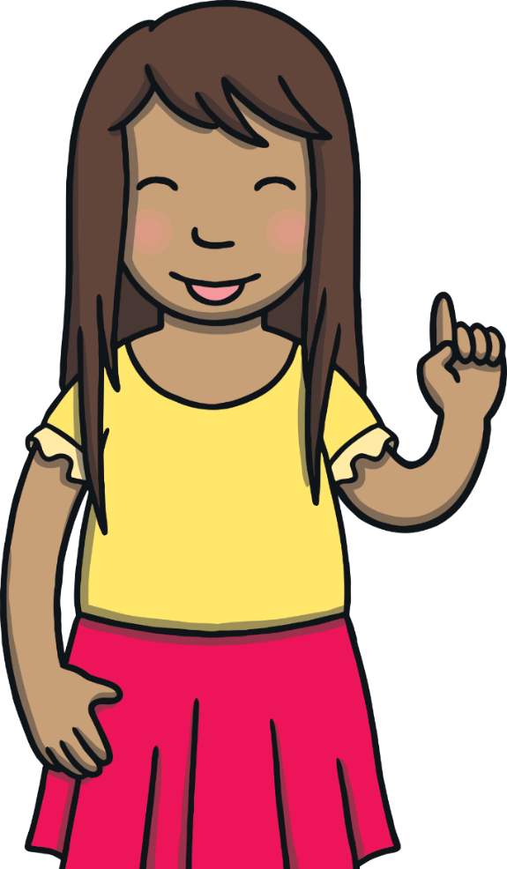
Today, we are learning to
add –er to words ending in y.

Slide 2
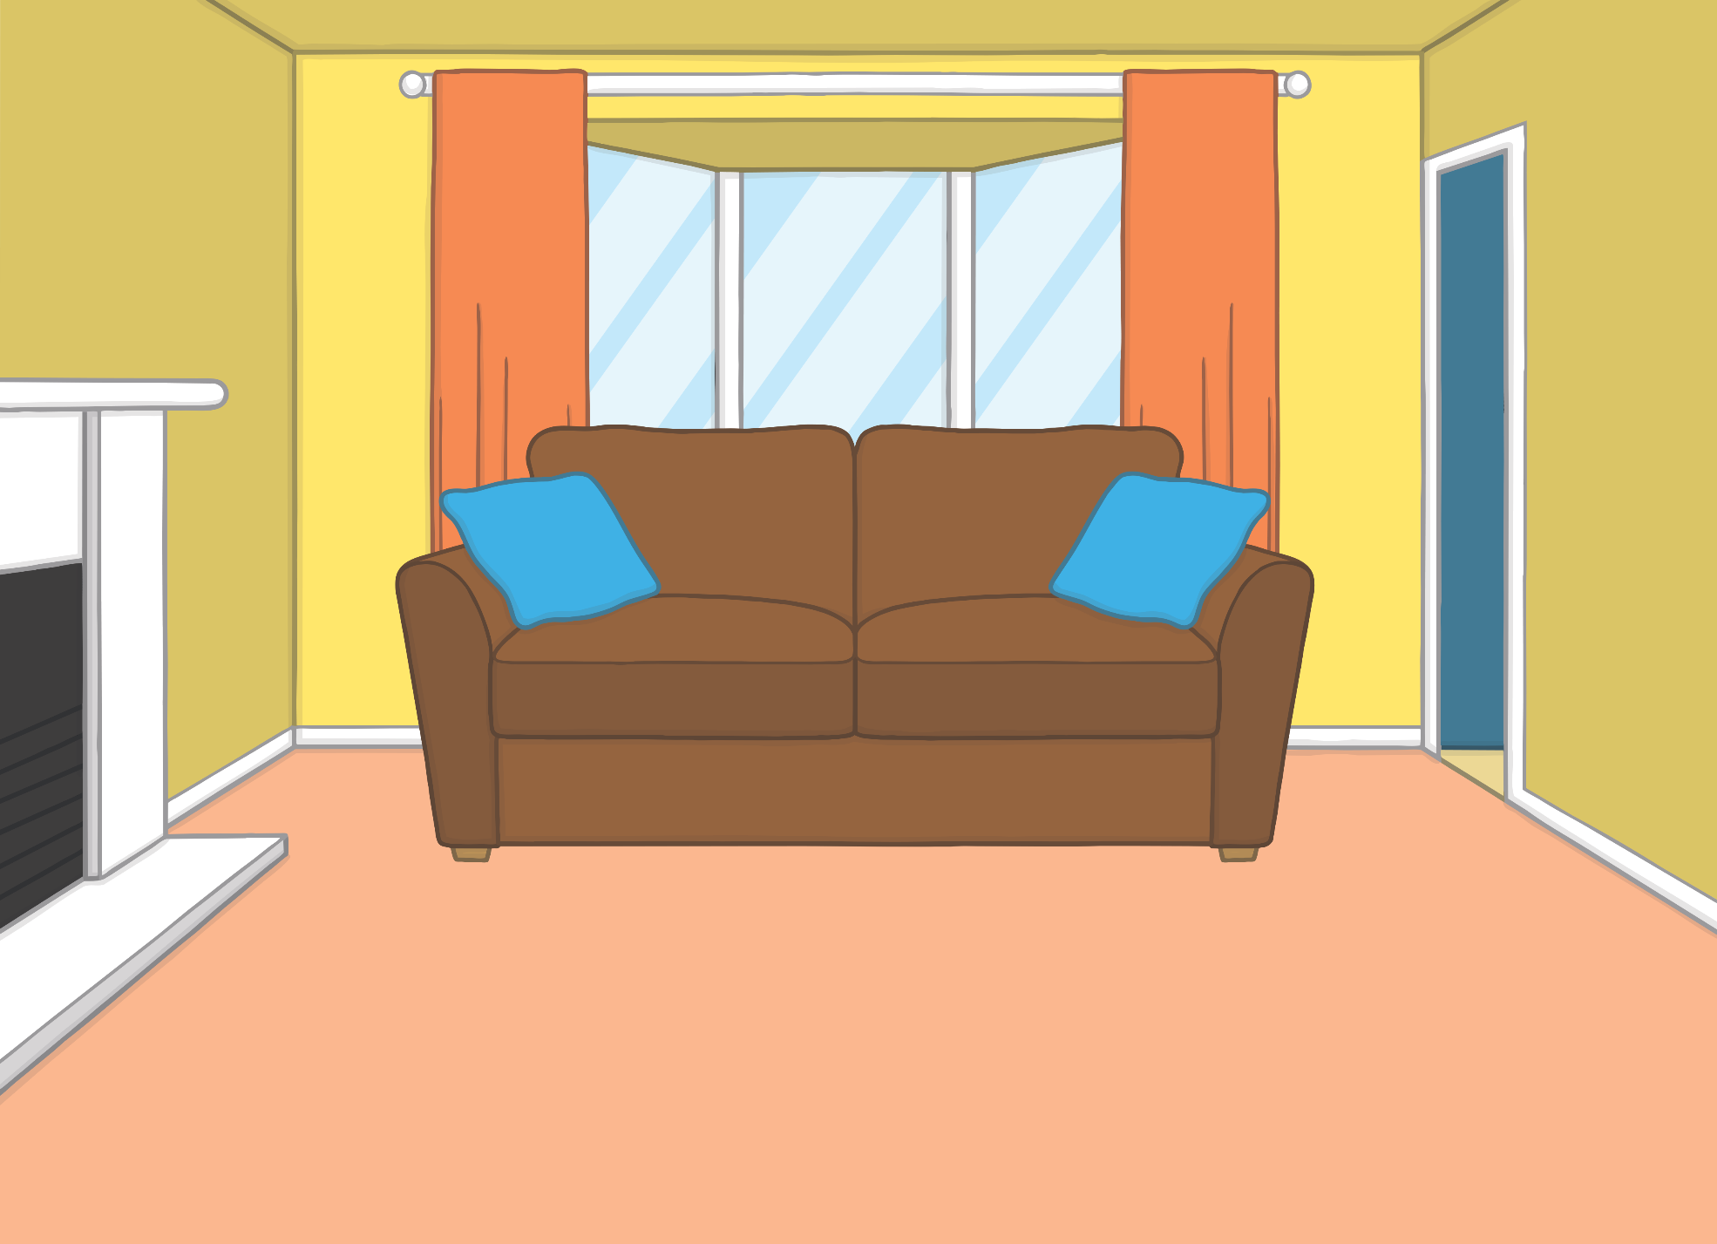


Teach
Sam was excited. it was the time of year that school held auditions for the school talent contest. She had been practising earlier than ever this time

Slide 3
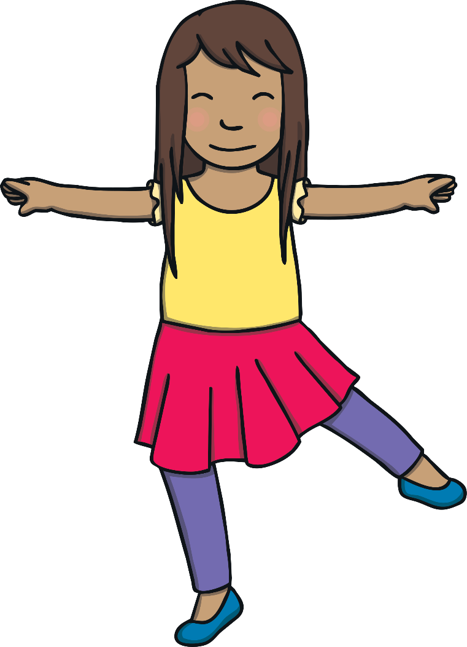
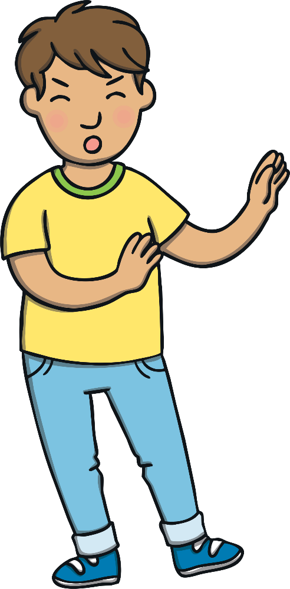
Teach
She had been learning to ballet dance with her friend, Gabi. “I love to dance,” she said, as she pirouetted in the living room.
“Careful!” shouted Kit when she nearly bumped into him.
“You get grumpier by the day!” said Sam and she flounced off to her room.

Slide 4
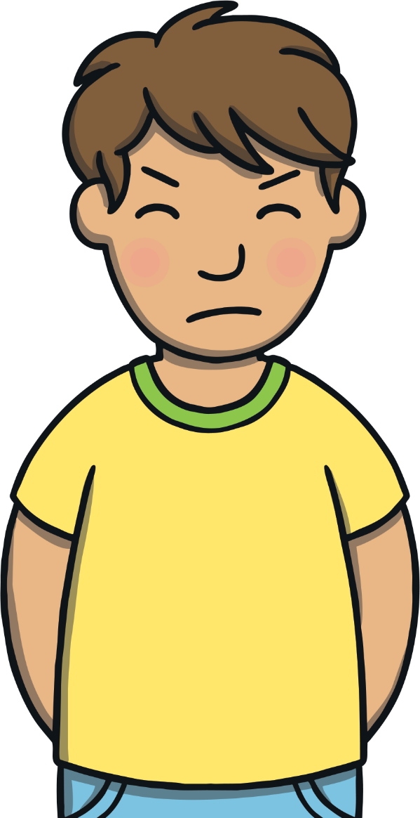
Teach
Kit had decided to tell jokes at the talent contest but he had not practised at all. He was feeling really quite grumpy about it.

Slide 5

Teach
When adding –er to words ending in –y with a consonant before it, the –y should first be changed to an ‘i’.
happi
easi
funni
happy
easy
funny
happier
easier
funnier
The –y is changed to an ‘i’ and –er is added when an adjective has two syllables. The adjective becomes a superlative, giving it a greater meaning or emphasis than the root word. For example, if one person is happier than another, then they are more happy than them.
X
Click me for Kit’s teaching tips!

Slide 6
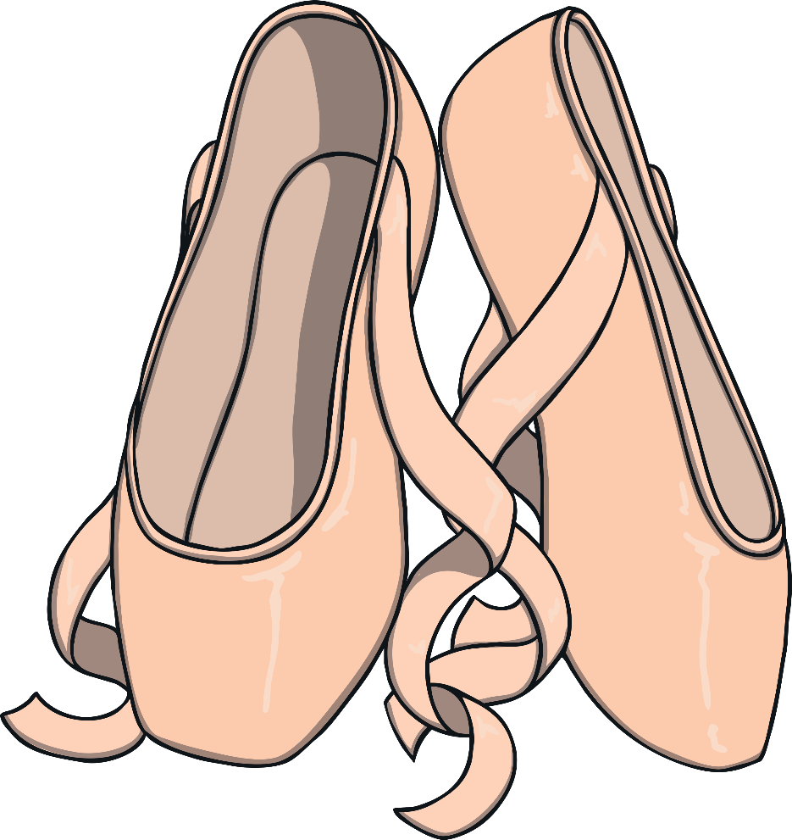
Teach
Sam is tidying up her ballet shoes.
Can you read the words ending in ‘y’ with –er added to them?

Slide 7

Teach
happier

Slide 8
Teach
easier

Slide 9
Teach
funnier

Slide 10
Teach
luckier

Slide 11
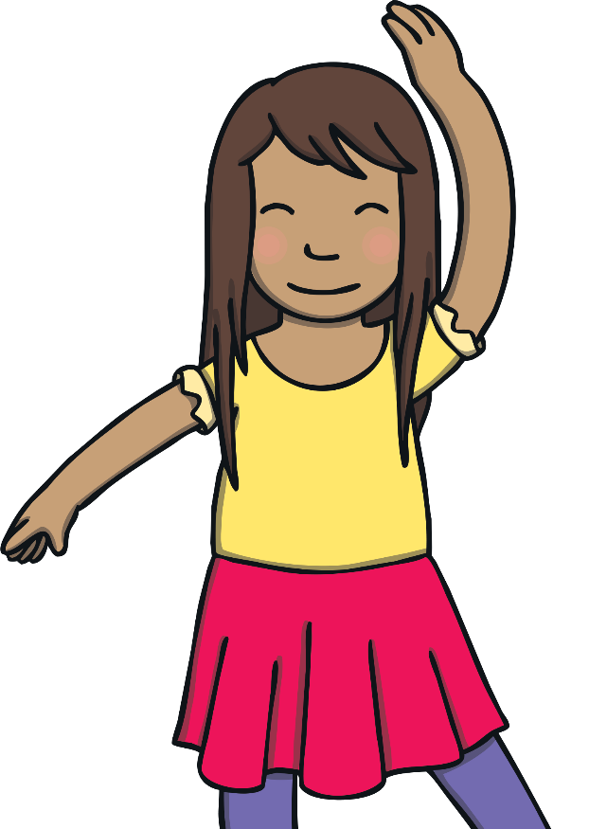
Dancing Sam
Practise
Sam is dancing around. As she dances, the missing words ending in ‘y’ with –er added to them have swirled around. Help to put them back in the right order so the sentence makes sense.

Slide 12

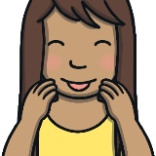
Practise
It is easier to dance well if you have practised
It is to dance well if you have practised.
s
r
e
e
i
a
Check

Slide 13
Practise
Kit is luckier when he wears his special shorts.
Kit is when he wears his special shorts.
u
r
i
l
k
e
u
Check

Slide 14
Practise
The funnier person made me laugh more.
The person made me laugh more.
n
i
u
n
f
n
e
Check

Slide 15
Practise
The I am, the more I smile!
The happier I am, the more I smile!
r
p
p
h
i
a
e
Check

Slide 16
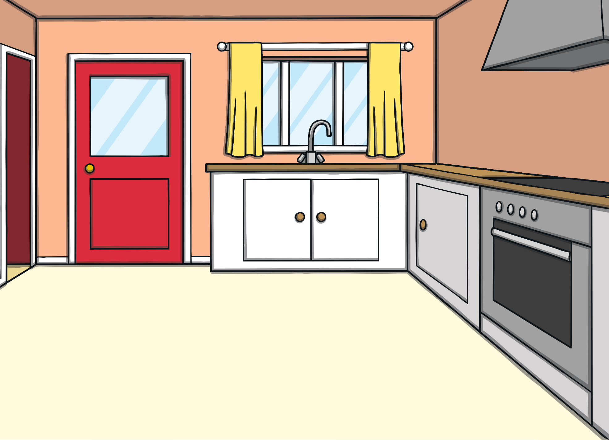

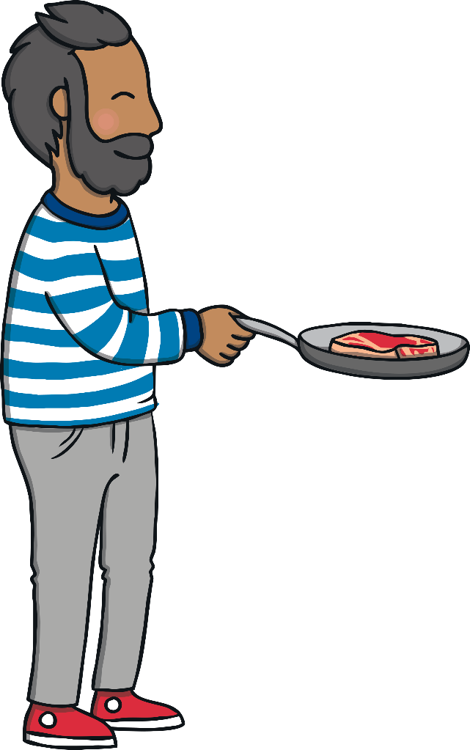
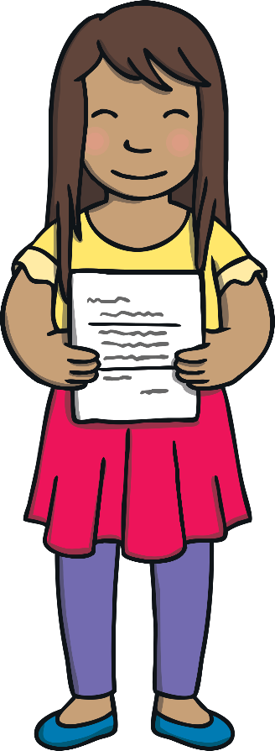
Apply
?
?
Why do you think Kit is feeling grumpy?
X
Sam was helping Dad to cook steak for tea when she remembered that she had an interesting letter in her book bag about the talent contest. “Kit! I have a letter from Mr Philips about the talent contest!” she called. Kit reluctantly came to have a look.

Slide 17
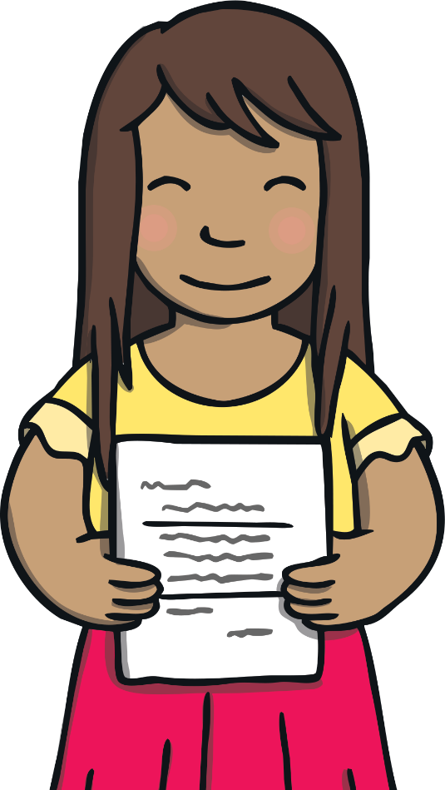
Text Detectives
Apply
Kit and Sam have brought a letter home from school. Can you spot any words ending in ‘y’ with -er added to them?

Slide 18
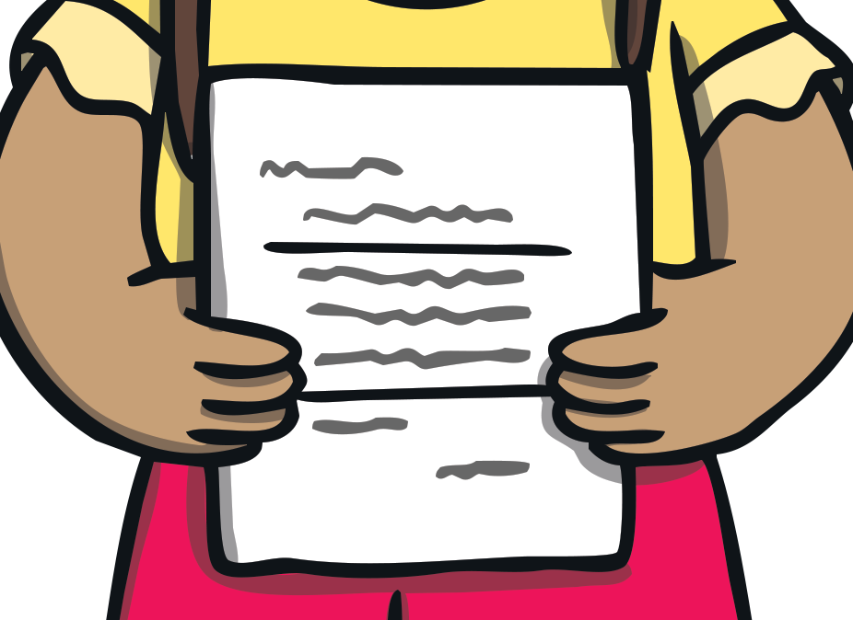
Apply
School Talent Contest
Do you find something easier than others?
Perhaps you are funnier than most?
Or just luckier than the average person!
Make Mr Philips happier than ever by performing in the school talent contest!
Do you find something easier than others?
Perhaps you are funnier than most?
Or just luckier than the average person!
Make Mr Philips happier than ever by performing in the school talent contest!
Check

Slide 19
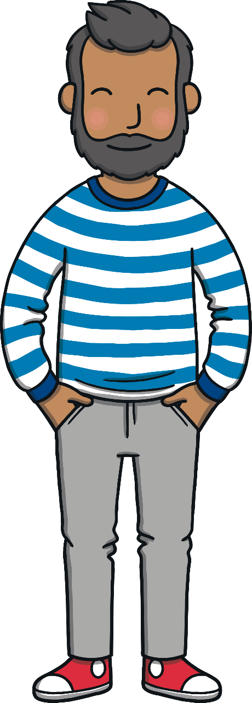
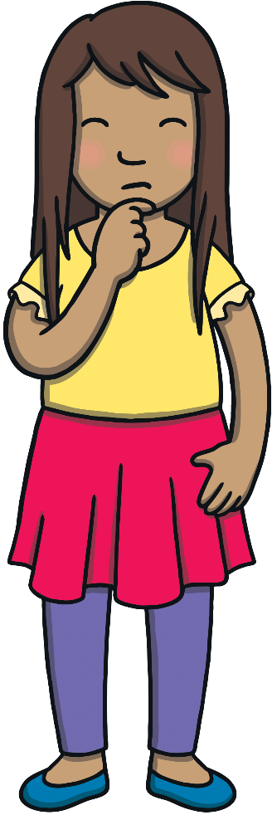
Apply
?
?
What is Sam going to do?
X
“I’m definitely going to perform! I can’t wait!” said Sam.
“Hmm,” said Kit as he grumpily stomped upstairs to his bedroom. Sam looked at Dad and shrugged her shoulders.

Slide 20
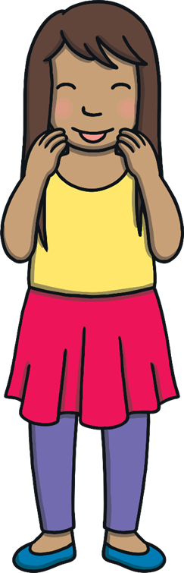

Apply
Today, we have learnt
to add –er to words ending in y.
The adventure continues next lesson!

