Slide 1
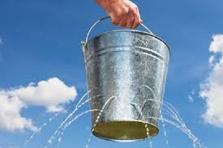
Science
WALT: be able to use simple measurements to gather data.

Slide 2
Help! There’s a hole in my bucket! I really needed to use this plastic bucket but when I filled it with water I realised there was a hole at the bottom and the water was leaking out.
https://www.youtube.com/watch?v=ijc1eJVR9Qw

Slide 3

HELP!
I sent this text
to my friend
last night but
she can’t help
me so I need
you.
I have a hole in my bucket and I need to find the best material to block the hole. Please can you help me!

Slide 4
HELP!
What material could I use to block the hole in my bucket?
Talk to your partner and write a list on your whiteboard

Slide 5
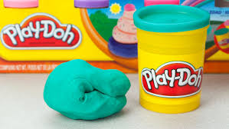
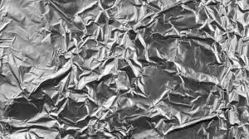
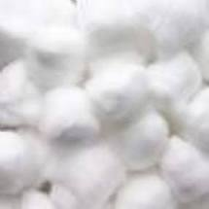
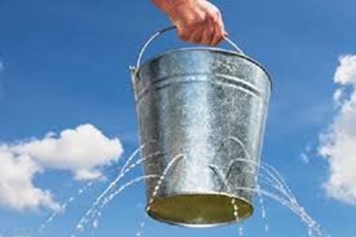
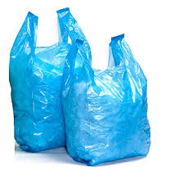
HELP!
Let’s test some different materials and see which one is best at blocking the hole.
Notes:
Teacher to model the investigation and how to record using the sheet

Slide 6
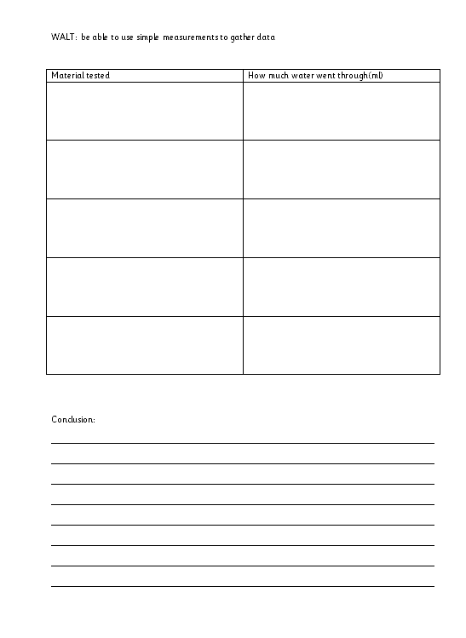

Slide 7
HELP!
Make sure you draw a picture of the material you test and record how much water gets through the hole on your recording sheet.
Notes:
Teacher to model the investigation and how to record using the sheet

Slide 8
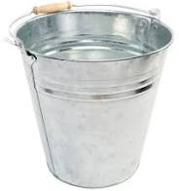
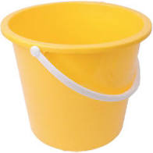
HELP!
Thank you so much for helping me find the best material to block the hole in the bucket.
Notes:
Teacher to model the investigation and how to record using the sheet

