Slide 1
RE
WALT: understand what Jesus taught

Slide 2
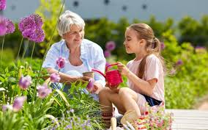
‘Love your Neighbour as yourself’ (Mark 12:28-31)
Jesus was sent to save the world by teaching people to be kind to one another.
How can we be kind and respectful to each other?
What does it mean to be tolerant?
Can you think of something kind someone has done for you today?
“If you can be anything in this world be kind”

Slide 3

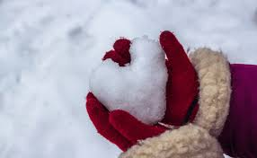
Kindness at Christmas
How do we show kindness at Christmas?
Why is it important to show kindness at Christmas?
Discuss with your partner before we discuss as a class

Slide 4
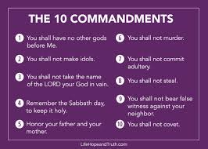
The 10 commandments
Jesus had 10 commandments that he wanted all Christians to live their lives by.
What do they mean?
Do we follow any
similar rules in our lives?
Notes:
Teacher to model 10 commandments sheet under the vizuliser/ smart board/flip chart

Slide 5
The 10 commandments
Jesus had 10 commandments that he wanted all Christians to live their lives by.
Today we are going to write our own 10 commandments for how to be
kind, tolerant and respectful.
What could we include?
Notes:
Teacher to model 10 commandments sheet under the vizuliser/ smart board/flip chart

Slide 6
The 10 commandments for kindness, tolerance and respect
Create your own commandments poster
You could include an illustration to match each commandment
Let’s write a few together
Well share your posters at the end of our lesson

