Slide 1
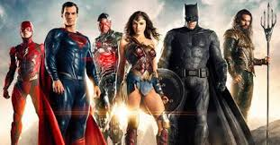
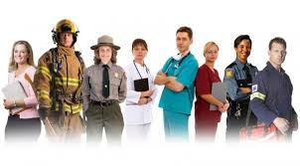

Who are these people?

Slide 2
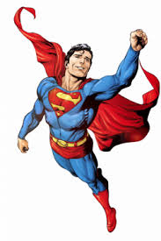
If you were a superhero…….
Think back to last week….
What current issues does our world need saving from?
If you were a superhero what powers would you have?
How would you use your powers to save the world from one of the current issues we are facing.

Slide 3
Superheroes
Today you are going to design your own superhero outfit.
Around your outfit you need to write adjectives to describe your superhero self.
Discuss with your partner what your superhero will look like and what powers you will have.
Let’s think of some of the adjectives we could use to describe the superheroes we have discussed.
Notes:
Adjectives could be written on a flipchart

Slide 4
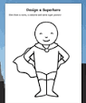
My superhero
Notes:
Teacher can model adding the details and adjectives under the visualizer

