Slide 1
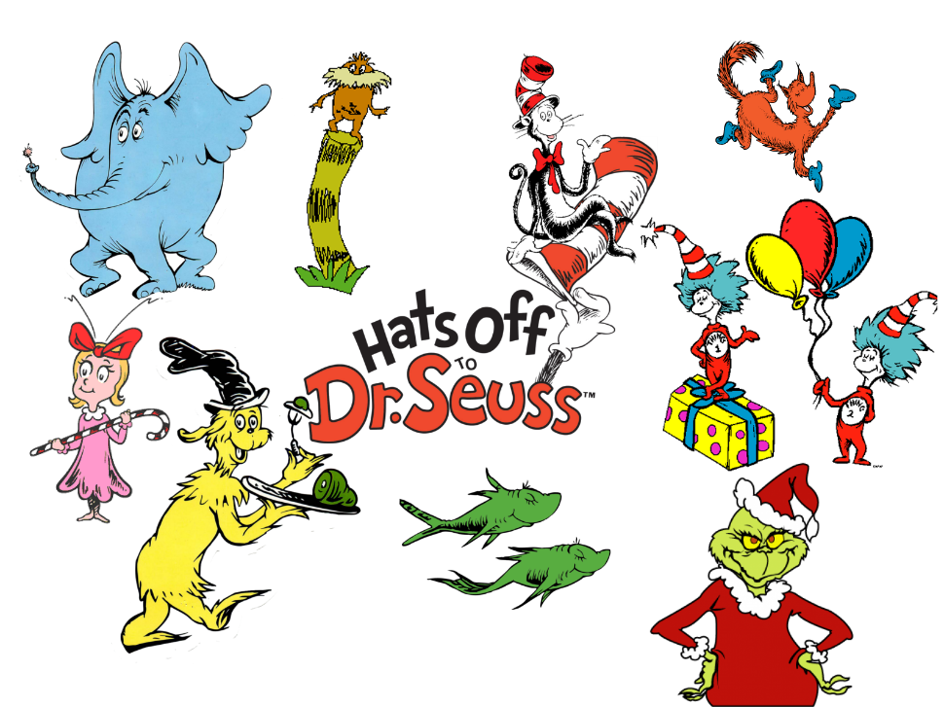
Objective: To appreciate different drawing styles and discover how significant illustrators have used drawing to express ideas in their creative works.

Slide 2
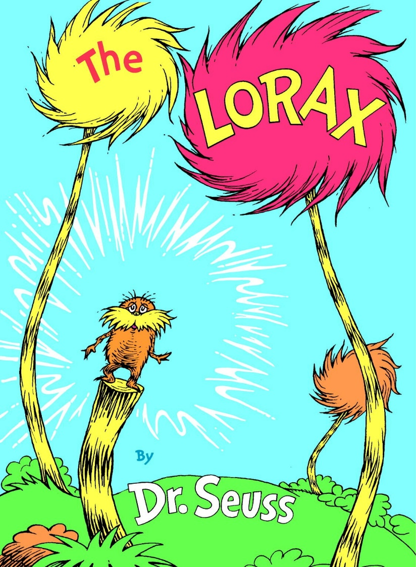
Dr Suess
He was an American writer and cartoonist from Springfield, Massachusetts. He was better known by his pen name, Dr. Seuss.
Notable work(s): The Cat in the Hat, Green Eggs and Ham, The Grinch
His favored medium is watercolor, usually either on bristol or illustration board. He also makes ample use of ink or pen, oil, and acrylic. This selection of media helps to expand his distinctive style.

Slide 3
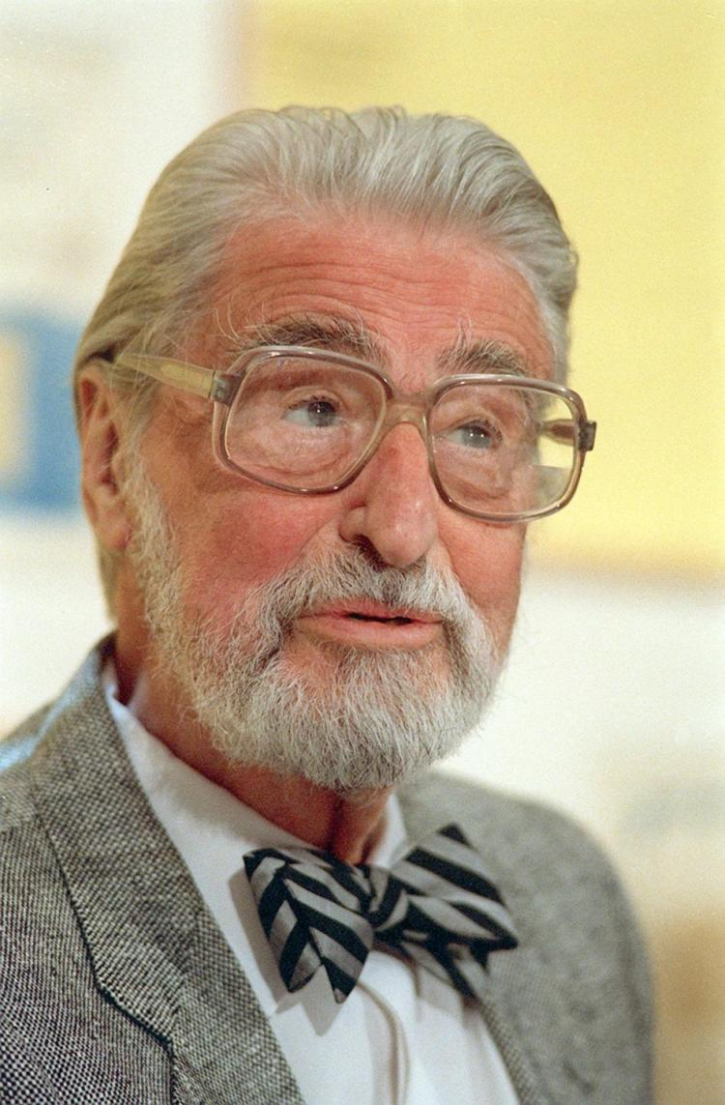
Dr Suess – Theodor Seues Geisel
He began his career as a little-known editorial cartoonist in the 1920s. His intriguing perspective ignited his career, and his work evolved quickly to illustrations.
Dr Seuss created every rough sketch, final line drawing, and finished work for each page of every project he illustrated.

Slide 4
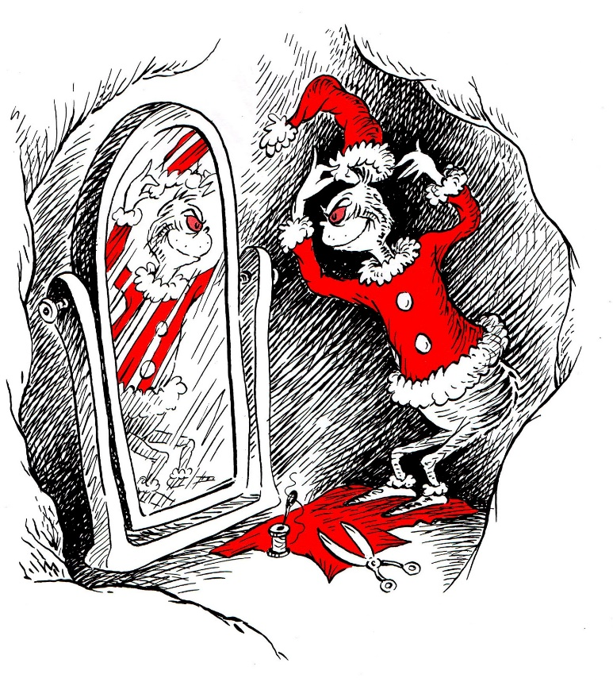
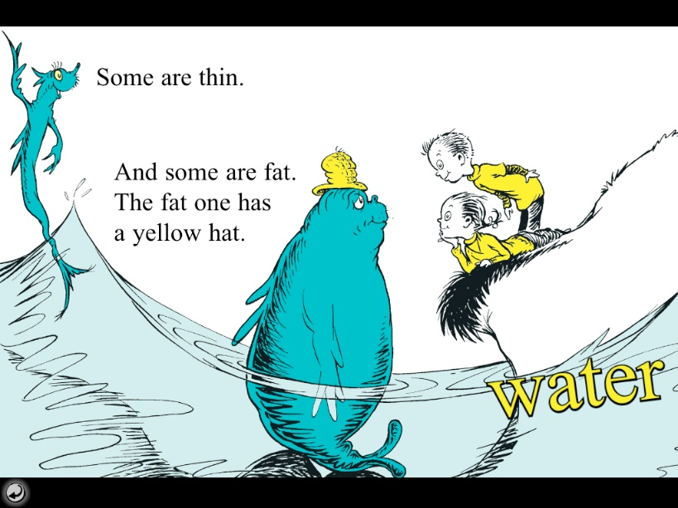
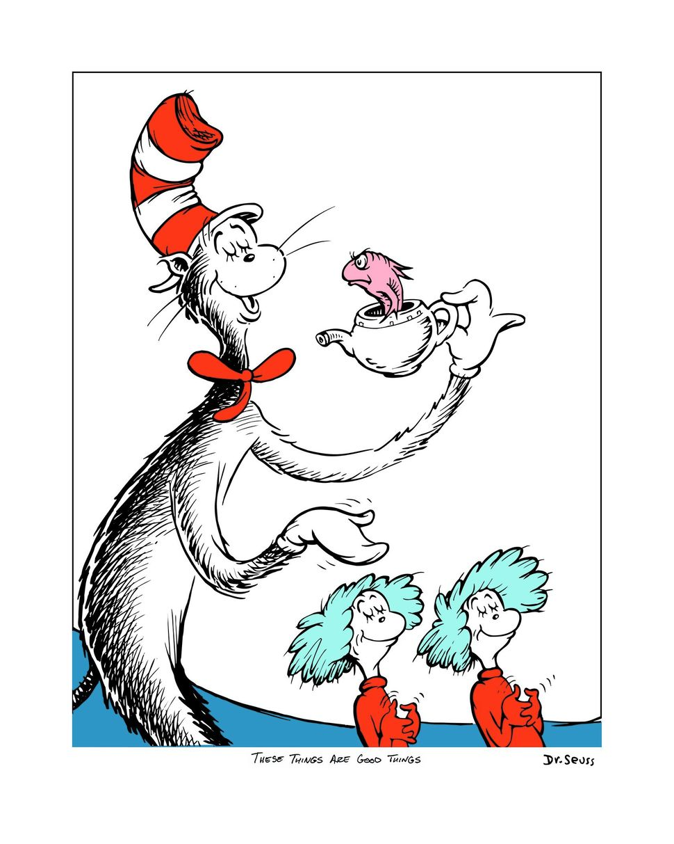
Dr Suess

Slide 5
Dr Suess
What do you notice about his style?
What do you like? Dislike?
Task
Recreate one of his characters or create your own Dr Suess style character. Look carefully at how you can mimic his style.

