Slide 1
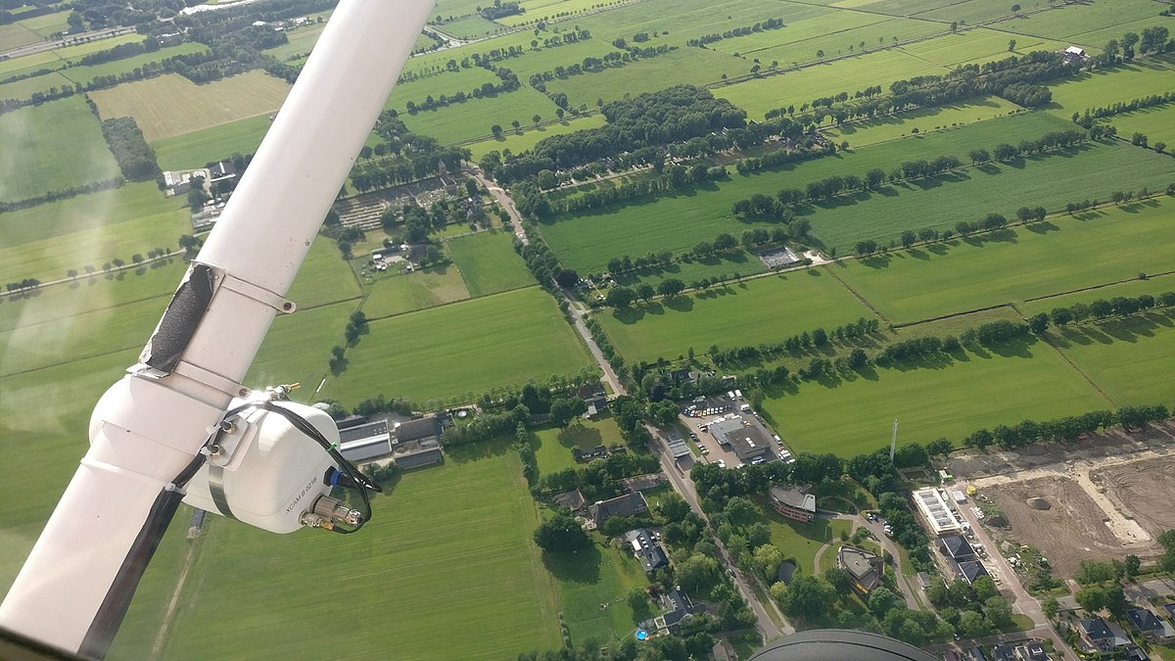
WALT: Use aerial and plan perspectives to recognise landmarks and use directional language

Slide 2
Quiz time!
What does aerial perspective mean?
What is the purpose of a key on a map?
What are the points on a compass?

Slide 3
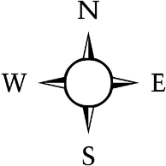
Let’s warm up!
Can you follow the directions?
https://www.mathsisfun.com/games/direction-nsew-.html

Slide 4
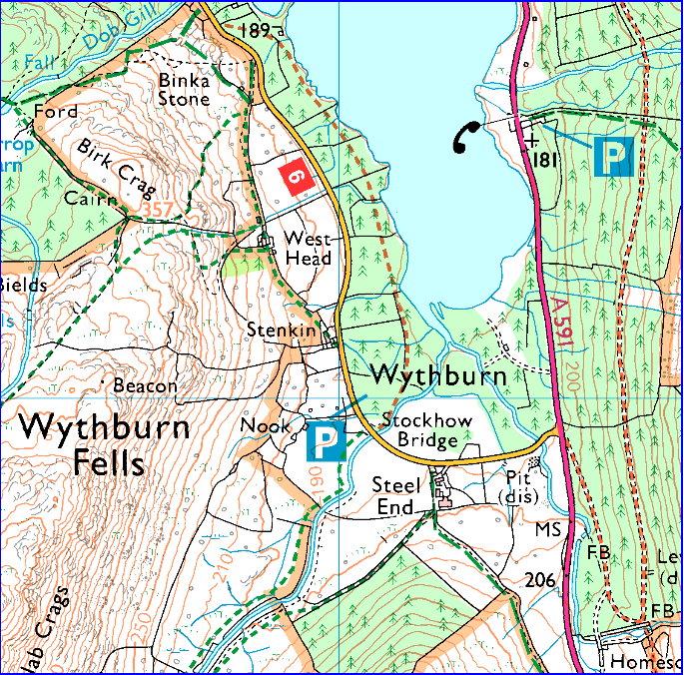




What can you see? What do the symbols mean?
Car park
Phone box
Road
Footpath

