Slide 1
Welcome to Year 2!
Class Teachers: Miss Barnett and
Mrs Woollard/Mrs Moyle
Professional Teaching Partners: Mrs Hibbard, Mrs Dukart and Miss Speer

Slide 2
Key learning/end of year expectations
Our aim is to make children independent learners. They are expected to take more responsibility for their own work and resources.
Please also visit the class pages and subject areas on our website for more information on how to support your child.

Slide 3
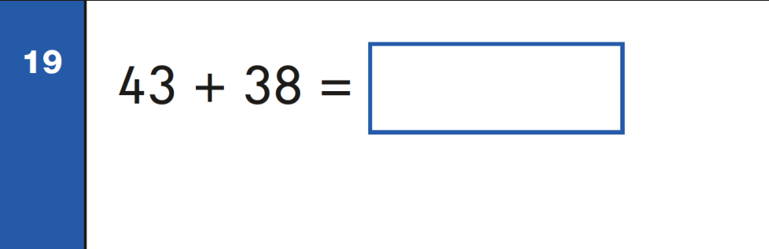
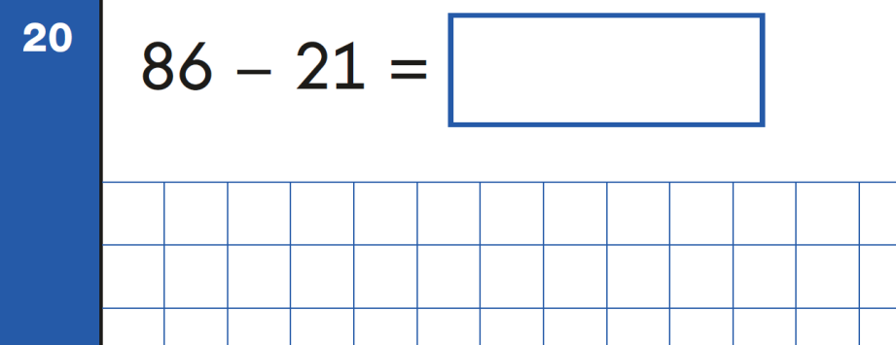
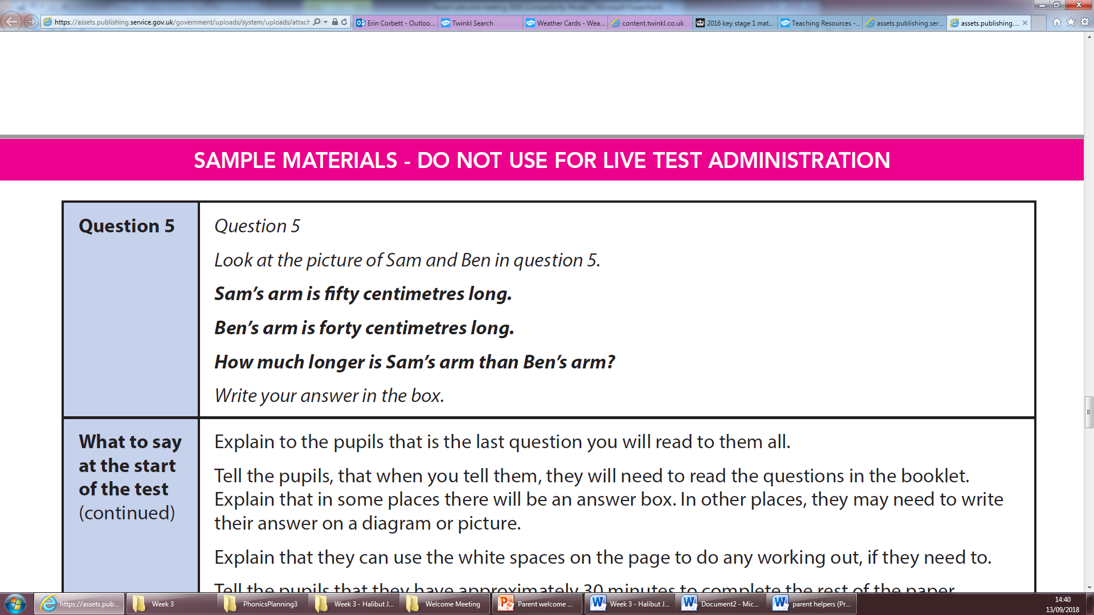
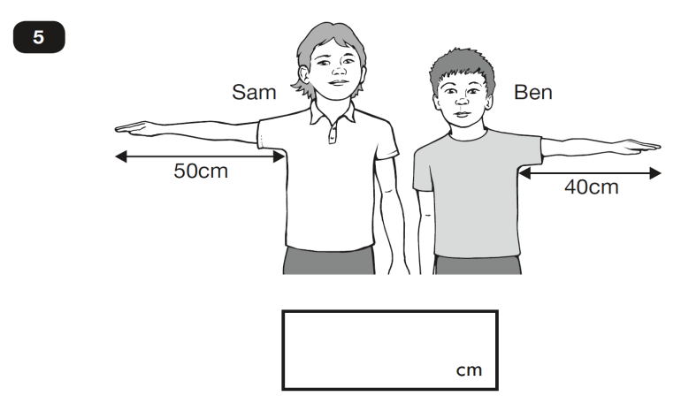
Key learning/end of year expectations
Arithmetic questions
Reasoning questions

Slide 4
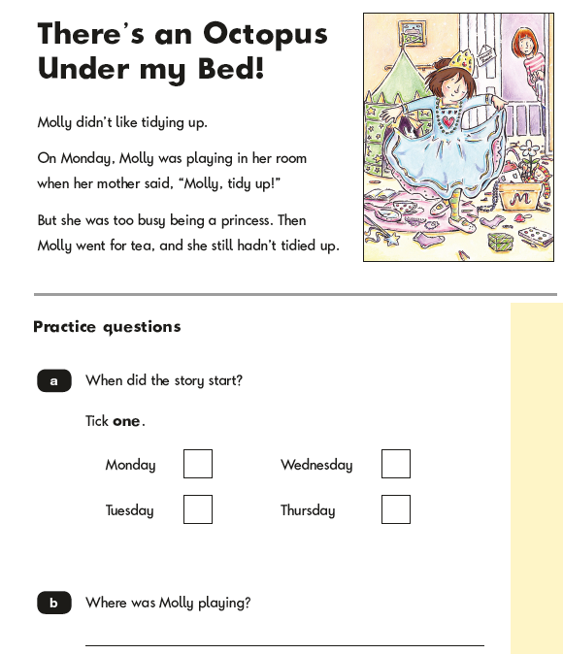
Key learning/end of year expectations
Reading Paper 1

Slide 5

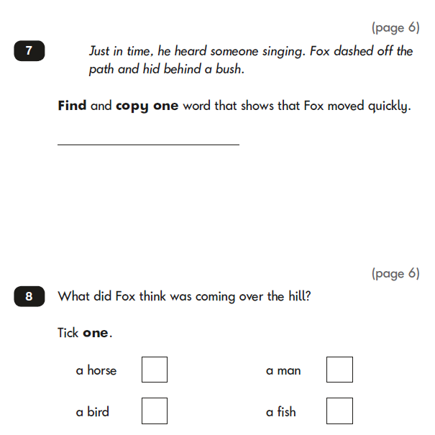
Key learning/end of year expectations
Reading paper 2

Slide 6
How to help your child at home.
Times tables – (2s, 5s & 10s)
Numbots
Reading – Read daily
Weekly Maths homework WB 16.09.24

Slide 7
Year 2 additional teachers
In Year 2 the children will be taught the following subjects by our specialist teachers:
  Spanish – Mr Santillan
  Swimming – Miss Sutherland

Slide 8
Curriculum /Outdoor Learning
We will continue to use the outside space at school to enhance the children’s learning.
Many lessons may take place outside and the children should be equipped for this, what ever the weather!
OPAL will continue ensure meaningful play at lunch time and children should bring in a waterproof / coat every day.
Notes:
‹#›

Slide 9
School Trips/Visitors
We aim to have visitors into school, local area visits and a day trip during the course of the year.
We encourage parents to come in to share their knowledge and expertise with the class whenever curriculum-linked opportunities arise.
Notes:
‹#›

Slide 10
Reading
Children are expected to hand in their reading records every Thursday so they can be changed and sent out on Friday.
Children should be encouraged to read every day for a minimum of 10 minutes at home and complete their reading record accordingly with a signature from an adult every week.
Suggested comments sheet may help.

Slide 11
SRE slide 1- principles
The Relationships Education, SRE and Health Education (England) regulations have made Relationships Education compulsory in all primary schools. Midfield Primary School, as part of the Spring Partnership Trust, offers Sex Education as part of the PSHE curriculum.

Slide 12
SRE Slide 2- specific year group content
Foundation Stage | Growing up: how we have changed since we were babies
Year 1 | Boys’ and girls’ bodies; naming body parts
Year 2 | Boys’ and Girls’ bodies; body parts and respecting privacy (which parts of the body are private and why)

Slide 13
SRE- Rights of parents
At the Primary Stage parents/carers have the right to request that their child be withdrawn from the lessons above and a letter will be sent out to inform parents about when these particular lessons will be taught and how to opt out if they wish.
Parents’ cannot withdraw their children from any part of the relationship or science curriculum.

Slide 14
Homework
Homework will be set on Google Classroom.
Weekly maths homework will be added to reading packs.
Termly homework passports will also be set.
Maths homework is due weekly.
Passport homework is due at the end of each term.
Notes:
‹#›

Slide 15
Social media and E-safety
Children are taught one e-safety lesson every half term as part of the Computing curriculum and this includes how to report concerns about content and contact online.
To support your child you can:
use parental controls at home
supervise your child’s use of Youtube
model positive use of social media
Please remember that social media for children is not permitted. The minimum age for apps and websites such as instagram, facebook and whatsapp is 13.
If you have an e-safety concern, please contact the school immediately.
Notes:
‹#›

Slide 16
Key dates
Autumn Term:
Parent consultations to take place week commencing
3rd and 5th November – PROVISIONAL DATE more details to follow
Half term 21st October – 1st November
INSET Day - 22nd November 2024
Notes:
‹#›

Slide 17
Before and after school
It is important that children are on time. There are important early morning activities that children complete between 8:40 and 9:00am. Being late has an impact on the children’s learning.
Going home:
  Children will only be permitted to go home with adults that have been introduced the Year 2 team.
  Please inform the school in writing if you have a change in these.

Slide 18
Uniform, outdoor wear and PE kits
Black enclosed shoes. No trainers!
No nail varnish. Small hair accessories in blue, white, black only.
Label school uniform: name and class.
Named PE kit (incl: trainers/tracksuits for outdoor PE)
Book bag every day.
Wellingtons and waterproof coat for outdoor learning.

Slide 19
Finally……
If you need to speak to someone, please contact one of us in the first instance. We can help or direct your question or query elsewhere.
Please remember we are completely nut free school (we have children with severe allergies) and snacks for break time should be healthy.
Notes:
‹#›

Slide 20
Finally……
We are a school committed to safeguarding. If you have a safeguarding concern, please speak to one of the following members of staff:
Mr Osborne
Mr Le Conte
Miss Moyle
Notes:
‹#›

