Slide 1
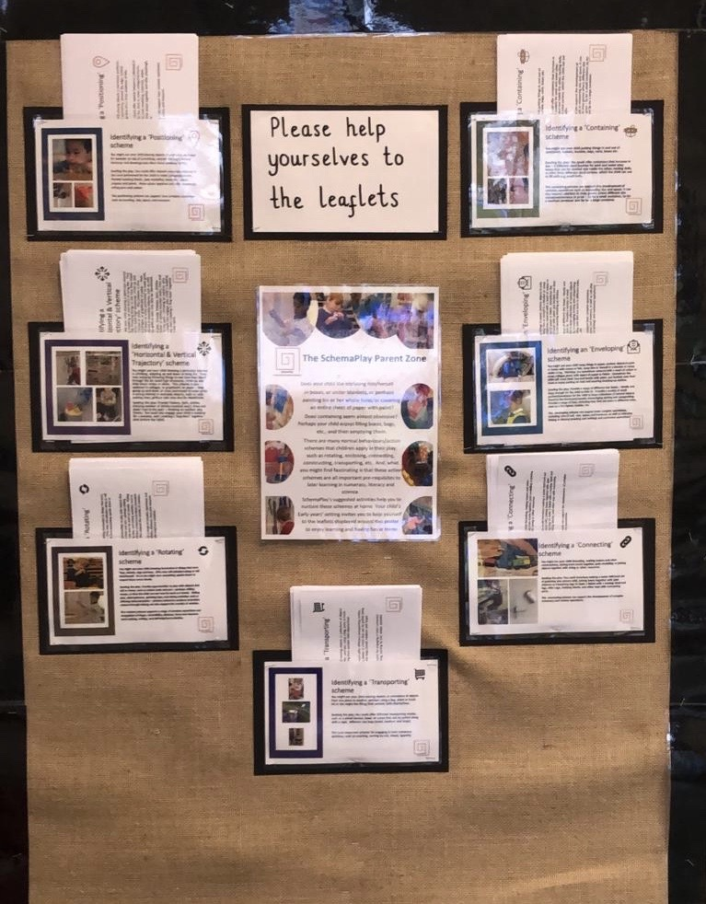
Schema Play

Slide 2
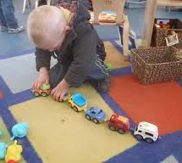
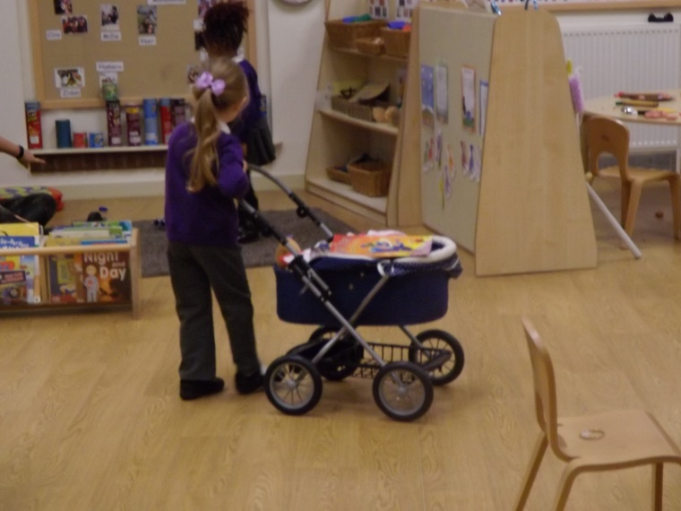
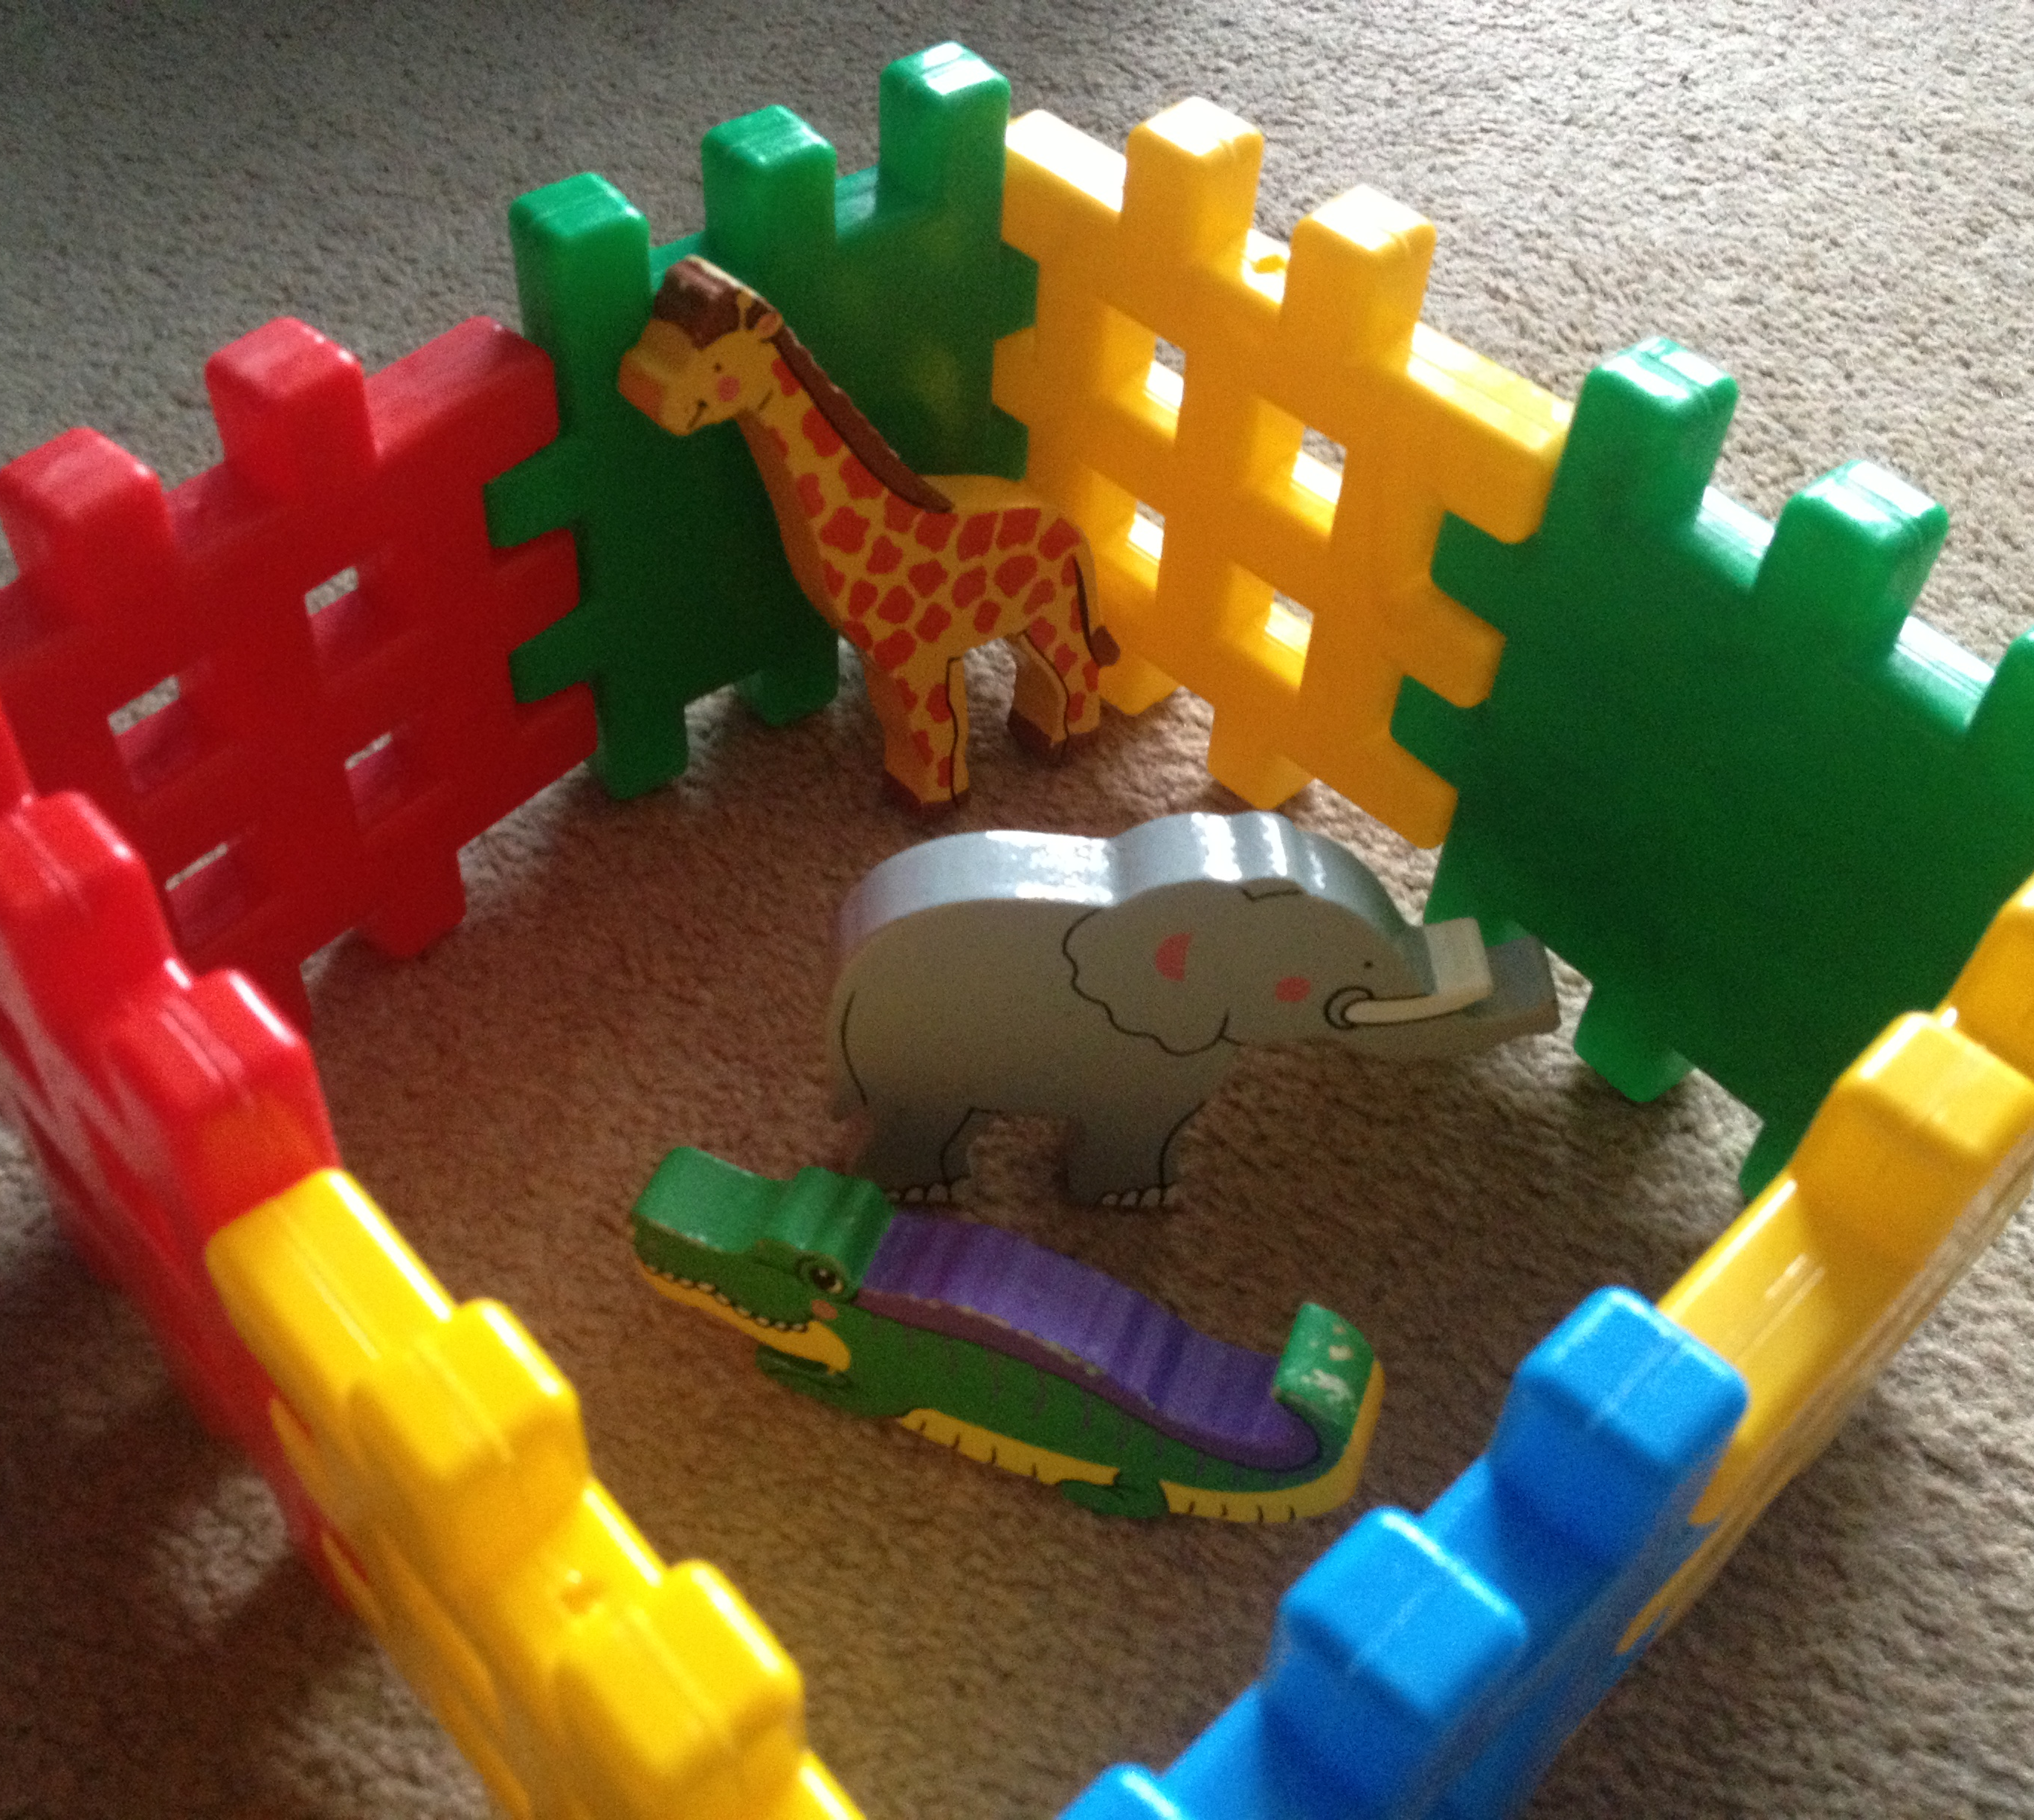
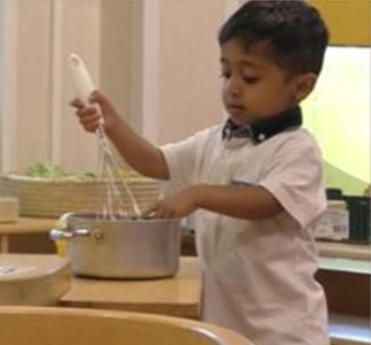
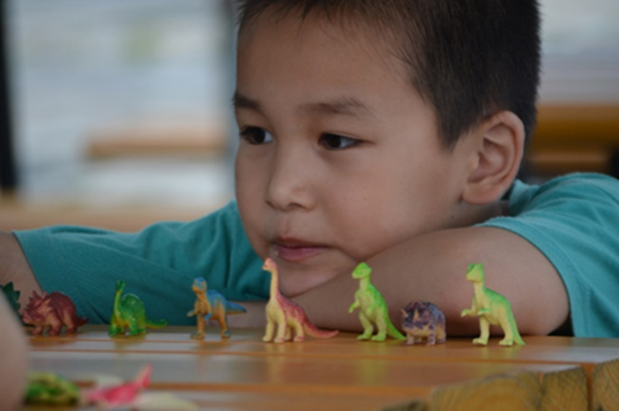
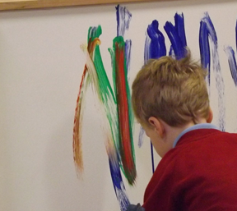
Example Schèmes
First identified by Chris Athey (1990)
Enclosing/Containing
Connecting
Transporting
Rotation
Grading
Trajectories
Notes:
NOTE SCHEMES ISNT’ IN INTALLICS.

Slide 3
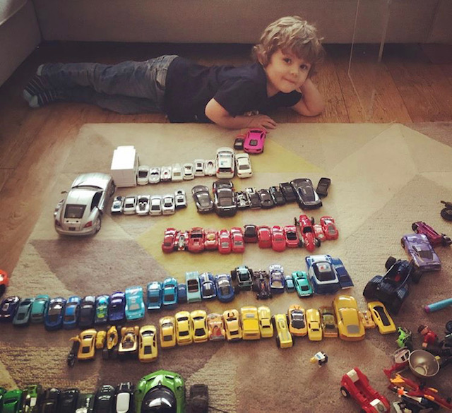

Slide 4
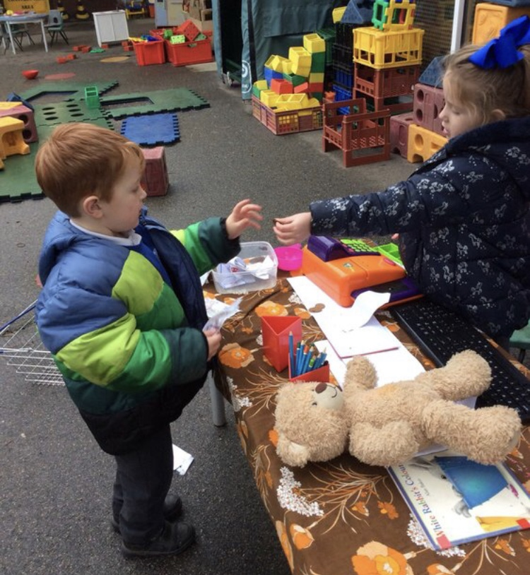

Slide 5
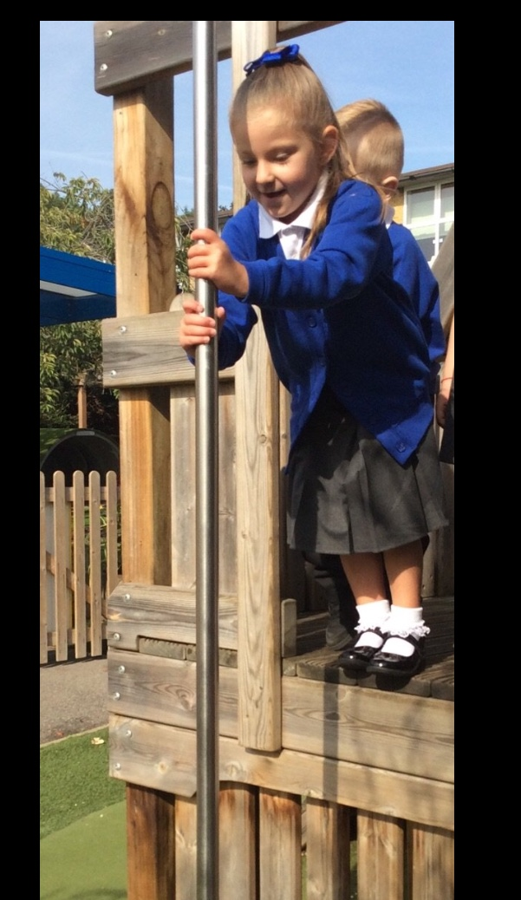
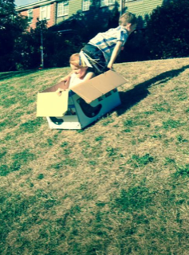

Slide 6
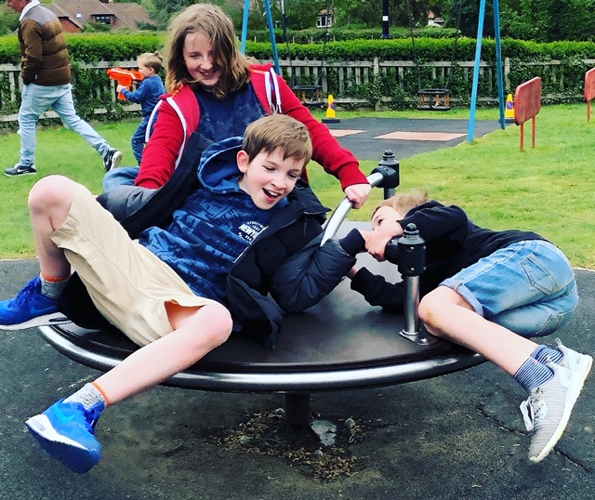

Slide 7
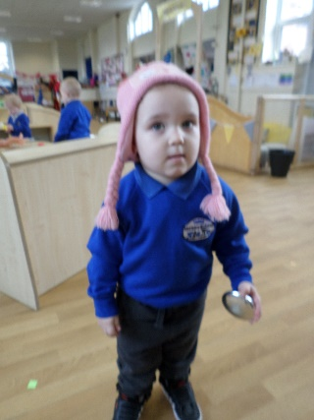
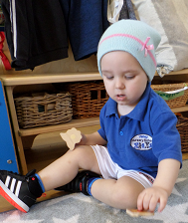
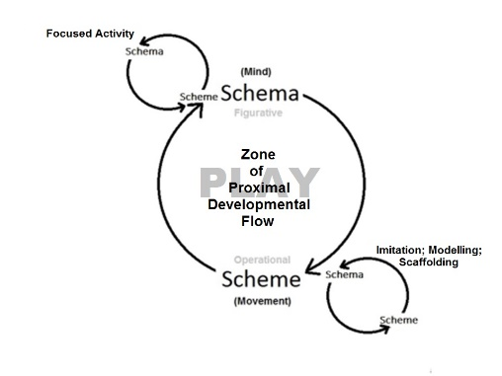
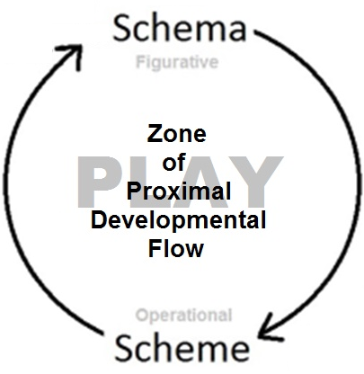
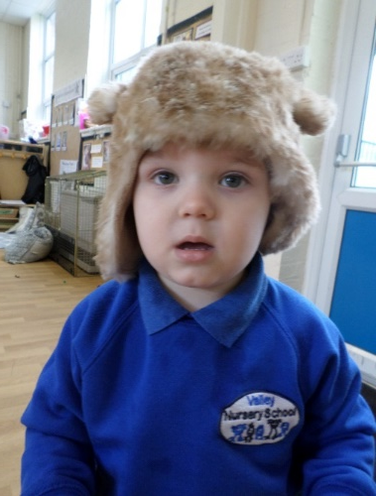
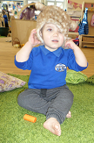
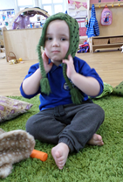
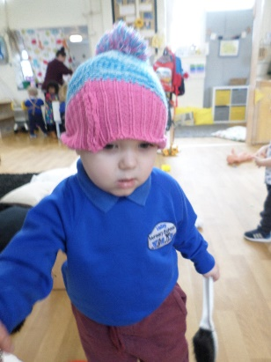
Child
Harry (27 months) really likes hats.
Notes:
Valley - Harry has been verbalising a word very close to the correct word, hat….and the hats are of course SCHEMAS – what is the SCHEME he is repeating?
- he is enveloping, enclosing
We can extend this to Dens
Things in boxes
Envelopes
Dressing up
Wrapping ‘presents’
- but where might it lead? We want the practitioners to have in mind some progression...try something, if it doesnt work try something else - and it might be for progression to something different - How old is Harry? (Valley?) I think he is probably two and the priority is probably socialisation - so dressing up and role play might be a good idea - need first pairs or groups of hats for role play to encourage interaction around a common object - hard hats , firehats, crowns, animal masks etc
Seeding has taken place by loading a greater variety of hats into the basket and then further showing him the variety in order for him to make a choice by seeing them laid out in front of him rather than blind choosing the one on the top of the basket.
Harry often realises that a photograph has been taken and likes to see the photograph on the camera and sees the image and checks and points to the hat in the picture and the one on his head.

Slide 8

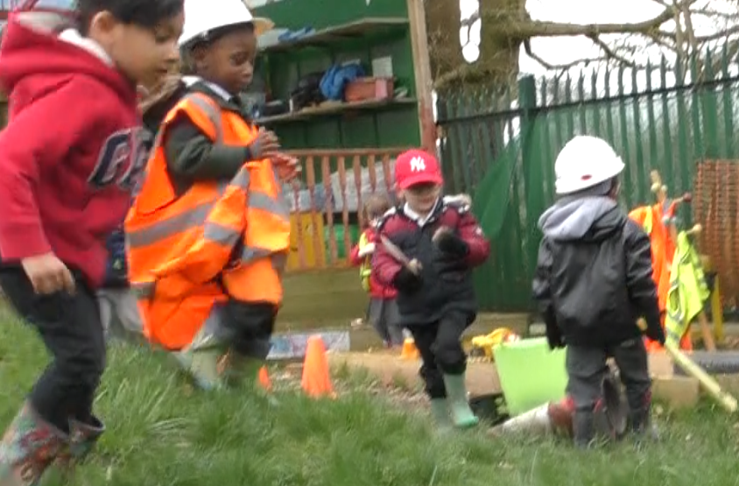
What it looks like in practice…
Harry’s initial observed Scheme & Schema
Harry is applying an enclosing scheme. He enjoys putting a hat on.
Scheme: Enclosing
Schema: Hats
‘Seeding’ Resources: A variety of hats were offered to support the enclosing scheme.
Extension: Role-play opportunities were suggested to build upon the enclosing scheme and schema of hats.

Slide 9
Common types of scheme
Trajectory - creating lines in space by climbing up and jumping down. Dropping items from up high.
Positioning - lining items up and putting them in groups.
Enveloping - covering themselves or objects completely. Wrapping items up or placing them in containers.
Rotating - enjoys spinning items round and round. Likes to run around in circles or being swung round.
Enclosing - adding boundaries to play areas e.g. fences around animals. Adding borders to pictures.
Transporting - carrying or moving items from one place to another; carrying items in containers or bags.
Connecting - setting out and dismantling tracks, constructing, joining items together with tape or glue.
Transforming - exploring the changing states of materials, transforming them from a solid to liquid state and back again.

