Slide 1

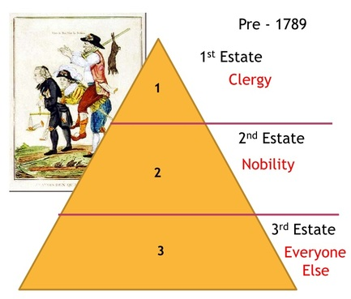
Midfield Primary School – Knowledge Organiser
History Focus | The French Revolution | Year 5 | Autumn 1
Background Information
The French Revolution was one of the most important events in world history. In 1789, the people of France rose up against Louis XVI, the absolutist King of France. Four years later, Louis XVI and his Queen Marie Antoinette were beheaded. France was declared a Republic, and ideas such as ‘liberty’, ‘equality’ and ‘rights’ were developed. The French people tried to export these ideas to the rest of Europe using force, particularly from 1799 onwards under the military leadership of Napoleon.
When? (Key Knowledge)
Pre - 1789 | King Louis XVI had absolute power, and did not share power with Parliament.
 | French society was structured into the aristocracy, the clergy and the rest, known as the ‘Third Estate’)
1789 | The French people staged a revolution against Louis XVI in order to share power more equally across the country.
1793 | Luis XVI and his wife were executed by the people.
1799 | Napoleon became the new leader of France.
1804 | Napoleon became the Emperor of France and led the country into a series of wars within Europe.
What? (Key vocab)
Spelling | Definition
Aristocracy | the highest class in certain societies, normally people of noble birth
Clergy | people ordained for religious duties such as priests
Third Estate | The working class people in the French society
Revolution | Overthrowing a government or social order, in favour of a new system, often by force
Monarchy | A country or state which has a royal family at its head
Republic | A country or state with no monarchy
Absolutist | A person who holds complete control
Democracy | A system of government voted for by the people
Diagrams and Symbols
Who?
Louis XVI | King of France Believed in ‘absolute’ power
Napoleon | Prominent military figure and statesman Led the revolution against Louis XVI

