Slide 1
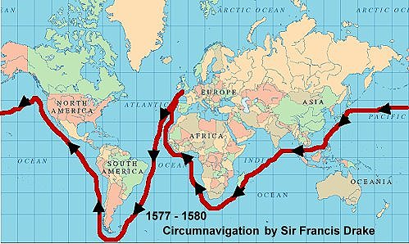
Midfield Primary School – Knowledge Organiser
History Focus | Elizabethan Explorers | Year 4 | Autumn 1
When? (Key Knowledge)
1556 | Portuguese traders were allowed to make a permanent settlement in the port of Macau.
1558 | Queen Elizabeth ascended to the to be crowned after Queen Mary died.
1559 | Tristan de Luna and 1500 Spanish crew land at modern day Pensacola Bay in North America.
1562 | John Hawkins sets sail for the Caribbean via Sierra Leonne and eventually pioneers slave trade.
1577 | Sir Francis Drake circumnavigates the world and becomes the second person in the world and the First English captain to accomplish the task.
1584 | Captains Philip Amadas and Arthur Barlower leave England to explore North American Coast.
1595 | Sir Walter Raleigh sets out in search of the city of El Dorado.
Background Information
The Elizabethan era began when Queen Elizabeth ascended to the throne in 1558 to be crowned as Queen after Queen Mary died in 1558. The period of time that she ruled is 45 years (1558 – 1603) was marked by prosperity in the field of exploration. The need for trade routes to the Far East had increased and all European powers were vying for the right to colonise the Far East nations. Queen Elizabeth was lucky enough to have some of the best navigators, explorers and sailors.
What? (Key vocab)
Spelling | Definition
Exploration | The action of exploring an unfamiliar area.
Circumnavigate | To sail or travel around something (e.g. the world).
Trade | The action of buying or selling goods and services.
Commodities | A raw material or primary agricultural product that can be bought and sold, such as copper or coffee.
Alliance | A union or association formed for mutual benefit, especially between countries or organizations.
Colonies | a country or area under the full or partial political control of another country and occupied by settlers from that country.
Diagrams and Symbols
Who?
Sir Francis Drake | Helped defeat the Spanish Armada of 1558 Most renowned seaman of Elizabethan era.
Sir Walter Raleigh | Captain of the Queen’s Guard Established a colony named Virginia.

