Slide 1
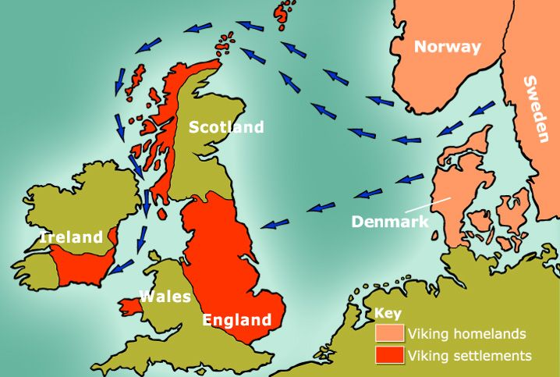
Midfield Primary School – Knowledge Organiser
History Focus | The Vikings | Year 3 | Autumn 1
When? (Key Knowledge)
793 | First invasion by the Vikings. They raided monasteries on the coast including Lindisfarne.
865 | Great Viking Army from Denmark invades England.
 | Danes capture York (Jorvik) and make it their kingdom.
876 | Vikings form Denmark, Norway and Sweden settle permanently in England.
901 - 937 | Eastern England (Danelaw) is conquered by the English.
954 - 994 | Eric Bloodaxe is thrown out of York. Olaf of Norway and Sven 'Forkbeard‘ lead an invading Danish army in an unsuccessful siege of London, and ravage the south-east.
1014 | King Canute of Denmark captures the English Crown.
1042 | Edward the Confessor becomes King.
Background Information
The Vikings came from all around Scandinavia. They sent armies to Britain about the year 700 AD to take over some of the land, and they lived here until around 1050. The Vikings wanted new land because the places where they came from in Scandinavia weren’t very easy to live on. It was hard to grow crops, but Britain and Europe had plenty of good farmland, so the Vikings tried to claim some of that land for themselves. The Vikings would turn up every now and then to raid towns and take a bit of land. Sometimes the Anglo-Saxons decided it was better to pay them money so they’d stay away.
What? (Key vocab)
Spelling | Definition
Longships | Longships were seagoing vessels made and used for trade, exploring, and raiding. They were used by early people on the Baltic Sea and the North Sea.
Invader | Someone who enters by force in order to conquer something e.g. land, money, possessions.
Scandinavia | A group of culturally related countries in Northern Europe.
Raids | A rapid surprise attack on an enemy by troops or other armed forces.
Settlements | A place, typically one which has previously been uninhabited, where people establish a community.
Diagrams and Symbols
Who?
Alfred the Great | Defeated the Vikings at Battle of Ethandun Created Danelaw
Canute the Great | Ruled as the First Viking King of England

