Slide 1
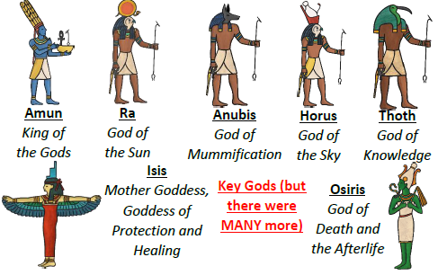
Midfield Primary School – Knowledge Organiser
History Focus | Egypt and Mesopotamia | Year 2 | Autumn 1
When? (Key Knowledge)
7000 BC | The first farmers settle in northern Mesopotamia, herd animals and grow crops on the fertile river soil.
5400 BC | The world’s first city is established by the ancient Sumer people. It is called Eridu.
5000 BC | Farmers begin to settle in the south of Mesopotamia. They develop irrigation which meant that they found a way to direct water to crops to make them grow more effectively.
3600 BC | Writing is invented at the city of Uruk. The people draw pictures to represent various objects.
2000 BC | The first Assyrian Empire is established in the north of Mesopotamia and lasts for more than 500 years.
1200 BC | Assyrians rule over the greater part of Mesopotamia due to aggressive military tactics and new weapons made of iron.
522 BC | Darius the Great comes to power as king of Persia.
Background Information
The word Mesopotamia means "the land between rivers". The heart of Mesopotamia lies between the two rivers in southern Iraq. Early settlers in Mesopotamia started to gather in small villages and towns. As they learned how to irrigate land and grow crops on large farms, the towns grew bigger. Eventually these towns became large cities. New inventions such as government and writing were formed to help keep order in the cities. The first human civilization was formed.
What? (Key vocab)
Spelling | Definition
Afterlife | The place where Egyptians believed they would go after they died.
Akhet | The season of the year when the River Nile flooded.
Pharoah | The title given to ancient Egyptian rulers.
Pyramids | Ancient pyramid-shaped masonry structures located in Egypt, often built as tombs for pharaohs.
Egyptologist | An archaeologist who focusses on Ancient Egypt.
Hieroglyphics | A type of writing that used pictures and symbols.
Mummification | The process of preserving a body after death in preparation for the afterlife.
Diagrams and Symbols
Who?
Narmer | First Pharaoh of Egypt Known as Warrior Menes.
Khufu | Responsible for the building of the Great Pyramid at Giza.
Cleopatra VII | Made alliances with famous Romans.

