Slide 1

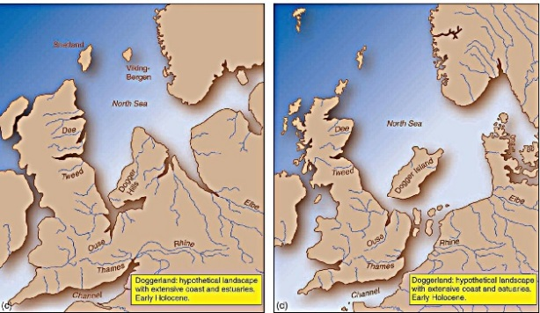
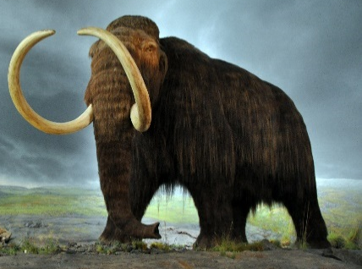
Midfield Primary School – Knowledge Organiser
History Focus | Ice Age | Year 1 | Autumn 1
When? (Key Knowledge)
2.58 million years ago | The most recent ice age, officially known as the Quaternary ice age, began with the spread of ice sheets in the Northern Hemisphere.
19,000 years ago | The Ice Age reaches it’s peak . Ice grew to more than 12,000 feet thick as sheets spread across Canada, Scandinavia, Russia and South America. Sea levels plunged more than 400 feet, while global temperatures dipped around 10 degrees Fahrenheit on average and up to 40 degrees in some areas.
12,000 years ago | Scientists have found evidence that there was a piece of land bridge between Britain and continental Europe. This has been called Doggerland.
10,000 years ago | The Ice Age begins to end as global temperatures rise.
Today | By definition, we are currently in the final stages of this ice age! This is because the Antarctic and Greenland ice sheets remain intact despite moderate temperatures.
Background Information
The last Ice Age was a period in Earth's history that started around 2.58 million years ago. The peak of the Ice Age is thought to be around 19,000 years ago, and the Ice Age ended around 10,000 years ago, although by definition we are still in the final stages. This was a time when the climate was much, much colder than it is today and much of the Earth's surface was covered in sheets of ice. It is estimated that about 1/3 of the Earth was covered in ice, and some of the ice sheets were up to a mile thick. Over the course of millions of years, scientists believe that the Earth has experienced at least five major ice ages.
What? (Key vocab)
Spelling | Definition
Ice Age | Periods of time when large areas of Earth’s surface were covered with ice sheets or glaciers.
Pre-history | Everything that happened before written records began.
Fossil | The remains of a prehistoric plant or animal embedded in rock and preserved.
Glacier | A slowly moving block or river of ice.
Extinct | A species which is no longer alive in today’s world.
Past | When something has happened before the time we are in.
Long ago | In the distant past.
Change | The process of becoming different.
Wholly Mammoth | Wholly mammoths were giant mammals that migrated across cold regions of the world.
Diagrams and Symbols
Who?
Cave Men | Early prehistoric people who lived in caves

