Slide 1
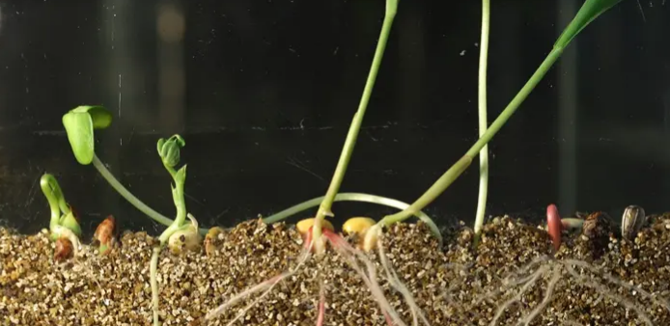

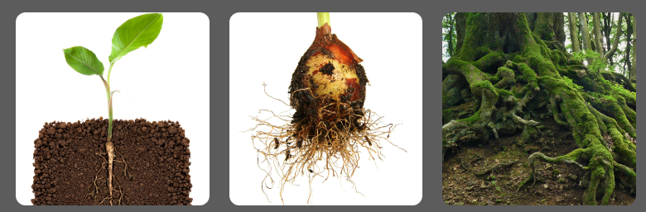
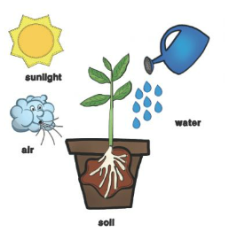
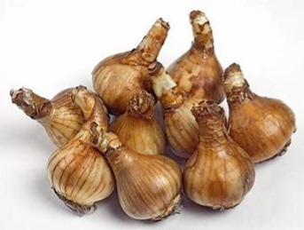
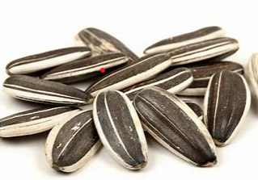
Spring Partnership Knowledge Organiser
Science Focus | Plants | Year 2 | Summer 1
What do I need to learn?
I can • Observe and describe how seeds and bulbs grow into mature plants. • Find out and describe how plants need water, light and a suitable temperature to grow and stay healthy.
Oracy – key questions for discussion
What’s going on? Shooting sprouts
The big question - Why don’t all plants look the same?
Which is the odd one out? Why?
What have we learned before that may help us?
Identify and name a variety of common wild and garden plants, including deciduous and evergreen trees. Identify and describe the basic structure of a variety of common flowering plants, including trees.
Diagrams/Pictures
Key vocabulary
light, shade, sun, temperature, grow, healthy, bulb, germinate, shoot, seedling
The 5 Enquiry Skills – What skills have you used?
Pattern Seeking, Identifying, Classifying and Grouping, Comparative and Fair Testing, Research using Secondary Sources, Observation over time

