Slide 1
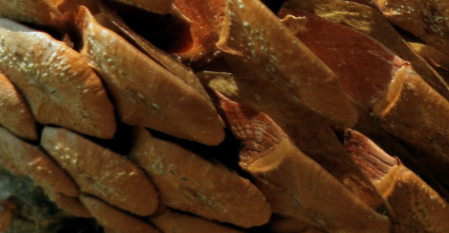

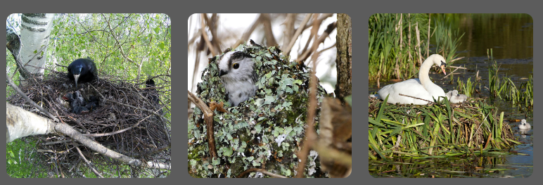
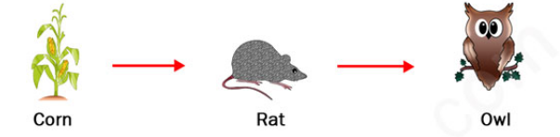
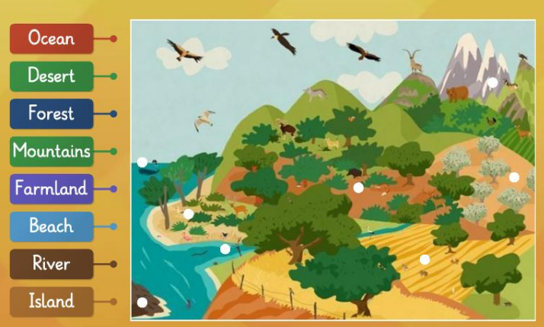
Spring Partnership Knowledge Organiser
Science Focus | Living Things and Their Habitats | Year 2 | Spring 2
What do I need to learn?
I can Explore and compare the differences between things that are living, dead, and things that have never been alive Identify that most living things live in habitats to which they are suited Describe how different habitats provide for the basic needs of different kinds of animals and plants, and how they depend on each other Identify and name a variety of plants and animals in their habitats, including micro-habitats Describe how animals obtain their food from plants and other animals, using the idea of a simple food chain Identify and name different sources of food
Oracy – key questions for discussion
Have you ever found it difficult to spot an animal because of its colour?
What is this? Is it alive?
Which is the odd one out? Why?
What have we learned before that may help us?
Identify and name a variety of common wild and garden plants, including deciduous and evergreen trees. Identify and describe the basic structure of flowering plants, including trees. Identify, name, describe and compare a variety of common animals including fish, amphibians, reptiles, birds and mammals. Identify and name a variety of common animals that are carnivores, herbivores and omnivores. Observe changes across the four seasons.
Diagrams/Pictures
Key vocabulary
living, dead, never been alive, suited, suitable, basic needs, food, food chain, shelter, move, feed, water, air, survive, survival, growth, respire, names of local habitats (e.g. pond, woodland etc.), names of micro-habitats (e.g. under logs, in bushes etc.), conditions, light, dark, shady, sunny, wet, damp, dry, hot, cold,
The 5 Enquiry Skills – What skills have you used?
Pattern Seeking, Identifying, Classifying and Grouping, Comparative and Fair Testing, Research using Secondary Sources, Observation over time

