Slide 1
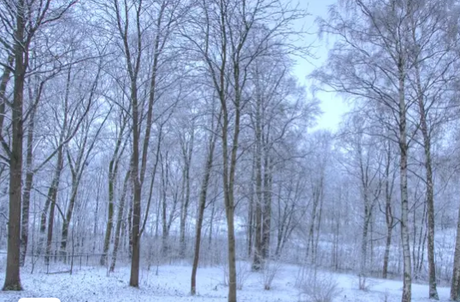

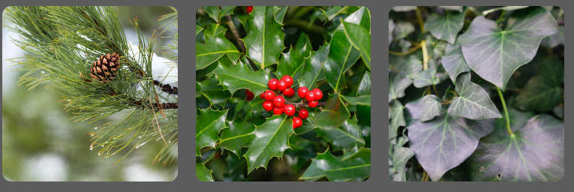
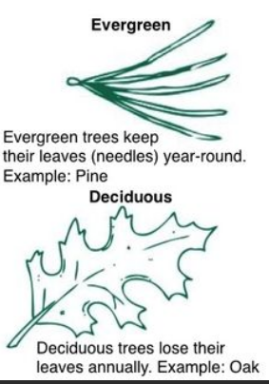
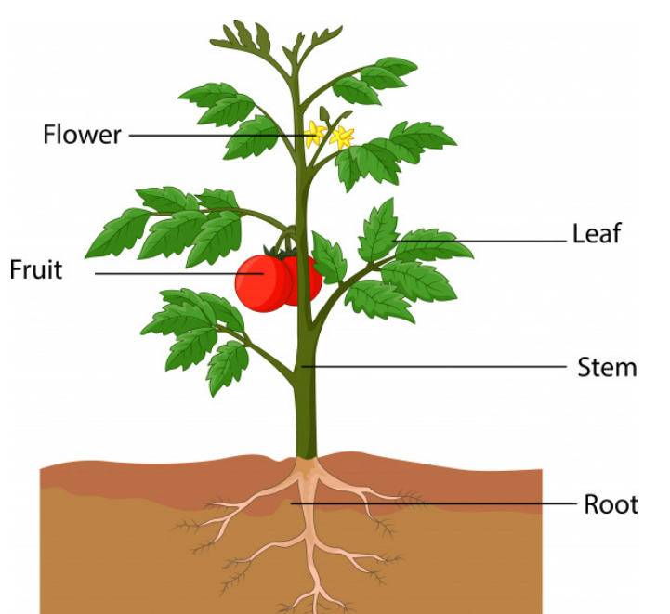
Spring Partnership Knowledge Organiser
Science Focus | Plants and Growth | Year 1 | Summer 1&2
What do I need to learn?
I can Identify and name a variety of common wild and garden plants, including deciduous and evergreen trees. Identify and describe the basic structure of a variety of common flowering plants, including trees.
Oracy – key questions for discussion
What is going on? Seasons
Have you ever? Grown plants or seeds? Spotted a flower you really like?
Which is the odd one out? Why?
What have we learned before that may help us?
How to plant seeds and care for growing plants. Understand the key features of the life cycle of a plant and an animal. Begin to understand why we should care for the natural environment and all living things. Explore the natural world around them. Recognise some environments that are different to the one in which we live.
Diagrams/Pictures
Key vocabulary
Leaf, flower, blossom, petal, fruit, berry, root, seed, trunk, branch, stem, bark, stalk, bud deciduous, evergreen Names of trees in the local area Names of garden and wild flowering plants in the local area
The 5 Enquiry Skills – What skills have you used?
Pattern Seeking, Identifying, Classifying and Grouping, Comparative and Fair Testing, Research using Secondary Sources, Observation over time

