Slide 1
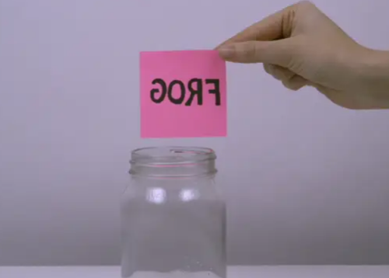
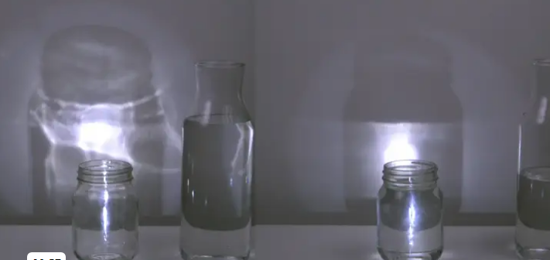
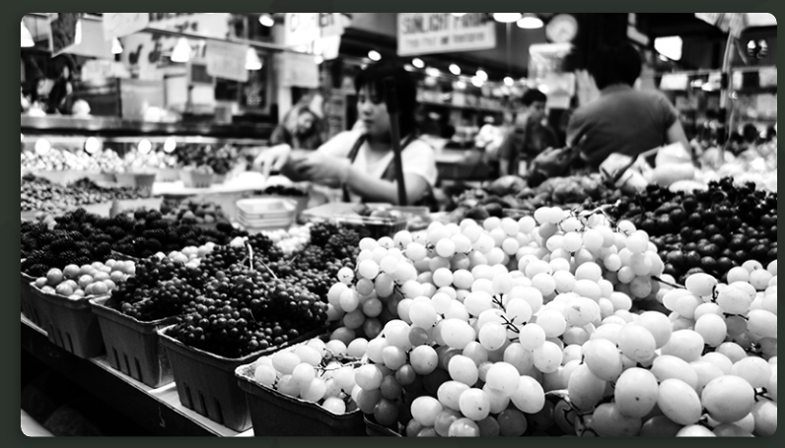
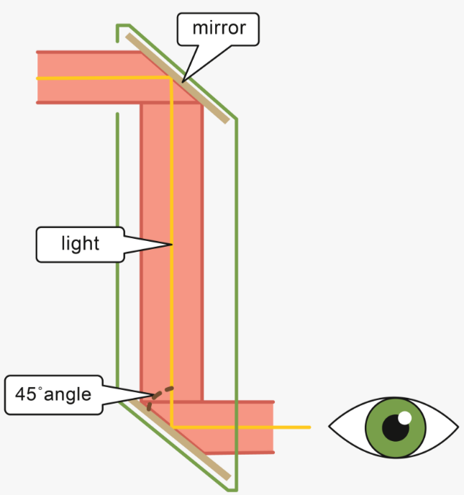
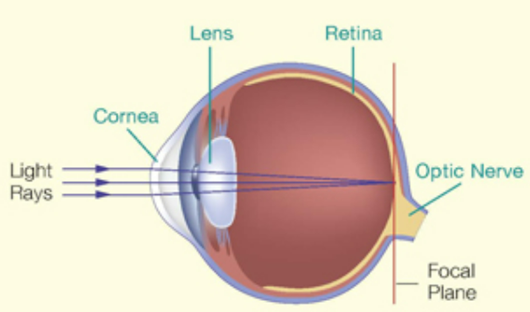
Spring Partnership Knowledge Organiser
Science Focus | Light | Year 6 | Spring 2
What do I need to learn?
I can explain that Light travels in straight lines Light travels from a light source to an object, and then to our eyes We see different colour objects because they reflect different colour light back into the eye. A shadow is formed when light is blocked Shadows are the same shape as the object that casts them because light travels in a straight line The lower the angle of the light source, the longer the shadow.
Oracy – key questions for discussion
What is going on? – Back to Front What is going on? Find your focus
What if – we couldn’t see colours?
Problem solvers - See round the bend Use everyday materials to make something to see round corners!
What have we learned before that may help us?
• Recognise that they need light in order to see things and that dark is the absence of light. • Notice that light is reflected from surfaces. • Recognise that light from the sun can be dangerous and that there are ways to protect their eyes. • Recognise that shadows are formed when the light from a light source is blocked by an opaque object. • Find patterns in the way that the size of shadows change. • Compare and group together everyday materials on the basis of their properties, including their hardness, solubility, transparency, conductivity (electrical and thermal), and response to magnets.
Diagrams/Pictures
Key vocabulary
light, light source, Sun, sunlight, dangerous, reflection, blocks, shadow, absorb, refract, angle, straight lines, light rays, longer, shorter,
The 5 Enquiry Skills – What skills have you used?
Pattern Seeking, Identifying, Classifying and Grouping, Comparative and Fair Testing, Research using Secondary Sources, Observation over time

