Slide 1
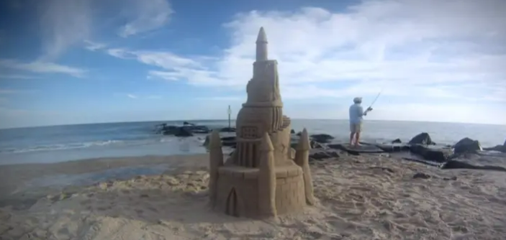
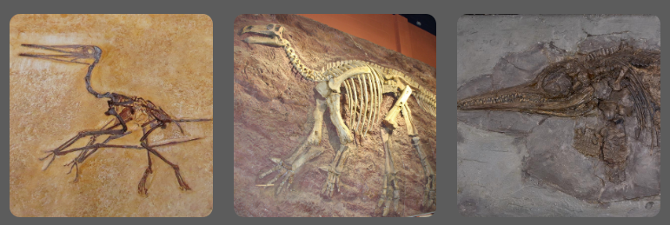

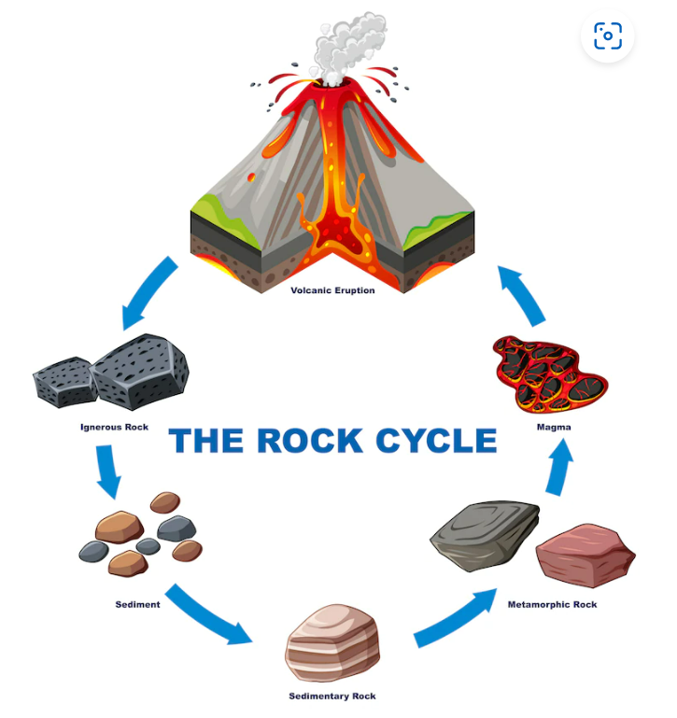
Spring Partnership Knowledge Organiser
Science Focus | Rocks | Year 3 | Spring 2
What do I need to learn?
I can Compare and group together different kinds of rocks on the basis of their appearance and simple physical properties. Describe in simple terms how fossils are formed when things that have lived are trapped within rock. Recognise that soils are made from rocks and organic matter.
Oracy – key questions for discussion
Have you ever picked up a rock you found and put it in your pocket to take home?
What’s going on? Sandcastle
Which is the odd one out? Why?
What have we learned before that may help us?
Distinguish between an object and the material from which it is made Identify and name different materials, including wood, plastic and glass Describe the physical properties of everyday materials. Compare and group materials on their physical properties Identify and compare the suitability of a everyday materials with their uses.
Diagrams/Pictures
Key vocabulary
rock, stone, pebble, boulder, grain, crystals, layers, hard, soft, texture, absorb water, fossil, bone, metamorphic igneous sedimentary flesh, minerals, marble, chalk, granite, sandstone, slate, soil, types of soil clay)
The 5 Enquiry Skills – What skills have you used?
Pattern Seeking, Identifying, Classifying and Grouping, Comparative and Fair Testing, Research using Secondary Sources, Observation over time

