Slide 1
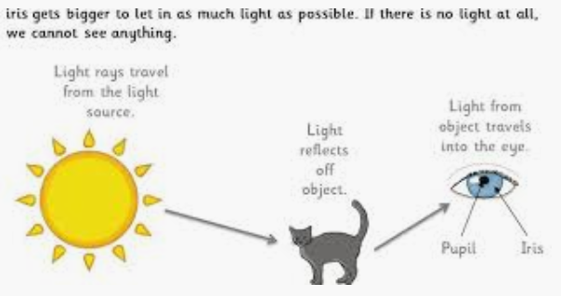
Midfield Primary School – Knowledge Organiser
Science Focus | Light | Year 3
What? (Key Knowledge)
Light sources | Places from which light is emitted: e.g. Sun, candles, torches, fire, etc
Ray model of light | Light travels in straight lines.
Seeing an object | When light reaches an object, it can be absorbed, or it can pass through the object or it can be reflected. Light can be scattered in all directions. Light colours reflect more light than darker colours. White objects reflect nearly all light. Black reflects very little light.
Transparent translucent opaque | Light passes through some materials and not others. Light passes through transparent materials (objects are not ‘see through’ – light passes through the material). Light passes through translucent materials but the light source is not clear. No light passes through opaque materials.
Shadows | Light is reflected of an object. The area that the light is therefore unable to reach is called a shadow.
Apparent movement of the Sun | Where the Sun is seen in the sky depends upon the rotation of the Earth on its axis. How long we see the Sun each day depends upon the seasons which are created by the tilt of the Earth on its axis.
Statutory requirements
- Recognise that they need light in order to see things and that dark is the absence of light - Notice that light is reflected from surfaces - Recognise that light from the sun can be dangerous and that there are ways to protect their eyes - Recognise that shadows are formed when the light from a light source is blocked by a solid object - Find patterns in the way that the sizes of shadows change.
What? (Key vocab)
Spelling | Definition
Shadow | Shadows are formed when objects block a source of light.
Transparent | A material that allows light to pass through so that objects behind can be distinctly seen.
Translucent | A material that allow some light, but not detailed shapes, to pass through; semi-transparent.
Opaque | A material that blocks all light so is not able to be seen through; not transparent.
Reflection | When light from an object is reflected by a surface, it changes direction. It bounces off the surface at the same angle as it hits it.
Refraction | Refraction is the bending of light as it passes from one substance e.g. water, to another.
Possible experiences
Make shadow puppets – try using different colours of paper or card, not just black to challenge misconceptions about shadows. Does blue paper cast a blue shadow? Try using other materials that are transparent but have a colour (like cellophane sweet wrappers), translucent (like tissue paper or wipe oil over paper) or opaque (like card). Make a periscope to see over walls or round corners. This works because rays of light hit the mirror of the periscope and are reflected twice. The beam of light is reflected through 90 degrees, because the mirrors are at a 45 degree angle to the path of the light ray.
Diagrams

