Slide 1

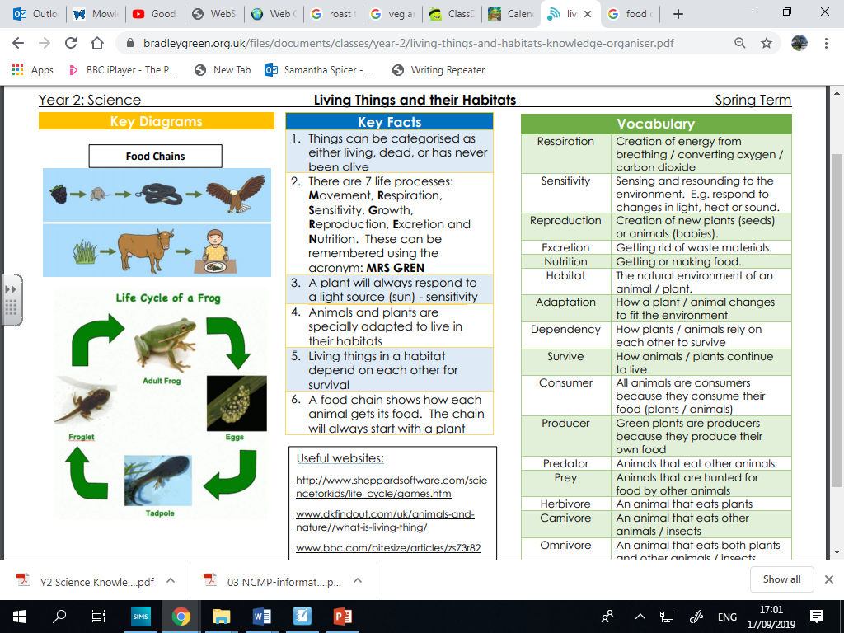
Midfield Primary School – Knowledge Organiser
Science Focus | Living Things and Their Habitats | Year 2 | Autumn 1
What? (Key Knowledge)
Is it alive? | Things can be categorised as either living, dead, or has never been alive.
How do we know? | There are 7 life processes: Movement, Respiration, Sensitivity, Growth, Reproduction, Excretion and Nutrition. These can be remembered using the acronym: MRS GREN
Sensitivity | Sensing and resounding to the environment. E.g. respond to changes in light, heat or sound.
Adaptation | Animals and plants are specially adapted to live in their habitats.
What do organisms need? | Animals need air, food, water, and shelter. Living organisms depend on each other and on their environments, or habitats, to meet their needs for survival.
Food chain | A food chain shows how each animal gets its food. The chain will always start with a plant.
Statutory requirements
Explore and compare the differences between things that are living, dead, and things that have never been alive Identify that most living things live in habitats to which they are suited and describe how different habitats provide for the basic needs of different kinds of animals and plants, and how they depend on each other. Identify and name a variety of plants and animals in their habitats, including micro-habitats Describe how animals obtain their food from plants and other animals, using the idea of a simple food chain, and identify and name different sources of food.
What? (Key vocab)
Spelling | Definition
Habitat | A home of plants and animals. E.g. Woodland, ocean, pond, meadow, log pile, river, lake, beach, cliff, desert, grassland, mountains.
Micro-habitat | A very small habitat. E.g. A log that woodlice live under or leaf litter.
Food chain | A food chain shows how living things are linked through their food. It starts with a plant.
Organism | Any living creature, plant or animal.
Trees | Deciduous or evergreen.
Wild flowering plants | E.g. Coltsfoot, daisy, dandelion, red clover, shepherd’s purse.
Pond animals | E.g. Pond skater, pond snail, leech, common frog, smooth newt.
Invertebrates | E.g. Snail, slug, woodlouse, spider, beetle, fly.
Pictures and diagrams
Possible experiences
Exploring the school grounds or Scadbury Park as a habitat. What birds or animals can be spotted? What plants are growing here? Can they see evidence of a food chain in action e.g. cracked snail shells, owl pellets. Going on a mini-beast hunt in the local area: looking under stones, logs, around trees and around ponds.

