Slide 1
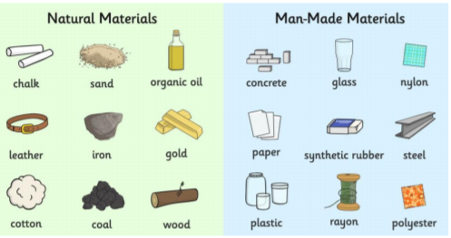
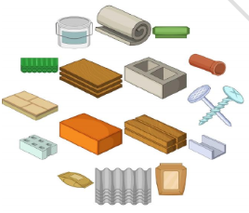
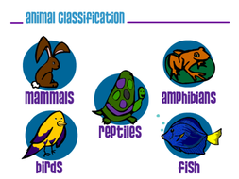
St Mary Cray Primary Academy – Knowledge Organiser
Science Focus | Everyday materials | Year 1 | Summer 2
What? (Key Knowledge)
Materials | Materials are all the ‘stuff’ that objects are made from. We create objects by treating and shaping materials in different ways.
Properties | All materials have characteristics that we associate with them. These are their properties. Properties of materials can be changed through heating, cooling and other methods.
We can use our 5 senses to explore materials | Our 5 senses are: touch, taste, smell, sight and hearing. We touch using our skin (usually our hands) We taste using our tongues by putting something in our mouth We smell by using our nose We see using our eyes We hear using our ears
Statutory requirements
Distinguish between an object and the material from which it is made. Identify and name a variety of everyday materials, including wood, plastic, glass, water and rock. Describe the simple physical properties of a variety of everyday materials. Compare and group together a variety of everyday materials on the basis of their physical properties.
What? (Key vocab)
Spelling | Definition
Material | The matter from which a thing is or can be made. Examples include: wood, plastic, glass, metal, water, rock, brick, fabric, sand, paper, flour, butter, milk, soil.
Property | An attribute, quality or characteristic of something. Examples include: hard/soft, stretchy/not stretchy, shiny/dull, rough/smooth, bendy/not bendy, transparent/not transparent, sticky/not sticky.
Texture | The feel, appearance, or consistency of a surface or a substance. Examples include: smooth, rough, sharp, abrasive.
State | The physical condition of something. Examples include: solid, liquid, gas.
Pictures and Diagrams
Possible experiences
Finding and classifying objects around the classroom according to the material from which they are made Feely bags of different textures to explore Sorting objects according to property Observing changes in materials through heating and cooling (freezing water to make ice, melting chocolate, ‘Will it melt?’ experiments) Observing changes through cooking (baking biscuits, making ice cream) Simple tests (making the best umbrella, Humpty Dumpty crash mats)

