Slide 1

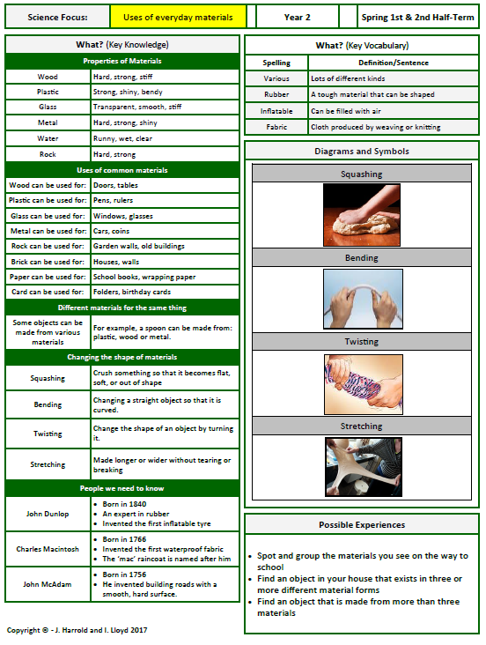
Midfield Primary School – Knowledge Organiser

