Slide 1

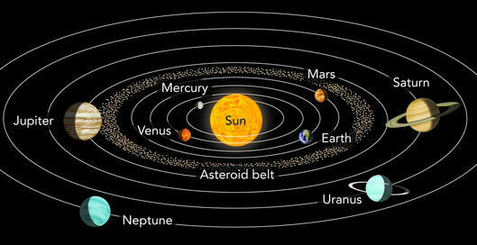
Midfield Primary School – Knowledge Organiser
Science Focus | Earth and Space | Year 5 | Autumn 1
What? (Key Knowledge)
The Earth and the Sun
WARNING It is not safe to look directly at the Sun, even when wearing sunglasses.
What is the Sun? | The Sun is the star at the centre of our solar system
What is the solar system? | The solar system as 8 planters: Mercury, Venus, Earth, Mars, Jupiter, Saturn, Uranus and Neptune.
How is the Earth related to the Sun? | The Earth obits (goes around) the Sun. The Earth takes one year to orbit the Sun. The Earth is held in its orbit by the Sun’s gravitational pull.
The Moon and the Earth
What is a moon? | A moon is a celestial body that orbits a planet The Earth has one moon; Jupiter hs 4 large moons and numerous small ones
How is the Moon related to the Earth? | The Moon orbits the Earth. It takes about 298 days for the Moon to orbit the Earth. The Moon is held in its orbit round the Earth by Earth’s gravitational pull.
Why does the Moon change shape? | IT DOESN’T, it just appears to change shape. The half of the Moon that points toward the Sun looks bright because it is lit by sunlight. The Moon appears to change shape because we see different amounts of the lit part as the Moon orbits Earth. ... As it moves around Earth, more and more of the lit side comes into view.
The rotation of the Earth
How else does the Earth move? | The Earth spins on it’s own axis The Earth takes 24 hours (1 day) to completely rotate on its axis
What causes day and night? | The Earth spins once a day The side of the Earth facing the Sun is in daytime The side of the Earth facing away from the Sun is in night time.
What causes sunrise and sunset? | The Sun doesn’t move – it’s us that moves Because the Earth is rotating, the Sun appears to move across the sky as the day goes on.
Pictures and Diagrams
What? (Key vocab)
Spelling | Definition
Solar | Relating to the Sun
Orbit | The curved path of an object around a star or planet
Axis | An imaginary line around which something moves
Rotating | Moving in a circle around an axis
Gravitational | Moving towards the centre of gravity
Possible experiences
Use the internet (pen pals) to establish that the time of day is different in different places in the world. Create a working model of the solar system Make shadow clocks or sundials

