Slide 1
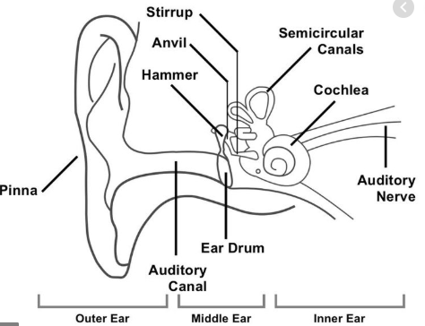
Leesons Primary School – Knowledge Organiser
Science Focus | Sound | Year 4 | Spring 1
What? (Key Knowledge)
Sound is a form of energy. | Sound energy travels in the form of waves. Unlike light energy, sound cannot travel through a vacuum, because there are no atoms to transmit the vibration.
Sounds are made when something vibrates. | The vibrating object pushes the air out in waves, which are not like waves in water (up-and-down), but horizontally spreading outwards from the source. Particles of air knock into ones next to them. Each particle moves only a short way, with energy being transferred as a series of pulses (squashed and then spread out).
Vibrations from a sound travel through a medium to the ear. | Sounds can travel through solids, liquids and gases. Sound travels faster in water and loses its energy less rapidly than in air. Sound travels more quickly through solids and liquids than through gases.
Sounds get fainter as the distance from the sound source increases. | When you are standing close to an alarm clock, it seems quite loud. As you move away from the clock, the alarm sounds quieter, so our distance from the source of a sound will affect how loud it seems.
How we can use a scientific enquiry to answer a question. | Choosing a suitable scientific enquiry., i.e. Observations. Fair testing. Sorting and classifying. Secondary sources. Choosing equipment. Collecting data. Measuring. Recording. Analysing data. Making improvements.
Statutory requirements
Pupils should be taught to: Identify how sounds are made, associating some of them with something vibrating Recognise that vibrations from a sound travel through a medium to the ear. Find patterns between the pitch of a sound and features of the object that produced it Find patterns between the volume of a sound and the strength of the vibrations that produced it. Recognise that sounds get fainter as the distance from the sound source increases.
What? (Key vocab)
Spelling | Definition
vibrations | Quickly moving back and forth or up and down.
source | Where something originates or comes from.
pitch | How high or low a sound is.
volume | How loud or quiet something is.
reflection | How sound or light is thrown back by a surface.
absorption | The process of taking something into another substance.
Possible lessons
Survey – What different sounds can be heard? Comparative test – What happens to the sound of the drum when we get further away from it? Using a data logger Problem-solving – Where in the school would be the best places to put fire alarms? Explore – What is a ‘sound’? Modelling - How can we represent a sound wave? Comparative test – How can we alter the loudness of a sound? Explore – How do we change the pitch of a sound? Comparative test – How can we alter the loudness of a sound? How does the height from which a tube is dropped affect the loudness of the sound produced? Does the length of an elastic band affect the pitch of the sound produced?
Diagrams and Symbols

