Slide 1
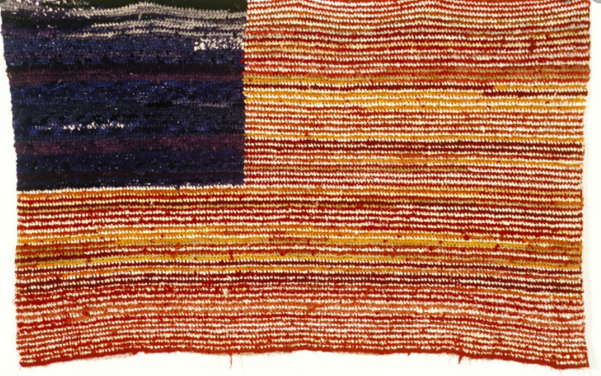
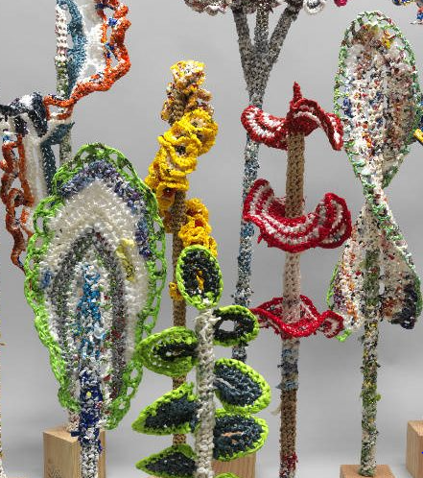

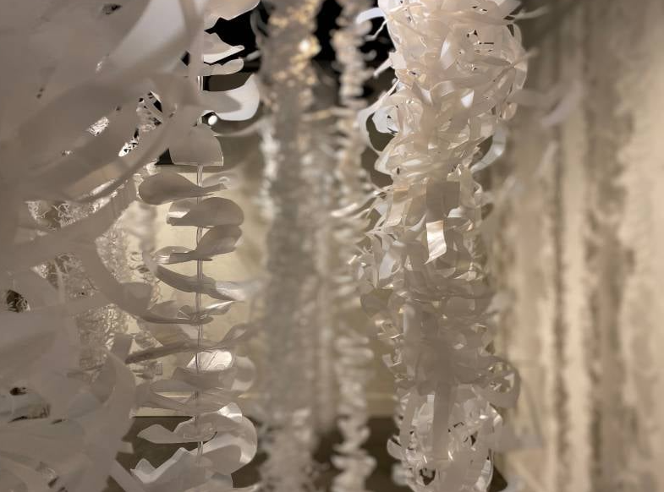
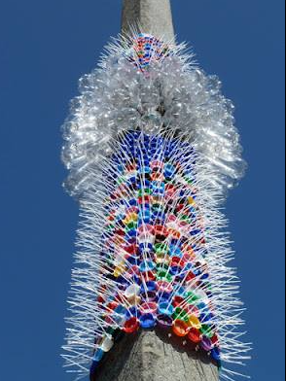
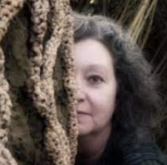
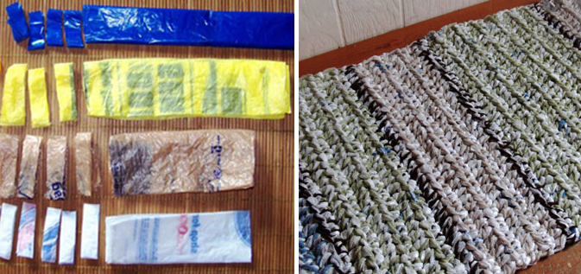
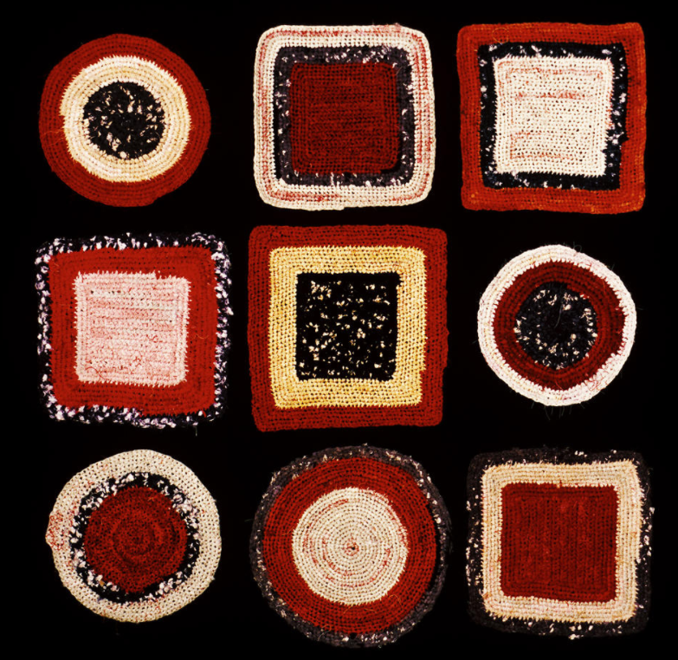
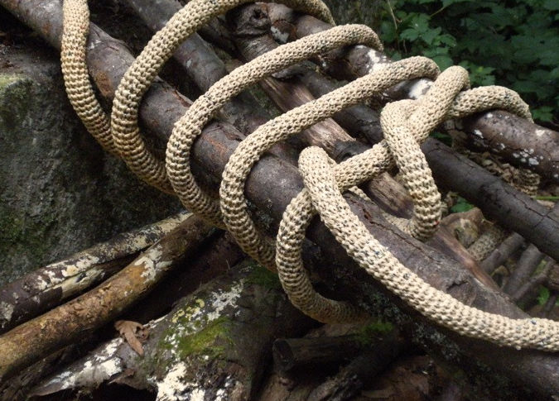
Spring Partnership Trust – Knowledge Organiser
Art Focus | Textiles | Year 6 | Summer 2
Who? Famous Artists
Jerry Bleem | (present day) artist, teacher, writer, Franciscan friar and Catholic priest. Examines what we discard (such as plastics) and transforms it into art. Uses crochet to reconfigure the familiar surface (eg flag) into an unfamiliar, abstracted one. His work serves to highlight the relationship between value and identity, and to consider assumed ideals. Topics ranging from apprehension to beauty, ecology to politics.
Barbara De Pirro | (present day) environmental artist and blogger. Creates mixed media sculptures and installations. Looks into the natural world, nurturing an understanding of our interconnection. Encourages reflection about our relationship with the environment. Uses familiar methods & techniques in unconventional ways, the process of making becomes an art meditation, a time of reflection & healing.
What? Key Skills
To cut materials with precision and refine the finish with appropriate tools with increasing proficiency To select the appropriate cutting, shaping, joining and finishing techniques and apply them accurately. To appreciate how significant artists, makers and designers use textiles effectively in their creative works. To develop experience in embellishing. To apply knowledge of different techniques to express feelings. To work collaboratively on a larger scale.
What? Key vocab
plarn | Yarn made from plastic bags.
yarn | Thread used for knitting, weaving, or sewing.
crochet | A handicraft in which yarn is made up into a textured fabric by means of a hooked needle.
textile | A type of cloth or woven fabric.
embellish | Make more attractive by the addition of decorative details or features.
Pictures and Diagrams

