Slide 1
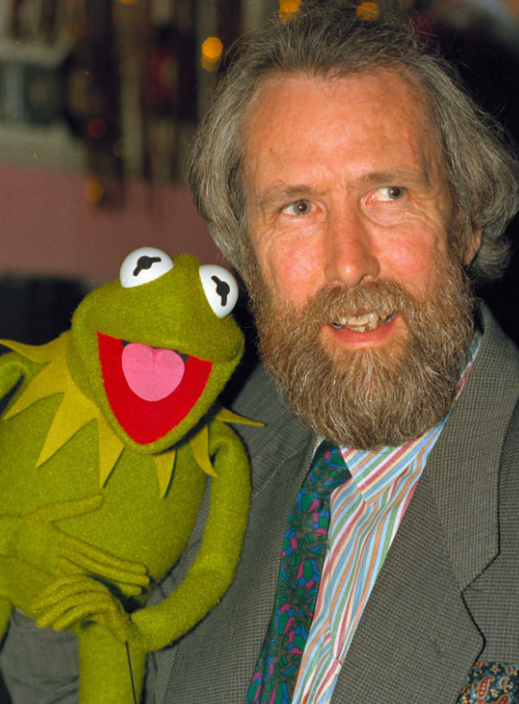
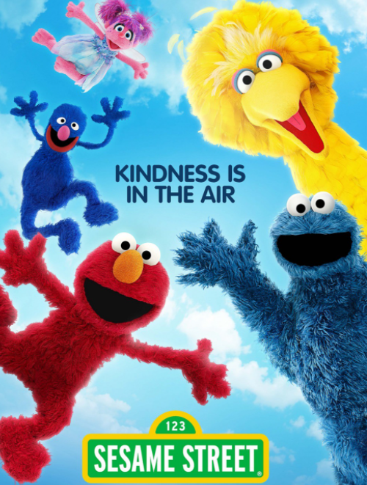
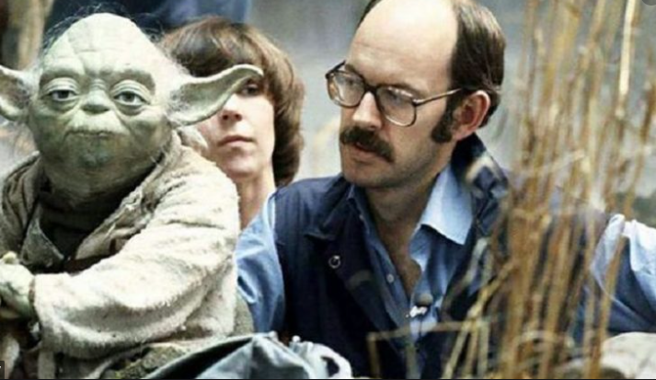
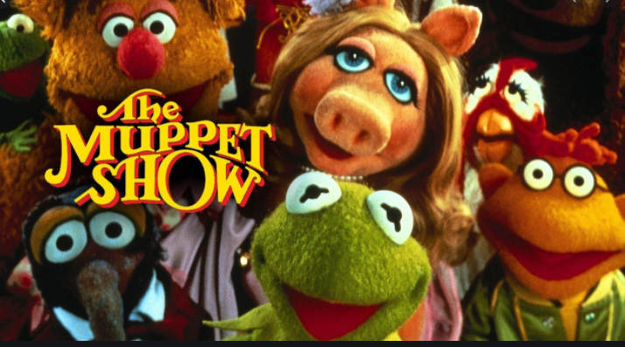
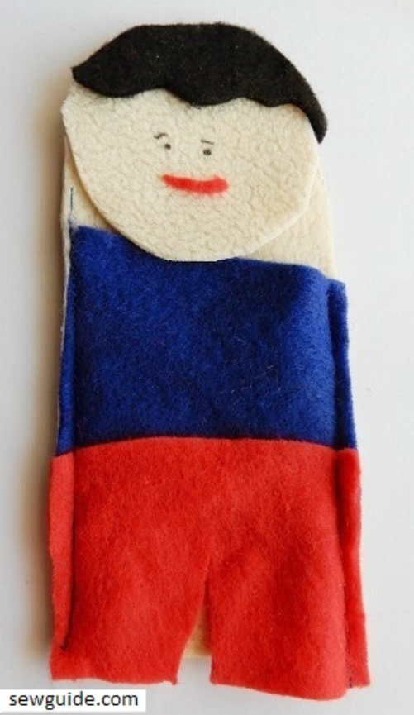
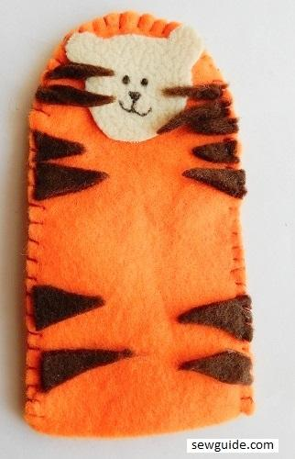
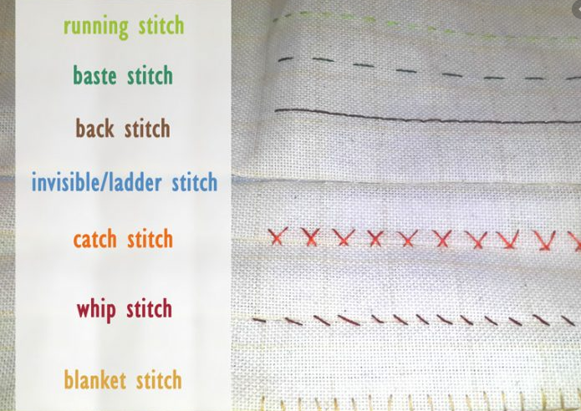
Spring Partnership Trust – Knowledge Organiser
Art Focus | Textiles | Year 4 | Summer 2
Who? Famous Artists
Jim Henson | (1936-1990) American puppeteer and educator. While still in high school he began his television career performing puppets on a local WTOP-TV. During freshman year given his own twice-daily, five-minute show Began work on a ground-breaking educational children's television show called Sesame Street that would premiere in 1969. In 1975, first recording of The Muppet Show developing well-loved characters such as Kermit the Frog. Went on to make animatronic films and TV shows such as Fraggle Rock and Labyrinth.
Frank Oz | (1944-present day), British born puppeteer. Moved to the USA and as a teenager began his puppeteering career at an amusement park. At 17 years old, discovered by Jim Henson. Two years later, Oz moved to New York to work with Henson on a new project, the Muppets and Sesame Street. Best known for Yoda in the Star Wars franchise. Now a successful film and theatre director.
What? Key vocab
design | A plan or drawing produced to show the look and function or workings of a garment, or other object before it is made
thread | A long, thin strand of cotton, nylon, or other fibres.
gather | Come together / assemble
stitch | A loop of thread or yarn resulting from a single pass or movement of the needle.
textile | A type of cloth or woven fabric
What? Key Skills
To explore the properties of different textiles and use tools and techniques to join textiles with appropriate stitching, with increasing proficiency. To explore the properties of different textiles and notice texture, selecting the most appropriate techniques to decorate textiles and add functionality. To appreciate how significant artists, makers and designers use textiles effectively in their creative works.
Pictures and Diagrams

