Slide 1
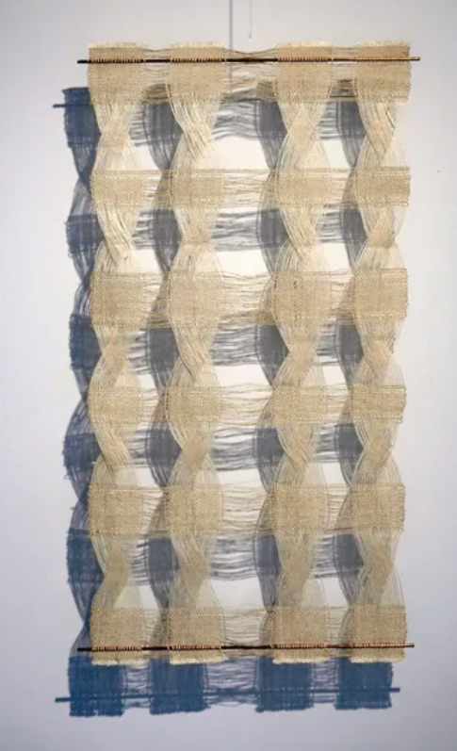
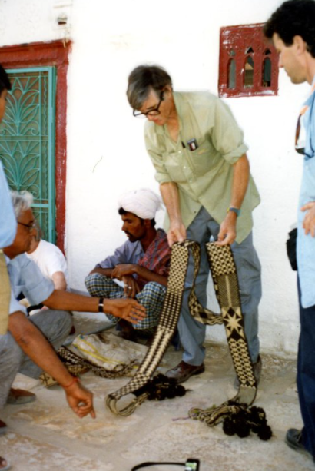
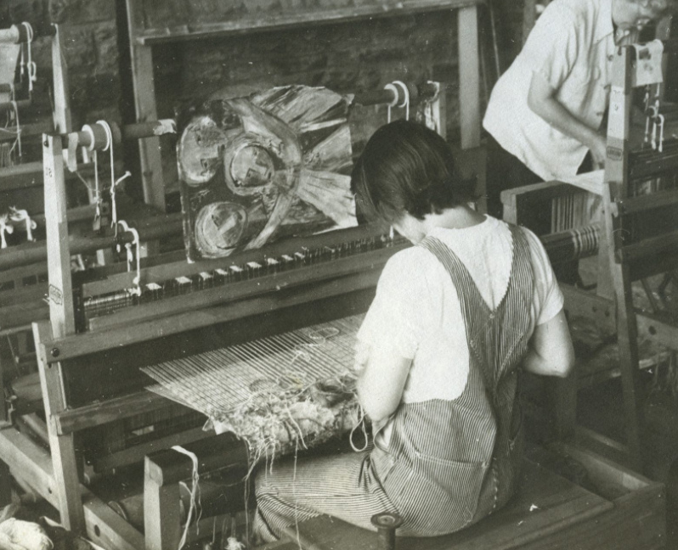
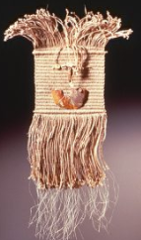
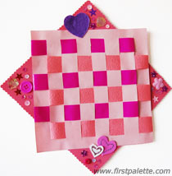
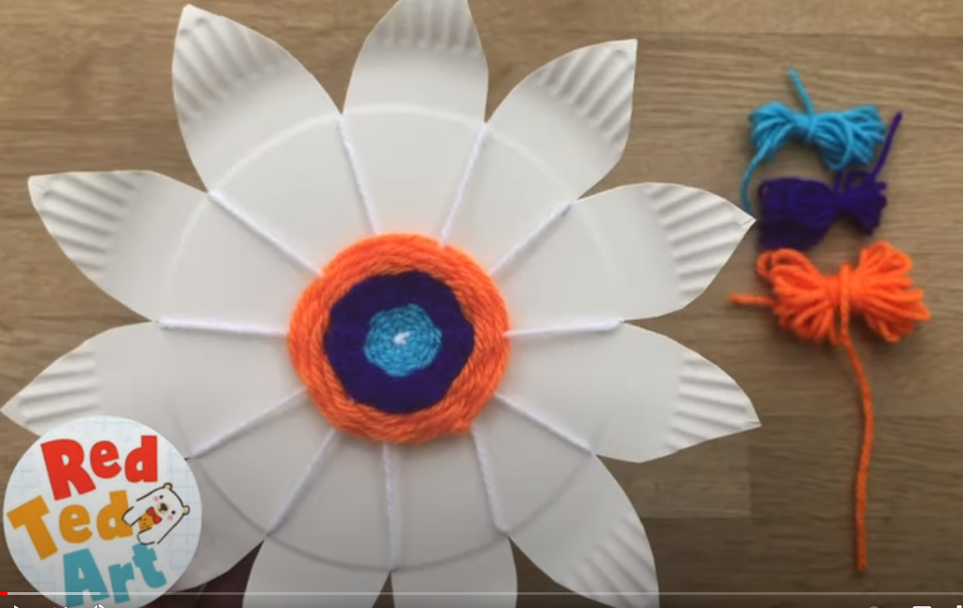
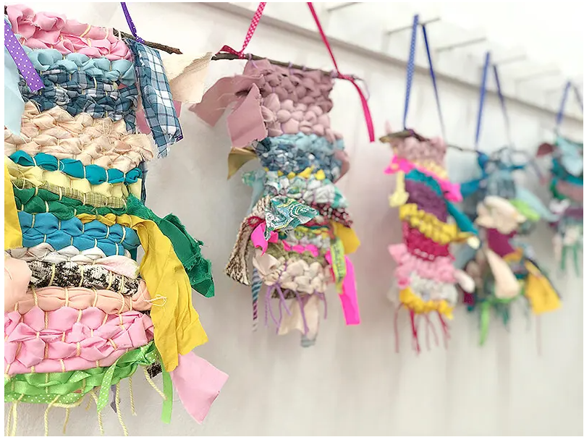
Spring Partnership Trust – Knowledge Organiser
Art Focus | Textiles | Year 2 | Summer 2
Who? Famous Artists
Peter Collingwood | (1922-2008), was the pre-eminent British artist weaver for 50 years. Educated at Epsom college but realised that he was not cut out to be a doctor. Served with Royal Army Medical Corps and a stint with the Red Cross in Jordan. Returned to UK and began training under master weavers. Lifetime of innovative design, inventing looms and effective production methods. Known particularly for Macrogauze wall-hangings.
Lenore Tawney | (1907-2007), was a pioneering American artist. Created a body of innovative woven work that helped to shape the course of fiber art. Known for the highly personal collages, sculptural assemblages, drawings and postcards. Works ranging from intimate to monumental in scale. Ground-breaking sculptural weavings were an important influence in the United States and internationally.
What? Key Skills
To use tools and techniques for textiles – weaving and construction - with increasing proficiency. To sort according to specific qualities, understanding how textiles create things. To notice texture & use this understanding in their own creative work to express their ideas, observations and feelings. To appreciate how significant artists, makers and designers use textiles effectively in their creative works. To shape textiles using templates.
What? Key vocab
weave | Make fabric by interlacing long threads passing in one direction with others at a right angle to them.
textile | A type of cloth or woven fabric.
loom | An apparatus for making fabric by weaving yarn or thread.
warp | The threads on a loom over and under which other threads (the weft) are passed to make cloth.
weft | The crosswise threads on a loom that are passed over and under the warp threads to make cloth.
texture | The feel, appearance, or consistency of a surface or substance.
fabric | Cloth or other material produced by weaving or knitting fibres.
Pictures and Diagrams

