Slide 1
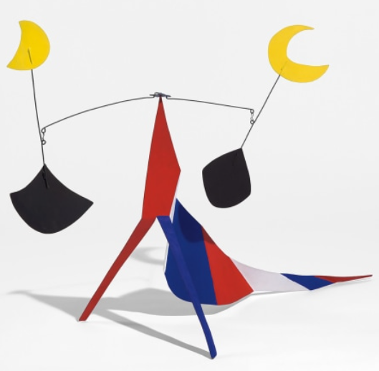
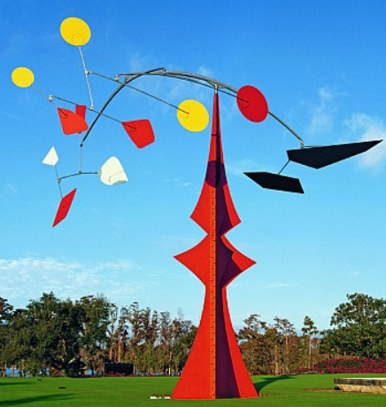
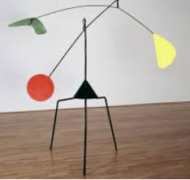
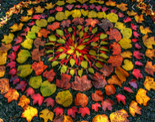
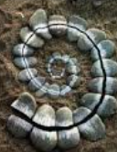
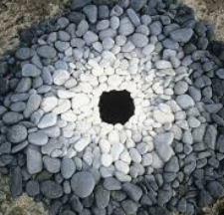
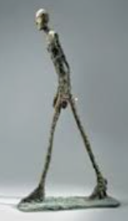
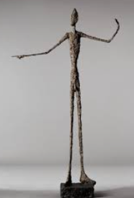
Spring Trust Academy – Knowledge Organiser
Art Focus | Sculpture | Year 5
Who? Focus Famous Artist
Alexander Calder | Born 22nd July 1898– Died 11th November 1976) Alexander Calder was an American sculptor known for his innovative mobiles and public sculptures. He also created paintings, jewellery, theatre sets and costumes His sculptures and mobiles were often made from wire and the mobile relied on careful weighting to achieve balance and suspension in the air
Who? Additional Artists
Andy Goldsworthy | Born :25th July 1956 British sculptor, photographer and environmentalist He lives in Scotland Working as both sculptor and photographer, Goldsworthy crafts his installations out of rocks, ice, leaves, or branches.
Alberto Giacometti | Born :10 October 1901, Died: 11 January 1966 He was a Swiss sculptor, painter and printmaker. He lived and worked mainly in Paris. Giacometti was one of the most important sculptors of the 20th century. He was influenced by artistic styles such as Cubism and Surrealism
What? Key vocab
Suspend | To hang (something) from somewhere
counterbalance | A weight that balances another weight.
mobile | A mobile is a type of sculpture that is formed of delicate components which are suspended in the air and move in response to air or motor power.
texture | Texture refers to the surface in a work of art – how something looks or feels.
Dimension | A measurement of length in one direction. Examples: width, depth and height are dimensions
pattern | A pattern is a design in which lines, shapes, forms or colours are repeated
Shape and form | How artwork is created through lines, textures, colour and shapes.
What? Key Skills
To study the work of artists and sculptures and the effectiveness of their designs. To use tools and techniques for sculpture. To evaluate their own work and success To apply an understanding of dimension (shape and form) To show life-like qualities and real-life proportions when working with different modelling materials eg Modroc, papier mache, wire. To use frameworks and structures to provide stability and form.

