Slide 1
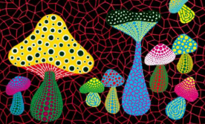
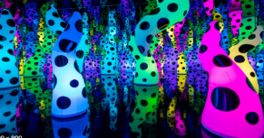
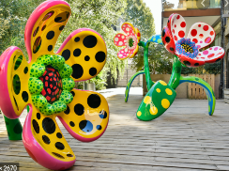
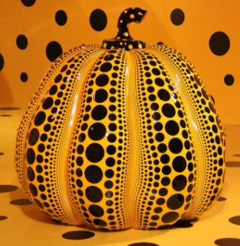
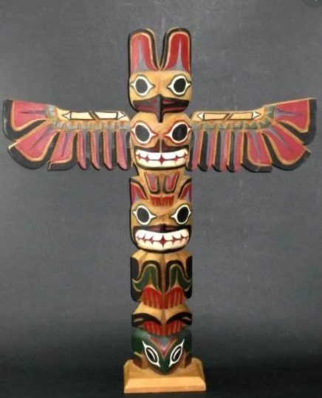
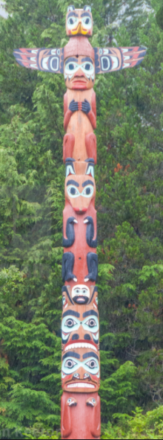
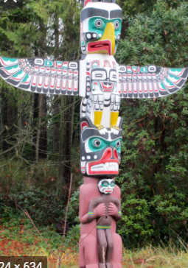
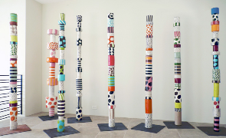
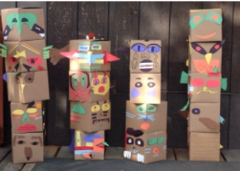

Spring Partnership Trust – Knowledge Organiser
Art Focus | Sculpture | Year 1 | Summer 2
Who? Famous Artists
Yayoi Kusami | She was born in Japan on 22nd March 1929 She works primarily in sculpture, but is also active in painting, performance, film, fashion, poetry, fiction, and other arts She is sometimes called ‘the princess of polka dots'. She loved drawing and painting and although her parents didn't want her to be an artist, she was determined. When she could not afford to buy art materials, she used mud and old sacks to make art. Eventually Yayoi Kusama persuaded her parents to let her go to art school and study painting. In the late 1950s she moved to New York. She had the first of many exhibitions there in 1959
Native American Art | Native American describe the different tribes found across North America. They each have their own unique culture. One of the most common types of art created by Native Americans was pottery Many native tribes also made beautiful carvings. Sometimes they carved bones or animal teeth, or even rocks. These carvings were often of animals like the totem pole. Totem poles were carved with many different faces. They were often used to tell stories or to pass down legends!
What? Key Skills
To use tools and techniques for sculpture – selecting, shaping, assembling, constructing and decorating - with increasing proficiency. To notice shape and form, and apply understanding of dimension in their own creative work to express their ideas, observations and feelings. To appreciate how artists, makers and designers use sculptures effectively in their creative works. To handle, shape and manipulate malleable materials. To create and combine shapes to create recognisable forms.
What? Key vocab
surface | The outside part of something
decorate | Make something look more colourful
roll | To create a cylinder by turning a material over and over on itself
twist | To turn something into a bending or curling shape
join | To link or connect something
Pictures and Diagrams

