Slide 1
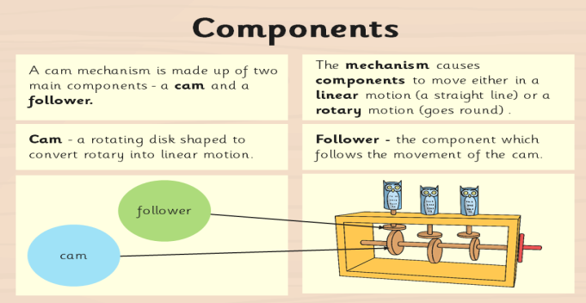
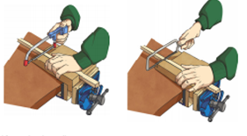
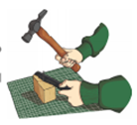
Spring Partnership Trust – Knowledge Organiser
DT Focus | Functioning Products | Year 6
Automata Animals Design Brief The WWF (World Wide Fund for Nature) want to get people interested in caring for the endangered/vulnerable animals which live on our planet. They would like you to create a collection of appealing moving, mechanical animal models that will captivate people’s interest.
What? Key Skills
Design | Make | Evaluate
To design, make and evaluate products that have a clear purpose or intended user. To make products, adapting and refining their design as their work progresses. | To communicate their ideas through discussions, annotated sketches/diagrams, prototypes, pattern pieces and Computer Aided Design (CAD) To select and use a wider range of materials and components, including functional properties, recyclability and aesthetic qualities. To apply their understanding of how to strengthen, stiffen and reinforce more complex structures eg nets, food packaging. To measure and mark out to the nearest millimetre. To select the appropriate cutting, shaping, joining and finishing techniques and apply them with increasing accuracy. To understand and use mechanical systems in their products, eg levers, pneumatics, gears and pulleys, winding mechanisms. | To explore and evaluate a range of existing products, identifying likes and dislikes and suggesting improvements.
Key Vocabulary
Mechanism | A part that controls the other parts of the machine to make it work
Rotary | Motion/movement around a point/axis.
Linear | Motion/movement along a straight line.
Cam | A disk shaped to convert rotary motion into linear motion.
Follower | Mechanisms which are in contact with the shape of the cam. They produce a motion
Cam Shaft | The axle that the cams attached to and rotate around.
Dowel | A peg used for holding together parts of a structure.
Axel | a pin or shaft on or with which a wheel or pair of wheels revolves
Component | A part that will help the whole object work
Key Knowledge
Holding a saw
Holding a hammer

