Slide 1
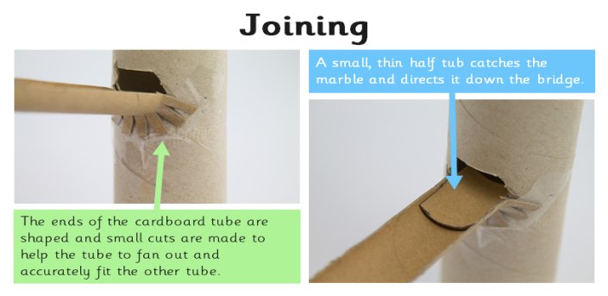
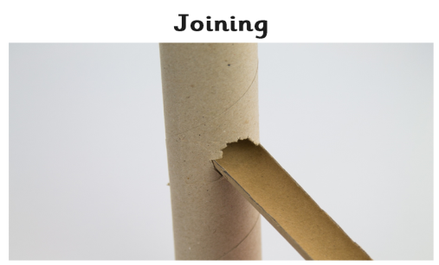
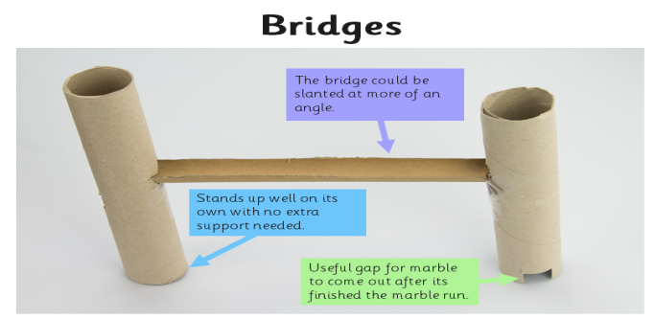
Spring Partnership Trust – Knowledge Organiser
DT Focus | Functioning Products | Year 5
Marble Runs Design Brief Create a free standing marble run including 2 vertical towers, 1 bridge that joins the 2 towers, joins that are strong, tidy and allow the marble to run smoothly
What? Key Skills
Design | Make | Evaluate
To design, make and evaluate products that have a clear purpose or intended user. To make products, adapting and refining your design as your work progresses. To understand what materials and structures are strongest when free standing To explain which aspects of building structures work well and what doesn’t work well and why. To develop an understanding of how marble runs work To explore and understand different structures and when it is best to use them (bridges, bends and speed) | Talk about Health and Safety requirements around using the tools required in this project. To work together to produce a marble run that meets the design brief. Children to be given a choice of materials and the freedom to use any of the techniques that they have learnt To test their own and each other’s marble runs to see if they meet the deign brief. | To explore and evaluate a range of existing products, identifying likes and dislikes and suggesting improvements.
Key Vocabulary
Design | a plan to show the look and function or workings of a product before it is made
Make | create something by putting parts together
Evaluate | to judge the quality of a product and how well it meets the design brief
Strengthen | to make something stronger for its purpose
Bridge | Support and connect 2 sides
Free standing | not attached to or supported by another structure.
Prototype | an original or first model of something from which other forms are copied or developed
Joining | connect things together
Key Knowledge

