Slide 1
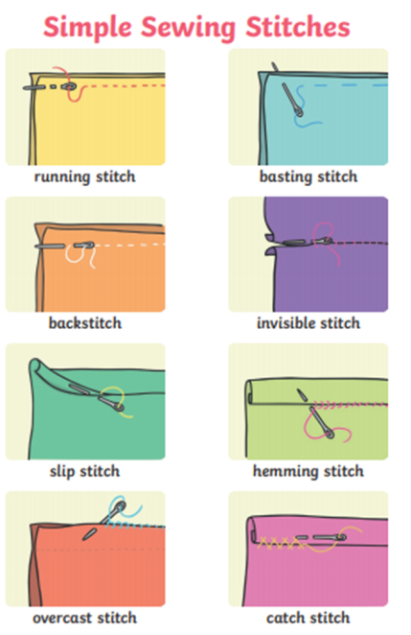
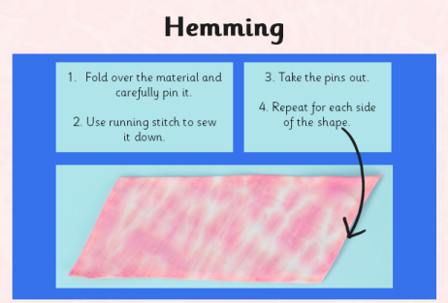
Spring Partnership Trust – Knowledge Organiser
DT Focus | Functioning Product | Year 4
Juggling Balls Design Brief A Toy Shop has asked the class to design and make a set of circus themed juggling balls to sell to children. The juggling balls will be an interesting shape, be colourful, be decorated with a design that appeals to children, fly through the air well, have a circus theme and be high quality.
What? Key Skills
Design | Make | Evaluate
To design, make and evaluate products that have a clear purpose or intended user. To make products, adapting and refining their design as their work progresses. | To communicate their ideas through discussions, annotated sketches/diagrams, prototypes, pattern pieces and Computer Aided Design (CAD) To select and use a wider range of materials and components, including functional properties, recyclability and aesthetic qualities. To apply their understanding of how to strengthen, stiffen and reinforce more complex structures eg nets, food packaging. To measure and mark out to the nearest millimetre. To select the appropriate cutting, shaping, joining and finishing techniques and apply them with increasing accuracy. To understand and use mechanical systems in their products, eg levers, pneumatics, gears and pulleys, winding mechanisms. | To explore and evaluate a range of existing products, identifying likes and dislikes and suggesting improvements.
Key Vocabulary
Design | a plan to show the look and function or workings of a product before it is made
Make | create something by putting parts together
Evaluate | to judge the quality of a product and how well it meets the design brief
Adapting | change something to make it suitable for its purpose
Running Stitch | Small, even stitches that run through the cloth without overlapping
Hemming | To turn under and sew the edge of a piece of material
Tie dye | Producing patterns by tying parts of the material in knots to protect it from the dye
Joining | connect things together
Cutting/ Shaping | to give a particular shape to an object, sometimes through cutting with scissors or other tool
Over cast stitch | a hand sewing stitch that wraps the working thread around the edge of fabric or seams
Key Knowledge

