Slide 1
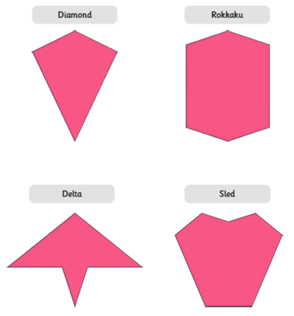
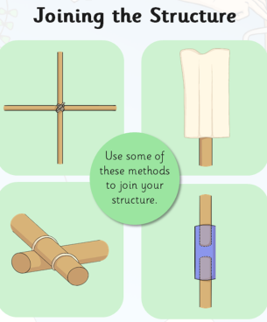

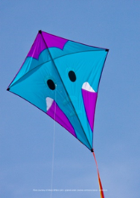
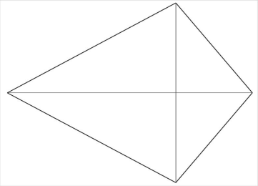

Spring Partnership Trust – Knowledge Organiser
DT Focus | Functioning Product | Year 3
Kites Design Brief To create a kite that is well made and meets the needs of the intended user.
What? Key Skills
Design | Make | Evaluate
To design, make and evaluate products that have a clear purpose or intended user. To make products, adapting and refining their design as their work progresses. | To communicate their ideas through discussions, annotated sketches/diagrams, prototypes, pattern pieces and Computer Aided Design (CAD) To select and use a wider range of materials and components, including functional properties, recyclability and aesthetic qualities. To apply their understanding of how to strengthen, stiffen and reinforce more complex structures eg nets, food packaging. To measure and mark out to the nearest millimetre. To select the appropriate cutting, shaping, joining and finishing techniques and apply them with increasing accuracy. To understand and use mechanical systems in their products, eg levers, pneumatics, gears and pulleys, winding mechanisms. | To explore and evaluate a range of existing products, identifying likes and dislikes and suggesting improvements.
Key Vocabulary
Design Brief | a description of what a new project or product should do and what is needed to produce it
Design | a plan to show the look and function or workings of a product before it is made
Make | create something by putting parts together
Evaluate | to judge the quality of a product and how well it meets the design brief
Adapting | change something to make it suitable for its purpose
Structure | an object or product that is made of more than one part
Strengthen | to make something stronger
Joining | connect things together
Cutting/ Shaping | to give a particular shape to an object, sometimes through cutting with scissors or other tool
Measuring | to use a ruler or measuring device to mark the size of something
Key Knowledge
Kite shapes:
Pictures and Diagrams

