Slide 1
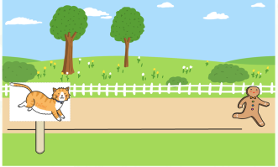
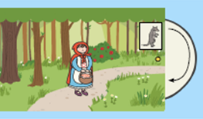
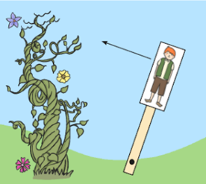
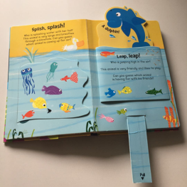


Spring Partnership Trust – Knowledge Organiser
DT Focus | Functioning Product | Year 2
Moving Picture Design Brief To create a moving picture that shows part of a well-known story, includes at least 1 moving part, appeals to young children, is neat and is well made.
What? Key Skills
Design | Make | Evaluate
To design, make and evaluate products that have a clear purpose or intended user. | To make products, adapting and refining their design as their work progresses. To be able to use a range of tools safely and accurately. To explore and use mechanisms in their products eg wheels and axles. To measure and mark out to the nearest centimetre. To demonstrate a range of cutting and shaping techniques, eg tearing, cutting, folding, etc. To demonstrate a range of joining techniques eg gluing, hinges or combining materials to strengthen. | To explore and evaluate a range of existing products, identifying likes and dislikes and suggesting improvements.
Key Vocabulary
Design Brief | a description of what a new project or product should do and what is needed to produce it
Design | a plan to show the look and function or workings of a product before it is made
Make | create something by putting parts together
Evaluate | to judge the quality of a product and how well it meets the design brief
Joining | connect things together
Sliders | a knob or lever that is moved to control something
Levers | a rigid bar resting on a pivot, used to move a heavy or firmly fixed load with one end when pressure is applied to the other
Wheels | a circular object that spins around a point
Cutting/ Shaping | to give a particular shape to an object, sometimes through cutting with scissors or other tool
Measuring | to use a ruler or measuring device to mark the size of something
Product | a thing that is the result of the design and making process
User | a person who uses something
Skills
Sliders Wheels Levers
Pictures and Diagrams

