Slide 1
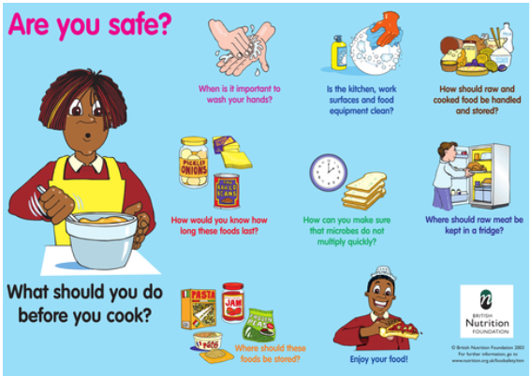
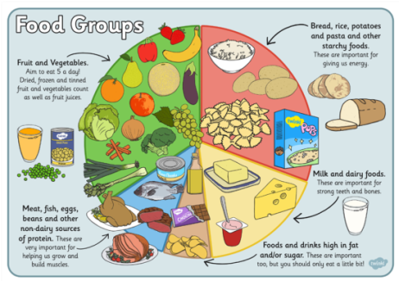
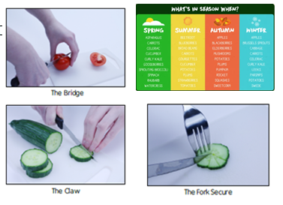
Spring Partnership Trust – Knowledge Organiser
DT Focus | Food | Year 5
Sandwiches Design Brief Create a sandwich or roll that would form part of a healthy balance diet. Your bread should be home made and your filling should include a range of food groups
What? Key Skills
Design | Make | Evaluate
To sample different breads and to identify which bread would be best to use for a sandwich Choose a sandwich filler and discuss taste, food groups, where and how it was sources and if it’s seasonable Understanding of how healthy the sandwich would be (balanced diet) | Awareness and understanding of food hygiene and how to stay safe in the kitchen To follow a recipe and instructions to make bread To make a sandwich filling and applying taught chopping techniques Assemble sandwich | To evaluate what part you found tricky, what you learnt and what would you do differently To check if your design met the brief
Key Vocabulary
Design Brief | a description of what a new project or product should do and what is needed to produce it
Design | a plan to show the look and function or workings of a product before it is made
Make | create something by putting parts together
Evaluate | to judge the quality of a product and how well it meets the design brief
Food groups | a collection of foods that have similar nutritional properties.
Carbohydrates | A food group that gives us energy that is used by the body
Protein | a food group that helps us grow and build muscle
Dairy | a food group that is important for strong teeth and bones
Seasonality | Food that you may find during a particular season
Kneading | Working the dough with your hands
Assembling | To construct, make or build something
Food Hygiene/Safety
Pictures and Diagrams

