Slide 1
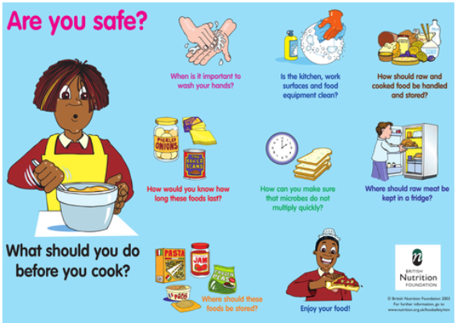
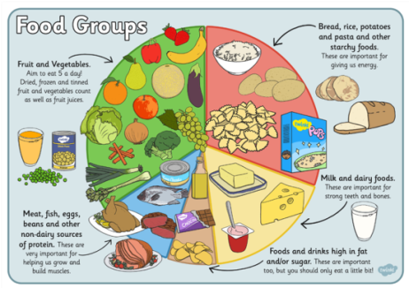
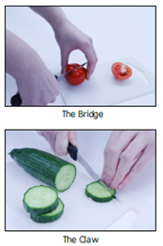
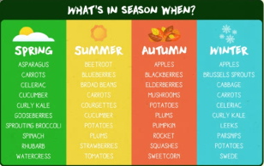
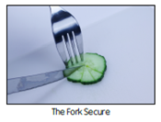
Spring Partnership Trust – Knowledge Organiser
DT Focus | Food | Year 4
Seasonal Meal Design Brief Create a meal that has a balance of ingredients the eat well plate, includes a varied selection of seasonal ingredients, is interesting and tasty and visually appealing.
What? Key Skills
Design | Make | Evaluate
To demonstrate an understanding of where food comes from and seasonality. To demonstrate an understanding of importing and processing | Discuss the important of food hygiene and how to stay hygienic. Discuss and understand how to stay safe To understand different techniques required to make a meal To make a meal in a hygienic and safe environment using a range of techniques | To evaluate what part you found tricky, what you learnt and what would you do differently To check if your design met the brief
Key Vocabulary
Design Brief | a description of what a new project or product should do and what is needed to produce it
Design | a plan to show the look and function or workings of a product before it is made
Make | create something by putting parts together
Evaluate | to judge the quality of a product and how well it meets the design brief
Food groups | a collection of foods that have similar nutritional properties.
Carbohydrates | A food group that gives us energy that is used by the body
Protein | a food group that helps us grow and build muscle
Dairy | a food group that is important for strong teeth and bones
Chopping | cut (something) into pieces with repeated sharp movements of a knife
Seasonality | Food that you may find during a particular season
Rearing | Looking after an animal that is bred for their use, e.g. farming, pleasure, profit
Processing | Preserving food so that it does not go off
Importing | Bringing foods or other goods into a different country from abroad to sell.
Food Hygiene/Safety
Pictures and Diagrams

