Slide 1
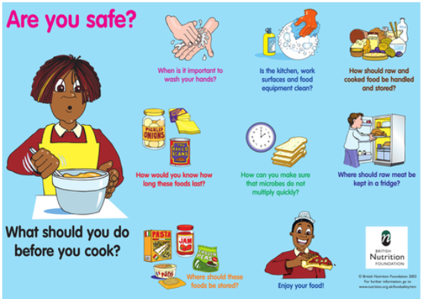
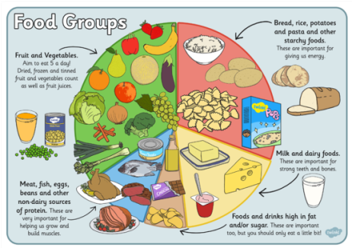
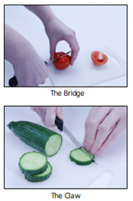
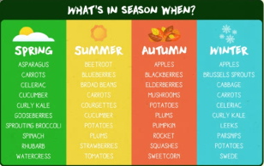
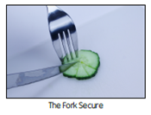
Spring Partnership Trust – Knowledge Organiser
DT Focus | Food | Year 3
Tomato Tart Design Brief Design and make a tasty tomato tart as part of a healthy, balanced meal.
What? Key Skills
Design | Make | Evaluate
To demonstrate an understanding of where food comes from and seasonality. | To follow safe procedures for food safety and hygiene. To measure ingredients to the nearest gram or millilitre accurately. To follow a recipe to assemble or make a healthy meal (controlling timing and the temperature of the oven or hob if cooking).To cut, slice, peel, grate and juice ingredients safely. To be able to use different food preparation techniques, eg cutting (bridge and claw), grating, spreading, etc. | To explore and evaluate a range of existing products, identifying likes and dislikes and suggesting improvements.
Key Vocabulary
Design Brief | a description of what a new project or product should do and what is needed to produce it
Design | a plan to show the look and function or workings of a product before it is made
Make | create something by putting parts together
Evaluate | to judge the quality of a product and how well it meets the design brief
Food groups | a collection of foods that have similar nutritional properties.
Carbohydrates | A food group that gives us energy that is used by the body
Protein | a food group that helps us grow and build muscle
Dairy | a food group that is important for strong teeth and bones
Chopping | cut (something) into pieces with repeated sharp movements of a knife
Baking | cook in an oven
Rolling | to remove the outer coating of skin from fruits or vegetables
Grating | to create small shreds of food by rubbing it on a grater
Measuring | use a device, e.g. scales, to get the right amount of something needed in a recipe
Food Hygiene/Safety
Pictures and Diagrams
Cutting techniques

