Slide 1
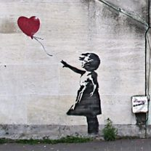
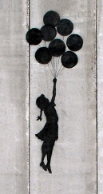
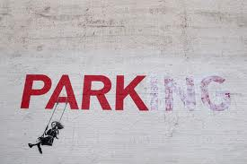
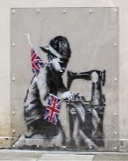
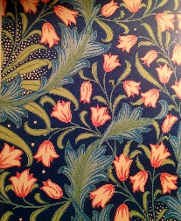
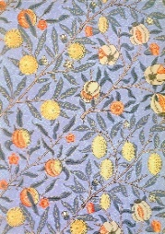
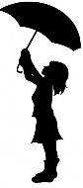

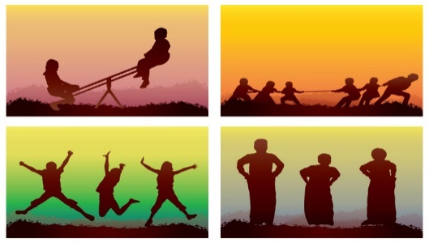
Spring Trust Academy – Knowledge Organiser
Art Focus | Printing | Year 6
Who? Focus Famous Artist
Banksy | Banksy is an anonymous English graffiti artist. That means he keeps his identity hidden. He will not do media interviews, he won’t release his real name, and he will not allow photos or copies of his artwork to be made and sold. Graffiti is writing or drawings scribbled, scratched, or sprayed secretly on a wall or other surface in a public place. It is generally considered to be vandalism. Vandalism is a crime and vandals can be punished. Banksy's works have been featured on streets, walls, and bridges of cities throughout the world. Banksy uses stencils to create his artwork. He draws an outline onto card or acetate sheets and then cuts the shapes out by hand. He then uses spray paint on the stencil to create the graffiti. Banksy's stencils feature striking and humorous images occasionally combined with slogans. Subjects often include rats, apes, policemen, soldiers, children, and the elderly.
Who? Additional Artists
William Morris | William Morris (1834-1896) was one of the most influential designers of the 19th century. His work included wallpaper design and print, furniture, stained glass windows, tiles and tapestries. He was also a writer and campaigner for environmental and social change. Morris endeavoured to use natural materials in his work.
What? Key vocab
Linoleum (lino) | A material consisting of a canvas backing thickly coated with a preparation of linseed oil and powdered cork, used especially as a floor covering.
Lino printing | A print made from a linocut block.
Designer | A person who plans the look or workings of something prior to it being made, by preparing drawings or plans.
Stencil | A picture made by drawing or painting through the holes of piece of card.
Observational drawing | A drawing which requires looking very closely at the subject
What? Key Skills
To study the work of other artists and talk about the techniques they have used. To experiment with approaches used by artists. Combine and design prints. Use of IT to design, discuss and evaluate work and that of others. Using reflection in all four lines of symmetry.
Pictures and Diagrams

