Slide 1
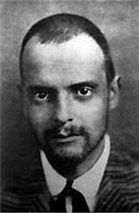
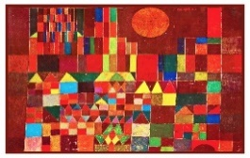

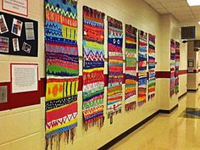
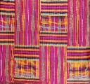
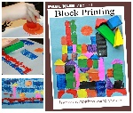
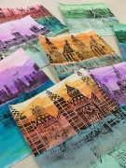
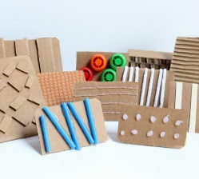
Spring Trust Academy – Knowledge Organiser
Art Focus | Printing | Year 4
Who? Focus Famous Artist
Paul Klee | Paul Klee was born in Switzerland in 1879. Klee died in 1940. As a child, Paul Klee was a very talented violin player and his parents wanted him to be a musician. At 17 Klee enrolled into the Academy of Fine Arts in Munich and got a Degree in Fine Arts. He travelled to Italy to see the famous paintings of the Renaissance. Klee was always worried that he wasn’t a good enough artist because he couldn’t make his pictures look realistic. He experimented with lots of different kinds of artwork, such as etching and drawing on glass. As a young man Klee worked mainly as a graphic designer and illustrator. He was close friends with Wassily Kandinsky, who encouraged him to experiment with new painting styles. Klee visited Tunisia in North Africa in 1914, he was inspired by the landscape and the simple shapes and patterns of African art. Klee spent five years as a soldier in WWI. After the war, his new works became very popular and he became very busy creating and exhibiting his art. He taught at the famous German art school, the Bauhaus. Over his life Klee created over 10,000 works of art
Who? Additional Artists
African Kente Cloth | Kente is a type of silk and cotton fabric made of interwoven cloth strips. Kente is made in the Ashanti Regions. This fabric is worn by almost every Ghanaian tribe. Kente cloth varies in complexity, from a simple design of stripes to highly decorated Kente with patterns woven into every available block of plain weave.
What? Key vocab
Block print | Printing from blocks of wood on which letters or characters have been carved in relief.
Relief | When you carve into a printing block that you then use to press onto paper and make a print.
Stamping | Carving images onto an object which is then pressed in paint or ink and stamped onto paper or fabric.
Tessellation | An arrangement of shapes closely fitted together, without gaps or overlapping.
Stencil | A picture made by drawing or painting through the holes of piece of card.
What? Key Skills
To study the work of other artists and talk about the techniques they have used. To develop ideas from starting points throughout the curriculum. To collect information, sketches and resources in a sketchbook. To create art using repeated patterns, including using digital media and stencilling. To use layers of two or more contrasting colours.
Pictures and Diagrams

