Slide 1
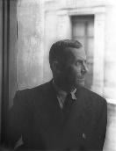
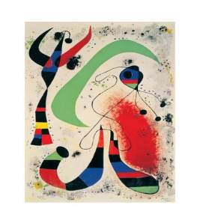
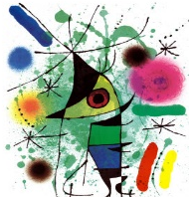
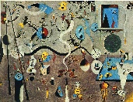
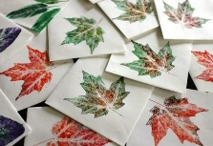
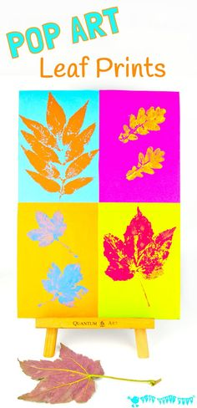
Spring Trust Academy – Knowledge Organiser
Art Focus | Printing | Year 2
Who? Focus Famous Artist
Joan Miro | Born 20 April 1893 – Died 25 December 1983) Spanish painter, sculptor, and ceramicist born in Barcelona. In his lifetime he earned international fame and his work as part of the surrealist movement. Surrealism is dream like imagery that is very imaginative. Joan’s style is unique: he creates organic forms and flattened pictures drawn with a sharp line and filled with strong colours. In his paintings Miró represents peoples with a combination of signs: a triangle for the head, curved lines for the moustache, angular lines for the body and the images are very simplified. Miró also practised ‘automatic drawing’ which was developed by the surrealist painters as a means of expressing the subconscious. In automatic drawing, the hand is allowed to move 'randomly’ across the paper.
Who? Additional Artists
Nature Printing | Nature printing is a printing process, developed in the 18th century, that uses the plants, animals, rocks and other natural subjects to produce an image. The subject undergoes several stages to give a direct impression onto materials such as lead, gum, and photographic plates, which are then used in the printing process.
What? Key vocab
Print | A process which transfers images from a crafted tool onto another surface.
Relief Printing | Relief printing is when you carve into a printing block that you then use to press onto paper and make a print
Rubbing | Placing paper over a textured surface and rubbing over the top to create the pattern
Symmetry | When both sides are the same
Stamping | Carving images onto an object which is then pressed in paint or ink and stamped onto paper or fabric.
Abstract | Abstract art is more about shapes and colours and the feelings it expresses, not about the accurate portrayal of a subject.
Surrealism | Surrealism is dream like imagery that is very imaginative.
What? Key Skills
To study the work of other artists and talk about the techniques they have used. To create their own printing stamps, e.g. using polystyrene tiles. To explore and create their own patterns using pressing, rubbing and stamping techniques. To use printing to represent the natural environment.

