Slide 1
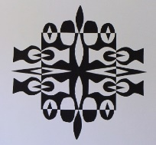
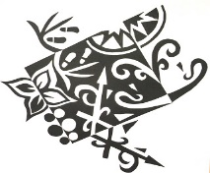
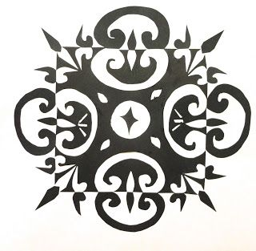
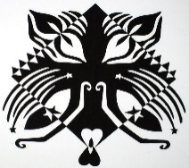
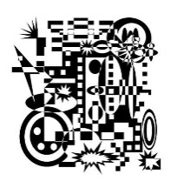
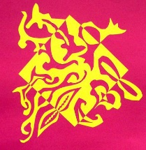
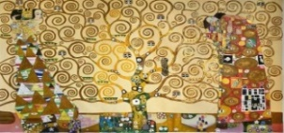
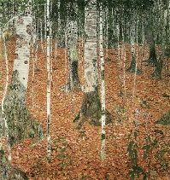
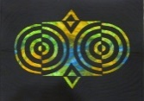
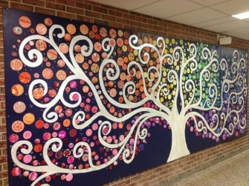

Spring Trust Academy – Knowledge Organiser
Art Focus | Collage | Year 5
Who? Focus Famous Artist
Notan | Nōtan (濃淡) is a Japanese design concept involving the play and placement of light and dark elements Notan is a Japanese word meaning the balance between dark and light. It is also an art form involving papercutting and positive and negative shapes. The Japanese artists begin with black and white paper and cut out shapes and lines to create a unique design. In Japan they have different beliefs and ways of life. They believe in the Buddhist religion. They believe in serving the mind, body, and soul. They also believe in the simplest of things and strong family ties. The Japanese Notan reflects their way of life in that they are simple, use only two colours, are neat, precise, and orderly. Notan can be symmetrical; meaning that it is the same on both sides, or asymmetrical; meaning that all sides are different.
Who? Additional Artists
Gustav Klimt | Gustav was a talented artist from a young age and he attended the Vienna School of Arts and Crafts. In the 1880s, Klimt became well known for his mural painting. Klimt’s art included lots of symbolism: love, death, sin, religion, and disease. Klimt’s paintings also incorporated gold leaf and were very intricate, so they took many hours to complete.
What? Key vocab
Symbolism | The use of symbols to represent ideas or qualities.
Asymmetrical | When the reflected sides are different – antonym to symmetrical
Complementary | Combining elements in such a way as to enhance or emphasize the qualities of each other or another.
Layering | The action of arranging something in layers.
What? Key Skills
To experiment with approaches used by artists. To design and create a collage in response to a stimulus. To select and arrange different materials, combining visual and tactile qualities. To apply knowledge of different techniques as a form of expression.
Pictures and Diagrams

