Slide 1
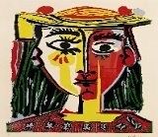
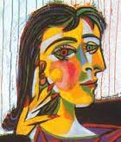
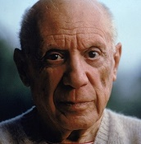
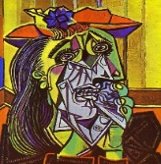
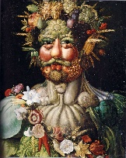

Spring Trust Academy – Knowledge Organiser
Art Focus | Collage | Year 3
Who? Focus Famous Artist
Pablo Picasso | Born 25 October 1881 – Died 8 April 1973 A Spanish painter, sculptor, printmaker, ceramicist, stage designer, poet and playwright who spent most of his adult life in France. Regarded as one of the greatest and most influential artists of the 20th century, he is known for co-founding the Cubist movement. Picasso demonstrated extraordinary artistic talent in his early years, painting in a naturalistic manner through his childhood and adolescence. During the first decade of the 20th century, his style changed as he experimented with different theories, techniques, and ideas. After 1906, Picasso was inspired by the work of the artist Henri Matisse and this motivated him to explore more radical styles. Picasso was thought of as a leader of modern art.
Who? Additional Artists
Giuseppe Arcimboldo Piet Mondrian | Giuseppe Arcimboldo produced many works of art on religious subjects, but he is most well-known for his portraits of people made up of fruit, vegetables and other objects from nature. Mondrian developed a style all of his own. He called it ‘neo-plasticism’. He got rid of everything that he thought was not ‘essential’ and limited his work to what he termed ‘the basic forms of beauty’.
What? Key vocab
Abstract | Abstract art is more about shapes and colours and the feelings it expresses, not about the accurate portrayal of a subject.
Composition | The term composition means "putting together". Composition is the way in which different elements of an artwork are combined or arranged.
Geometric | A geometric pattern is made up of shapes such as squares and triangles.
Cubism | A style of art which aims to show all of the possible viewpoints of a person or object all at once. It is called Cubism because the items look like they are made out of cubes and other geometrical shapes.
Art Movement | A style in art with a specific philosophy, followed by a group of artists during a specific period of time.
What? Key Skills
To study the work of other artists and talk about the techniques they have used. To develop ideas from starting points throughout the curriculum. To collect information, sketches and resources in a sketchbook. To select and arrange materials for a purpose. To understand and make use of coiling, overlapping, tessellation, mosaic and photo-montage. To ensure that work is precise.

