Slide 1
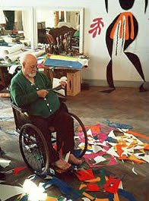
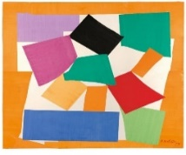
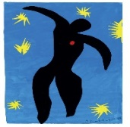
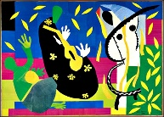
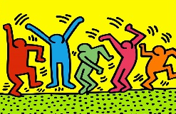
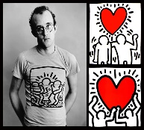

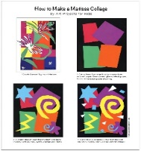
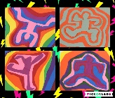
Spring Trust Academy – Knowledge Organiser
Art Focus | Collage | Year 1
Who? Focus Famous Artist
Heri Matisse | Born - 31 December 1869 Died - 3 November 1954 French artist, known for his use of colour and originality In later life Matisse underwent surgery that left him chair and bed bound. Painting and sculpture become physical challenging, so he turned to a new type of medium- collage He would cut sheets of paper into shapes of varying colours and sizes, and arrange them to form lively pieces of art. At first, these pieces were small, but eventually they transformed into murals or room-sized works. The result was very distinct and complex.
Who? Additional Artists
Keith Haring | Keith Haring was an American artist whose pop art and graffiti-like work developed on the streets of New York City in the 1980s. Haring developed a love for drawing at a very early age, learning basic cartooning skills from his father and from studying the drawings of Dr. Seuss and Walt Disney.
What? Key vocab
Technique | A specific way of carrying out a task
Abstract | Abstract art is more about shapes and colours and the feelings it expresses, not about the accurate portrayal of a subject.
Composition | A creative piece of work such as a picture, poem or song
Geometric | A geometric pattern is made up of shapes such as squares and triangles.
Texture | The feel, appearance, or consistency of a surface or a substance.
Layout | The way parts or pieces are positioned.
Silhouette | A silhouette is an image represented as a solid shape of a single colour.
What? Key Skills
To study the work of other artists and talk about the techniques they have used. To select, sort, cut, tear and combine various man-made and natural materials. To develop skills of overlapping and layering. To develop awareness of contrast, texture and colour.
Pictures and Diagrams

