Slide 1
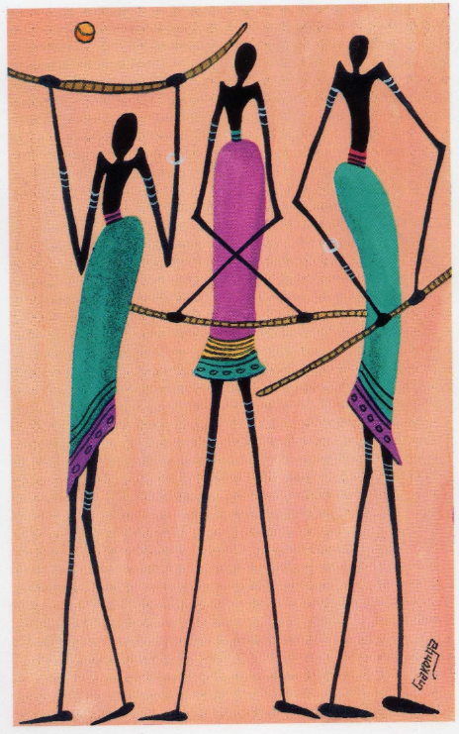
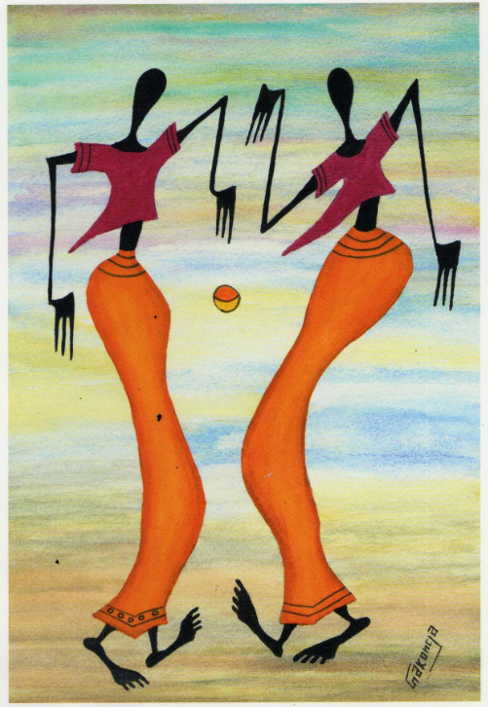
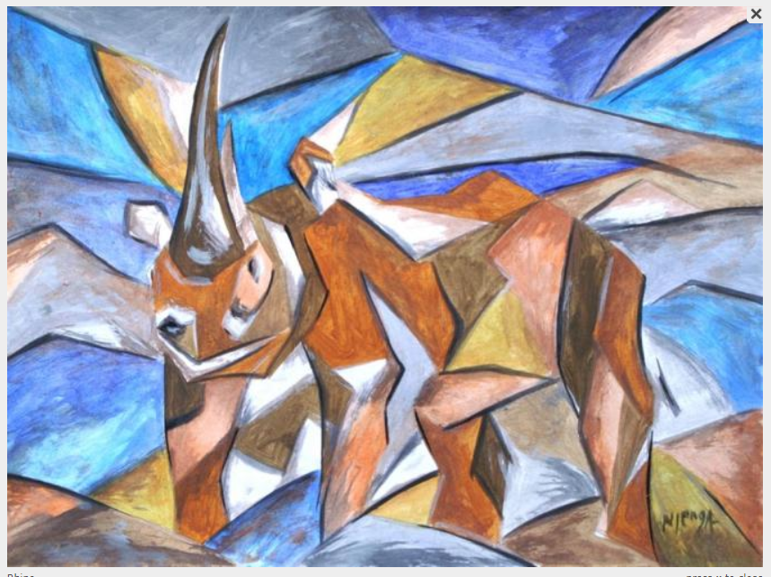
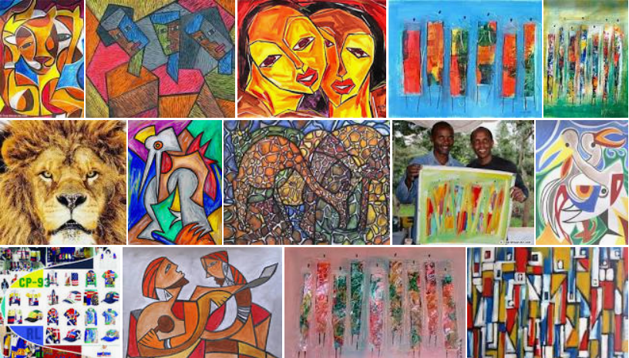
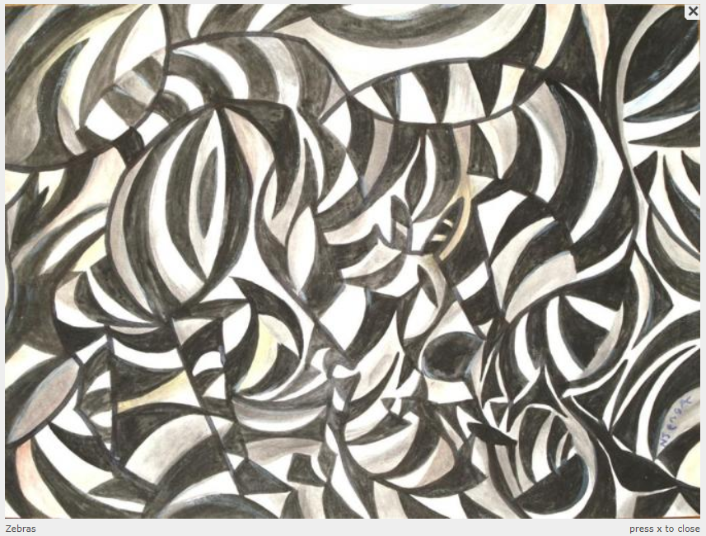
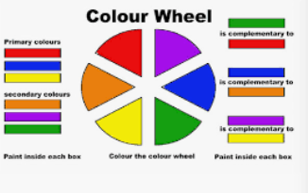
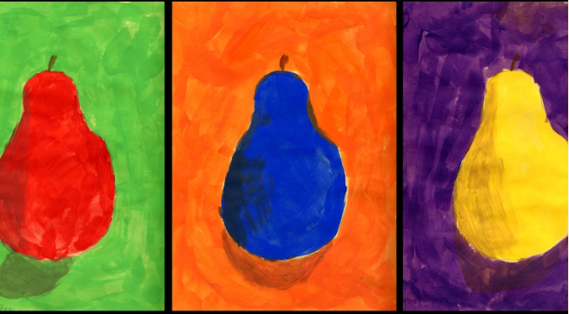
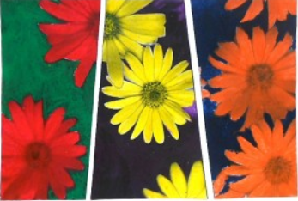
Spring Partnership Trust – Knowledge Organiser
Art Focus | Colour mixing | Year 6 | Autumn 2
Who? Famous Artists
Gakonga | Gakonga is based in London but was born in Kenya near the foot of Mount Kilimanjaro. He began experimenting with plant dyes and sea shells on his father's wise-man mud hut. He is inspired by the colours of his homeland Kenya. The golds and reds of the African sunset and the bright, happy colours of a tribal dance. Gakonga is a trained artist in education, he provides visual Arts and dance workshops to Primary and Secondary schools, Art centres and Community centres. Gakonga runs school workshops and has worked with children and teachers in over 300 schools across the UK.
Stephen Njenga | Born in 1962 in Kenya, Njenga was part of the Kikuyu tribe He uses watercolours, oils and pastels to create semi abstract African paintings. Much of his work is inspired by the Maasai tribe and African wild life. His art uses a variety of texture, colour, shapes and pattern.
What? Key Skills
To study the work of other artists and talk about the techniques they have used. To experiment with approaches used by artists. To mix paints and create a palette based upon colours observed. To combine colour, use tonal qualities and texture to enhance shape and form To develop a personal style of painting, drawing on the ideas and work of other artists.
What? Key Vocabulary
Complementary colours | Colours that are directly opposite on the colour wheel. | Abstract | Abstract art is more about the shapes and colours and the feelings it expresses, not about the accurate portrayal of a subject.
Geometric form | regular shapes,, such as squares, rectangles, circles, cubes, spheres etc. | Composition | The term refers to the arrangement of elements within a work of art.
Pictures and Diagrams
Notes:
https://artboost.com/sjenga/about - short biography of Stephen Njenga
https://trueafricanart.com/pages/stephen-njenga - art of Stephen Njenga

