Slide 1
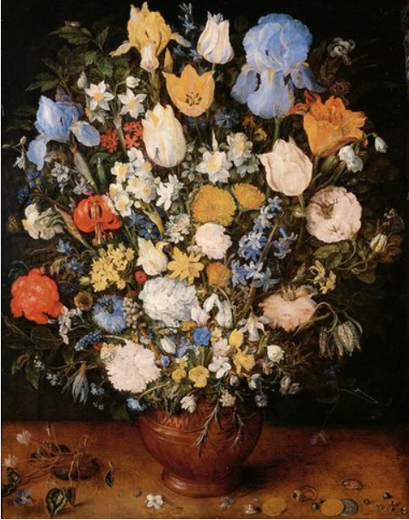
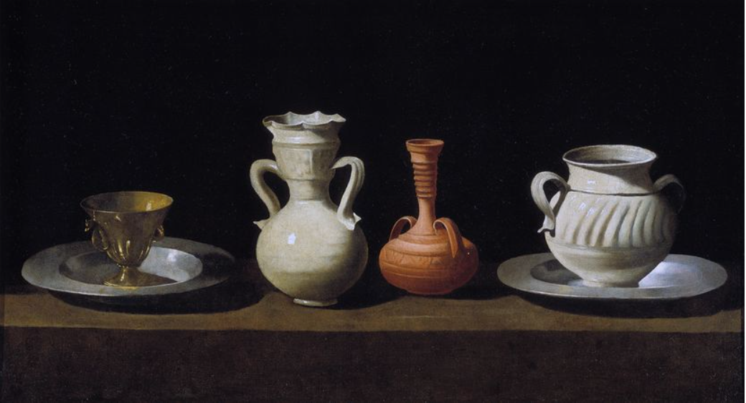
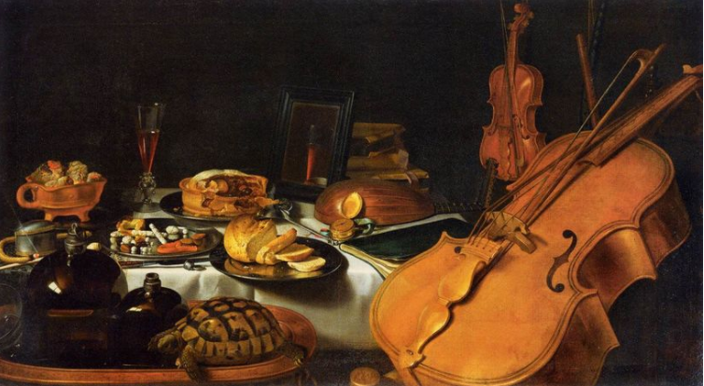

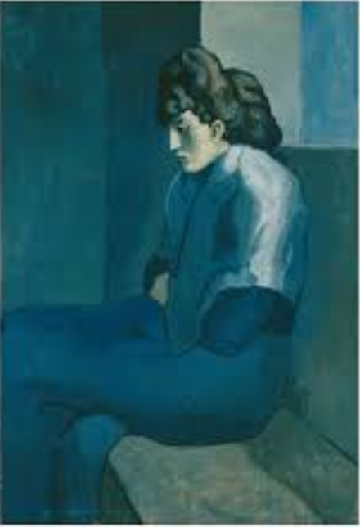
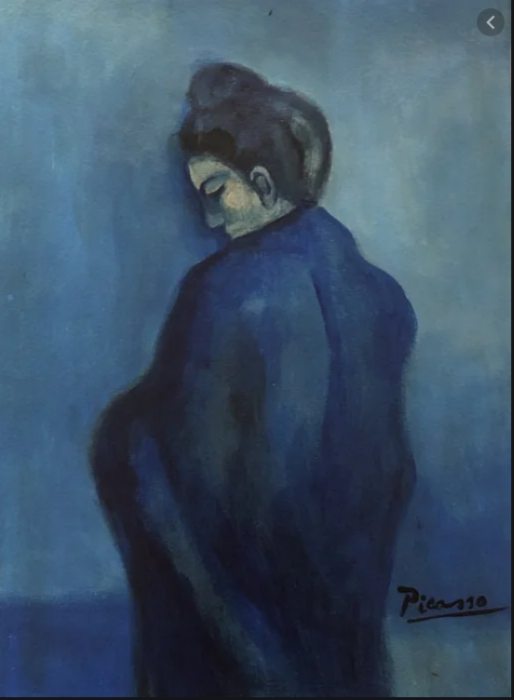
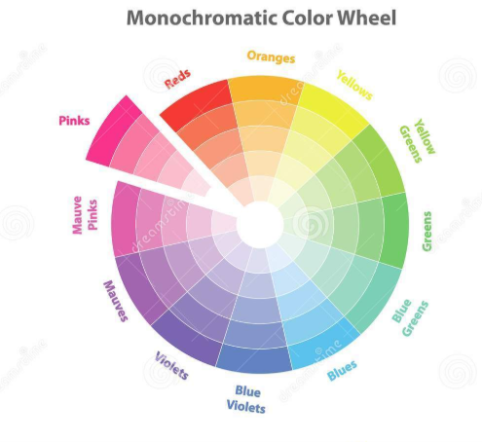
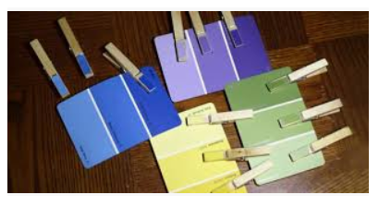
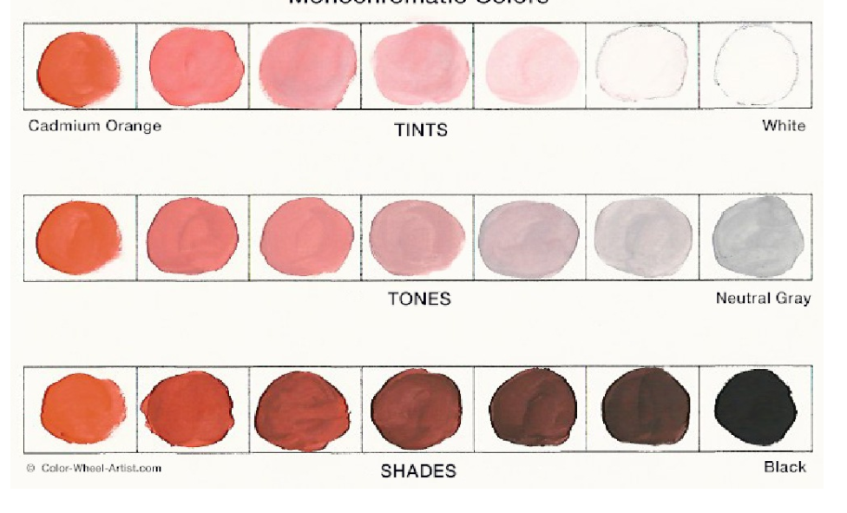
Spring Partnership Trust – Knowledge Organiser
Art Focus | Colour mixing | Year 5 | Autumn 2
Who? Famous Artists
Still life | A still life is a work of art depicting mostly inanimate subject matter. Typically commonplace objects which are either natural (food, flowers, dead animals, plants, rocks, shells, etc.) or man-made (drinking glasses, books, vases, jewellery, coins, pipes, etc.) With origins in the Middle Ages and Ancient Greco-Roman art, still-life painting emerged as a genre in Western painting by the late 16th century and has remained significant since then. One advantage of the still-life art form is that it allows an artist a lot of freedom to experiment with the arrangement of elements within a composition of a painting. Still life began with Dutch painting of the 16th and 17th centuries, and the English term still life derives from the Dutch word stilleven.
Pablo Picasso | Guernica is a world-famous painting by Pablo Picasso. It is one of the world's greatest anti-war paintings. It is a very large painting (a mural) which shows the bombing of the Spanish town of Guernica in 1937 during the Spanish Civil War. It shows how people, as well as animals, all suffer because of the tragedies of war. The painting soon became so famous that it was seen as a world symbol for peace. The fame of the painting helped to bring the Spanish Civil War to an end. | Blue Period (1900-1904) For four years he painted monochromatic paintings dominated by the colour blue and blue-green. Many of the subjects were sad and sombre looking. He painted people with elongated features and faces. They are now some of his most popular works.
What? Key Skills
To study the work of other artists and talk about the techniques they have used. To experiment with approaches used by artists. To mix paints and create a palette based upon colours observed. To combine colour, use tonal qualities and texture to enhance shape and form To develop a personal style of painting, drawing on the ideas and work of other artists.
What? Vocabulary
monochrome | A monochromatic object or image reflects colours in shades of limited colours or hues. | View point | Is the spot (point) from which the artist is looking at the scene.
hue | A shade of a colour e.g. sky blue. | Tints, tones and shades | Tints – add some amounts of white to a colour. Tones- add small amount of colour to grey. Shades- add small amounts of black to a colour.
Pictures and Diagrams

