Slide 1
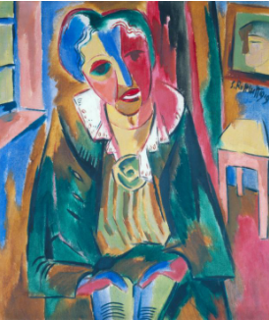
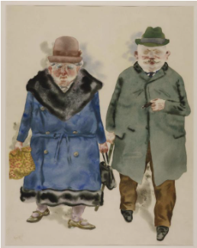
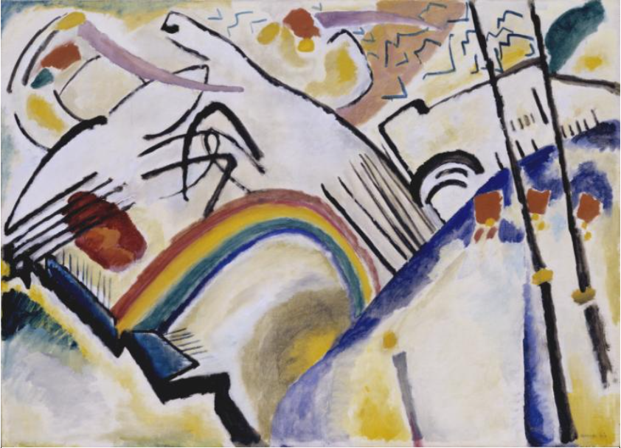
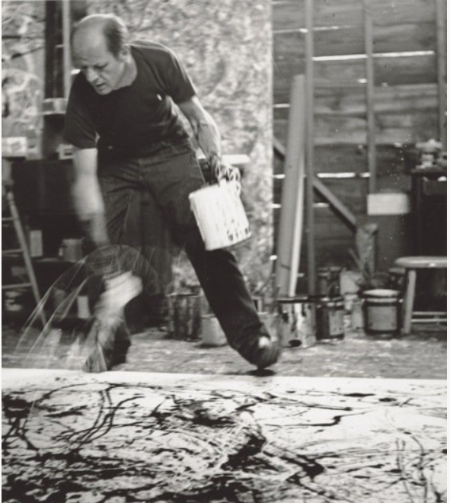
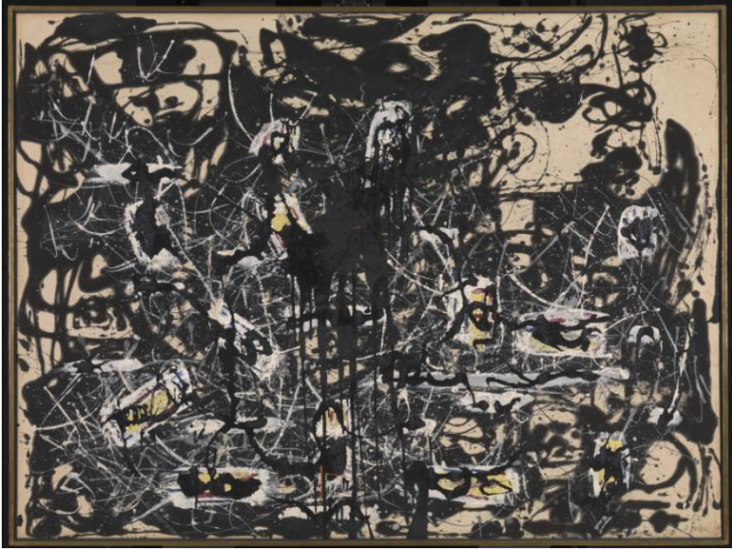
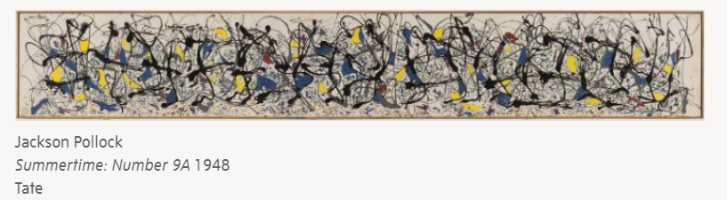
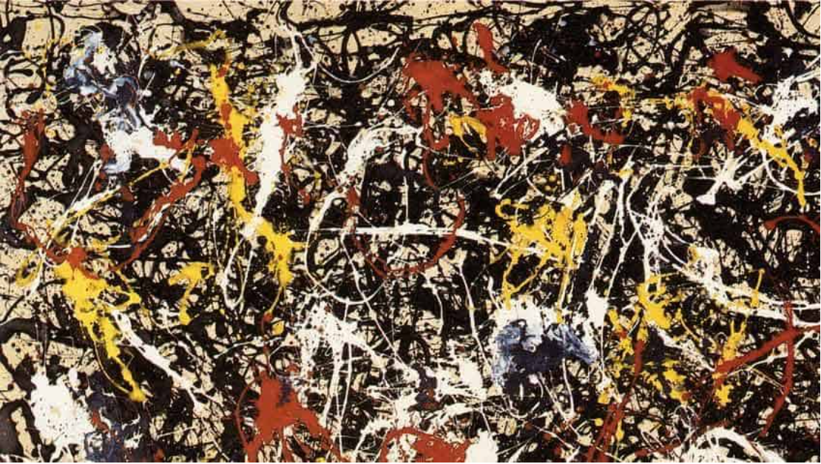
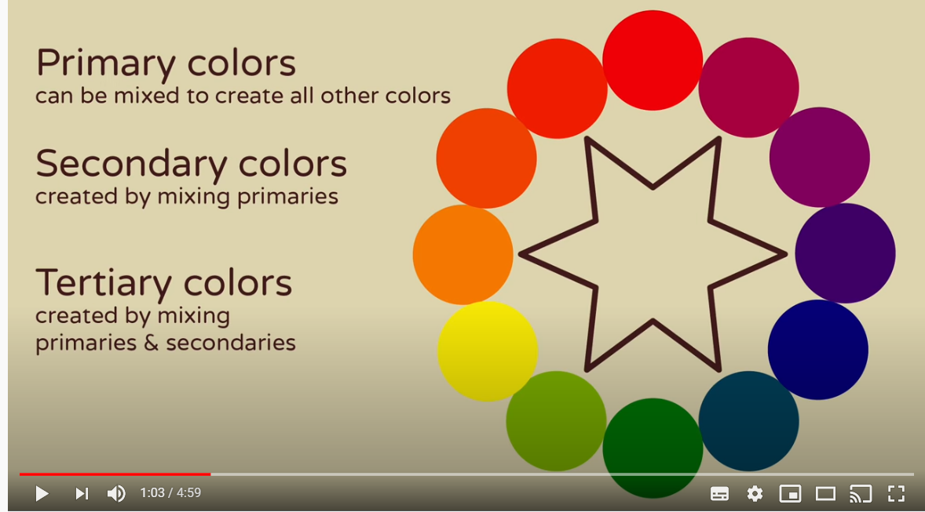
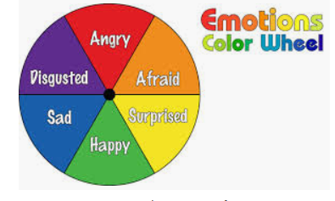
Spring Partnership Trust – Knowledge Organiser
Art Focus | Colour mixing | Year 4 | Autumn 2
Who? Famous Artists
Expressionism | Expressionism is an art and cultural movement of the 20th century. Expressionist artists try to express a feeling with what they create. Colours and shapes are not used in a way people see them, but as the artist feels them. Expressionism presents the world as subjective: how the artist feels it, not how it is scientifically. The art looks to get an emotional effect, and transmits personal moods and ideas. Expressionist artists sought to express the meaning of "being alive" and emotional experience rather than physical reality.
Jackson Pollack | Pollock was born in 1912 in Wyoming in America. When he was eighteen he moved to New York and trained as a mural painter He was an abstract expressionist this was a form of art developed by American painters including Jackson Pollack, Mark Rothko and Willem de Kooning. He was used to working on a very large scale and so the idea of painting on a big canvas didn't scare him at all. In 1943 a very rich art collector called Peggy Guggenheim asked him to make a mural for her. Pollock was so excited that he ripped down a wall in his house so that he could fit a huge 20 foot canvas inside. Peggy was very pleased with the painting and she invited him to have an exhibition at her gallery.
What? Key Skills
To study the work of other artists and talk about the techniques they have used. To demonstrate control in the application of tools and techniques. To use different shades, tools and effects to express mood and for different purposes (hot and cold, harmonious colours) To use techniques, colours, tools and effects to represent things seen, remembered or imagined.
What? Key vocab
Tertiary colours | Created when mixing a primary and secondary colour.
Automatism | A type of Surrealist art – you don’t plan what you draw or paint but use chance or accident to create the picture.
Surrealism | an artistic and literary movement of the 20th century that attempts to depict the subconscious mind with dream imagery, fantastic juxtapositions, and other unusual effects.
Harmonious colours | A harmonious colour is one that sits next to another on the colour wheel
non-representational | Creations that don't "represent" anything, at least not any object others would recognise.
Pictures and Diagrams

