Slide 1
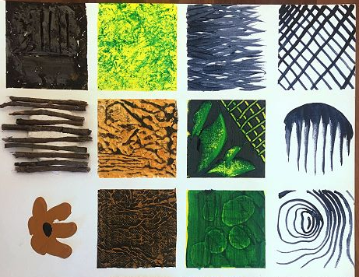
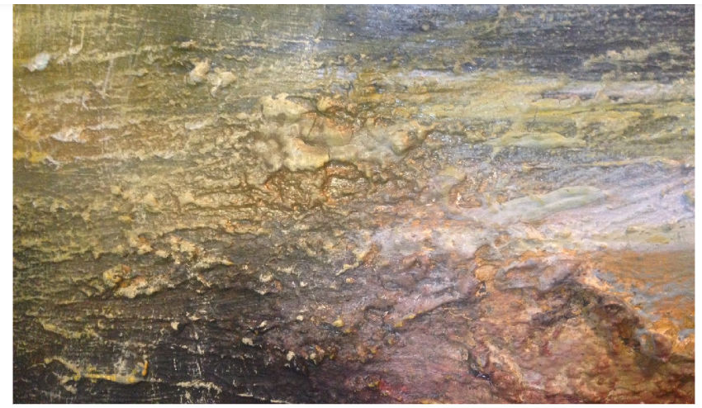
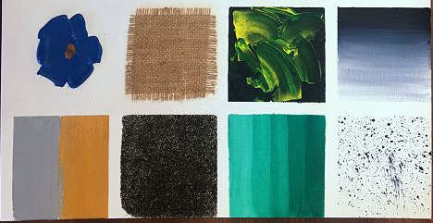
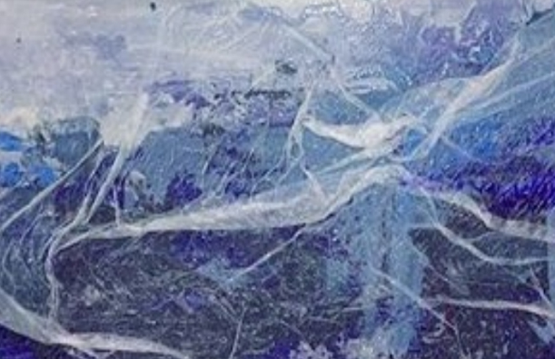
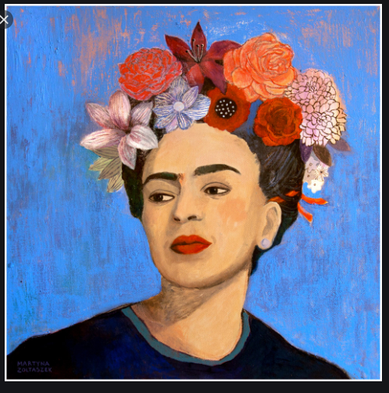
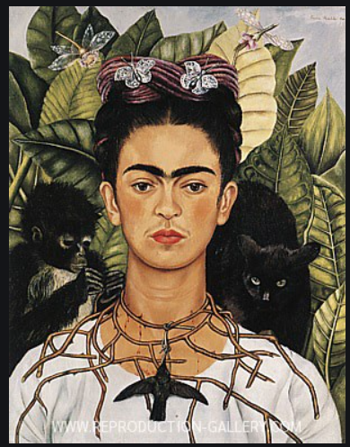
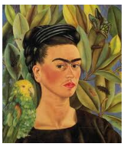
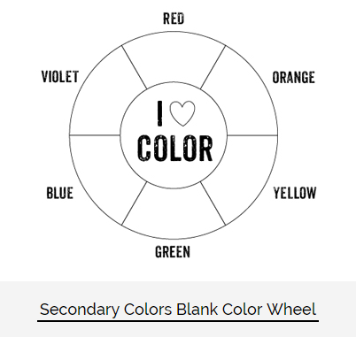
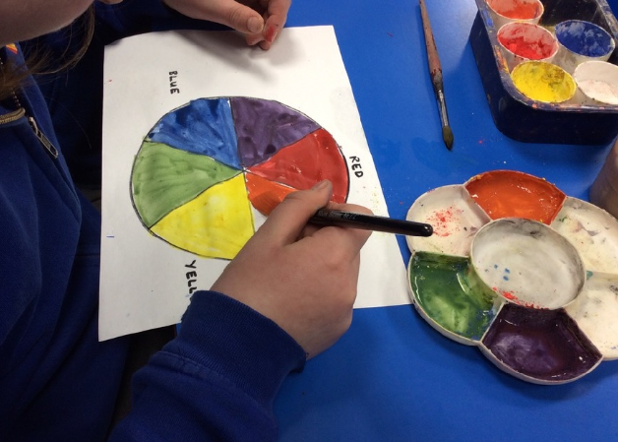
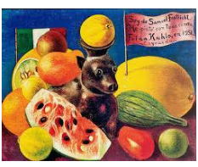
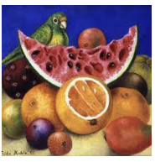
Spring Partnership Trust – Knowledge Organiser
Art Focus | Colour mixing | Year 2 | Autumn 2
Who? Famous Artists
Adding materials to paint to add texture
Frida Kahlo | Frida Kahlo was born in Mexico in 1907 She had polio that left her disabled when she was 6 years old and some people think that she may have had spina bifida (a birth defect affecting the development of part of the spine) as well. She studied medicine and was going to become a doctor. Because of a traffic accident at age 18 which badly injured her, she had periods of severe pain for the rest of her life. After this accident, Kahlo no longer continued her medical studies but took up painting. She used ideas about things that had happened to her. Her paintings are often shocking in the way they show pain and the harsh lives of women, especially her feelings about not being able to have children. Fifty-five of her 143 paintings are of herself. She was also influenced by native Mexican culture.
What? Key Skills
To study the work of other artists and talk about the techniques they have used. To know that the primary colours can be used to create the secondary colours. To explore the effect on paint of adding different materials e.g. water, sand, glue, sawdust etc. To create pattern and shape through selected use of primary and secondary colours.
What? Key vocab
Primary colours | Colours that can not be created by mixing colours: red, yellow and blue.
Secondary colours | Colours made by mixing 2 primary colours together. e.g. red and yellow = orange
Tint | Adding white to a colour to make it lighter
Shade | Adding black to a colour to make it darker
tone | Shade of a colour
blend | To mix enough so there are no longer separate colours.
texture | The feel or look of a surface
Self portrait | A painting of oneself
Still life | small objects, such as fruit, flowers, and bottles, that are used as subjects for a painting or photograph.
Pictures and Diagrams

